Slide 1
The Professional Development Process

Slide 2

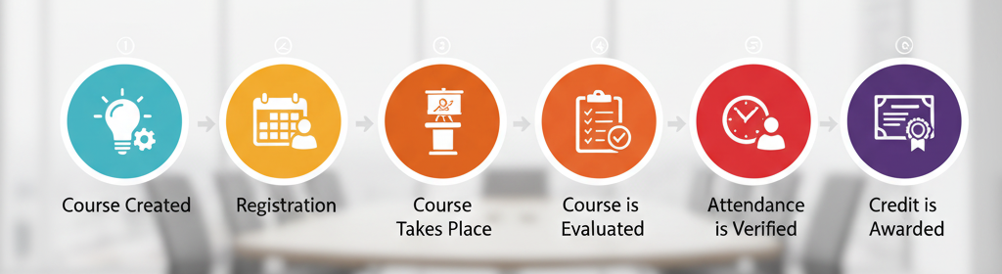
Professional Development Process

Slide 3


Course Creation
A course is first created and submitted for manager review (approval/denial). If approved, the status updates to Open.
Course Creation: Status is set to Pending.
Submission: Status updates to Review.
Manager Review: Requester is notified via email.
  Approved: Status updates to Open.
  Denied: Status updates to Denied.

Slide 4


Registration
Once a course status is open, registration may begin.
Learner: Under Enroll in Courses click on the course title and select the desired session.
Instructor: Locate the course and select the learners.

Slide 5


Course Takes Place
Instructors and Facilitators track learner attendance via:
Attendance Rosters: Print via the Reports mene.
Digital Check-in: Learners may check-in via their “My Courses” menu up to 15 minutes prior to the start of the course .
Scanner: Learners may “scan in” upon arrival to the PD session.
By Session: Record learners attendance and seat time.

Slide 6


Course Evaluation
Upon course completion, learners submit an evaluation for the course content.
Select My Courses, locate the course, click the Row Action gear to the far right and select Evaluate.
An evaluation reminder with a link to the evaluation may also be sent.

Slide 7
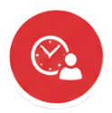

Attendance Verification
An Instructor, Facilitator or Manager verifies the attendance marking learners as Verified and adjusting credits earned.
Click the Set Attendance Verified button. An email will be sent to the learners an the course status will be updated to Attendance Verified.
Note: If a multi-session course, attendance can be verified for each session to create a running total of hours that will populate on the course attendance screen.

Slide 8


Awarding Credits
The manager updates the status of the course to Complete.
From the Post Credits menu:
Processes Holds (checks data against criteria).
Posts the Earned Credits to the learner’s transcript.

Slide 9

Exporting Credits (Optional)
Exporting earned credits to an external fiscal system.
Download File: Data Extracts > Data Tables > Pro Dev Clock Hour Earned Credits.
Import Credits: Follow the directions for your fiscal system to import the credits.
Update Status: When complete, update the course status to Exported. Courses are removed from credit file.

Slide 10
Course Statuses
 | Course Status | Definition
1 | Pending | A course has been created but not yet submitted.
2 | Review | A course has been submitted for review.
3 | Denied | A course has been denied.
4 | Open | A course has been approved is open for registration (If the registration open date has past). The course can be viewed in Enroll in Courses up to the registration closing date.
5 | Attendance Verified | The attendance and earned credits have been verified.
6 | Complete | The course is complete and credits can be posted.
7 | Exported | The credits for the course have been posted to the transcript and exported to a fiscal system (optional).
8 | Cancelled | The course has been canceled.
9 | Hold | The course is on hold.

