Slide 1
STAND Connect Training

Slide 2






Welcome!
Your name, district, role and at least one thing you are hoping to walk away with from today’s training.
Notes:
Who’s with us today?

Slide 3
Www.(yourdistrict).schooldata.net/connect/#/

Slide 5
Getting There and More
Charts and Data Tables
  Behavior Charts
  Attendance Charts
  Class Grades
  Gradebook Grades
  Risk Index
  On Track Success Data Table
Help

Slide 6
Getting There and More

Slide 7
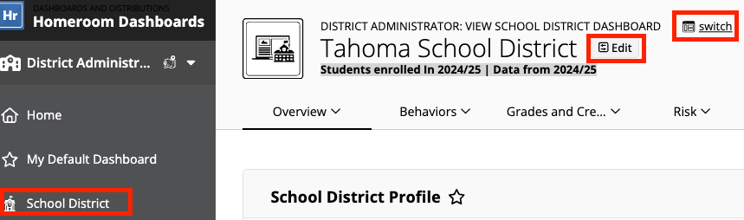
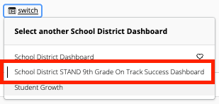
Select the School Dashboard in the left navigation.
Click Switch and choose the STAND dashboard.
Use the Edit Page Data Settings to adjust the enrollment status and or data year.

Slide 8
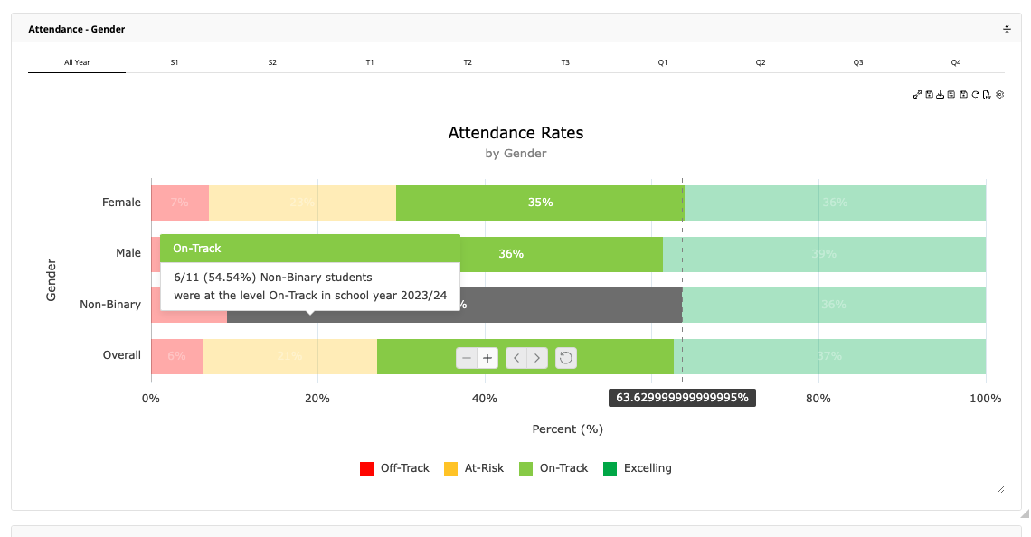
STAND Dashboard
Select a term view from the tabs across the top of the page.
Hover over any bar for more detailed information.
Click the bar to see a detailed data table of the included students.
Click indicator to hide/show the bar
Notes:
Due to us being in Demonstration mode, we won’t see data on our screen.

Slide 9
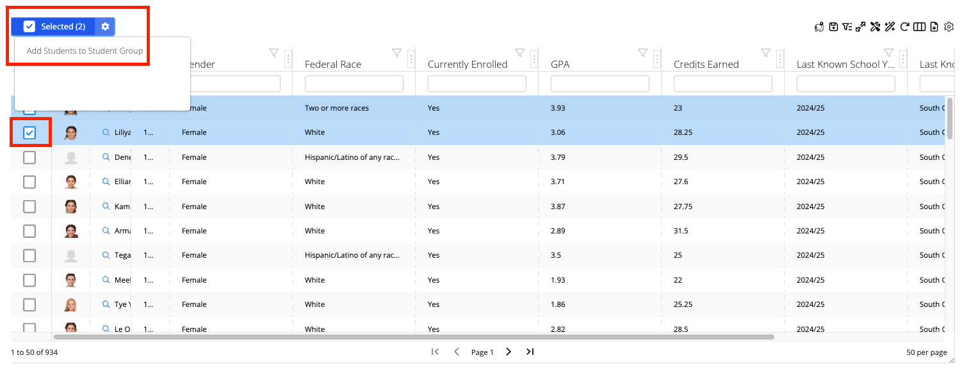
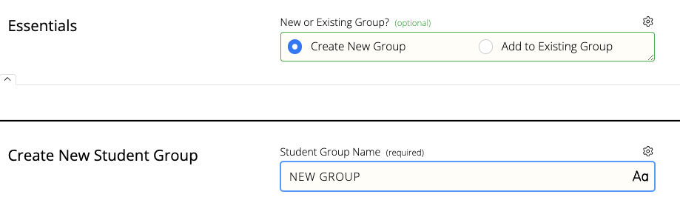
Create Student Group
Download Data Table
Select the checkbox to the left of one or more students.
Click the Selected Gear checkbox and choose Add Students to Student Group.

Slide 10
Charts and Data Tables

Slide 11
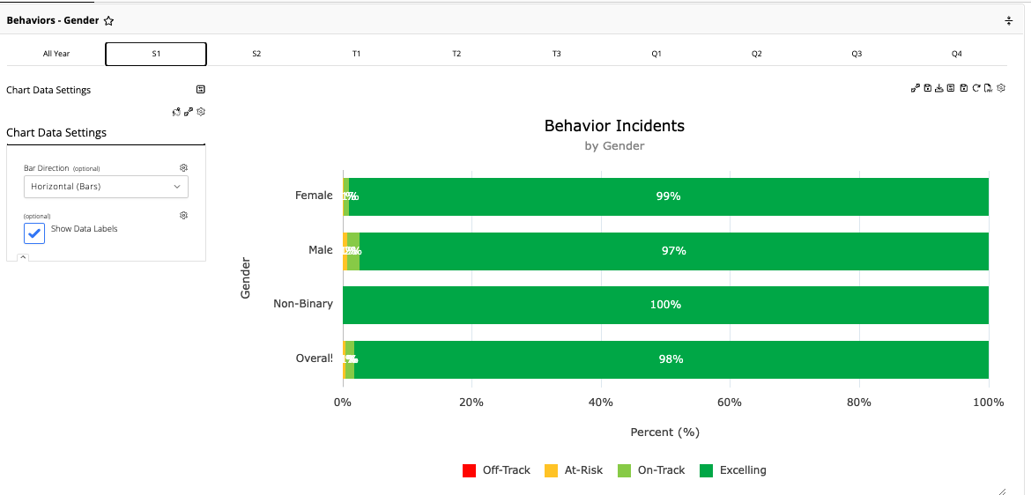
Behavior Charts
Available by Race, Gender and Program/Service Type
Tiers
Excelling: 0.00-0.99
On-Track: 1.00-2.99
At Risk: 3.00-5.99
Off Track: 6.00-100.00

Slide 12
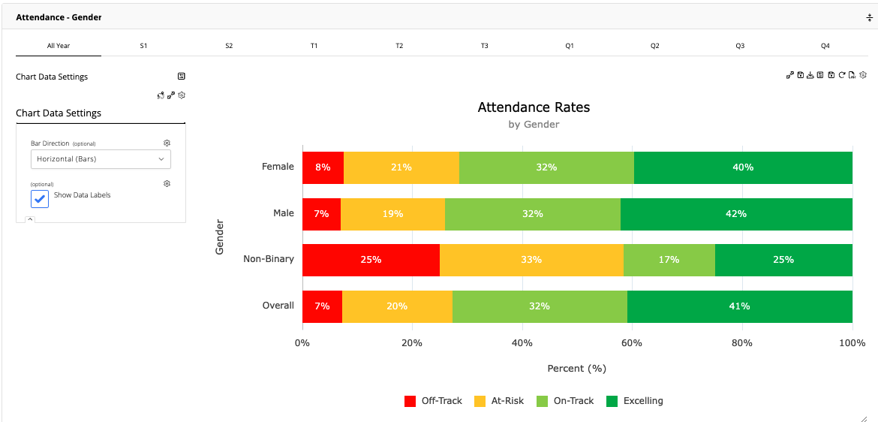
Attendance Charts
Available by Race, Gender and Program/Service Type
Tiers
Excelling: 95.00-100.00
On-Track: 90.00-94.99
At Risk: 80-89.99
Off Track: 0.00-79.99

Slide 13
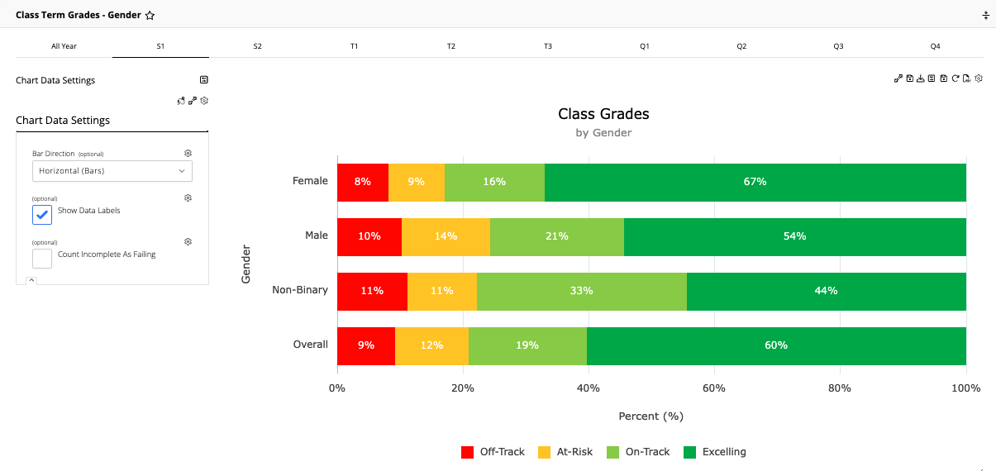
Class Grades
Available by Race, Gender and Program/Service Type
Tiers
Excelling: All grades are B or better
On-Track: No Grade below a C
but not all grades are B or better
At Risk: Has at least one D grade
Off Track: Has at least one F grade

Slide 14
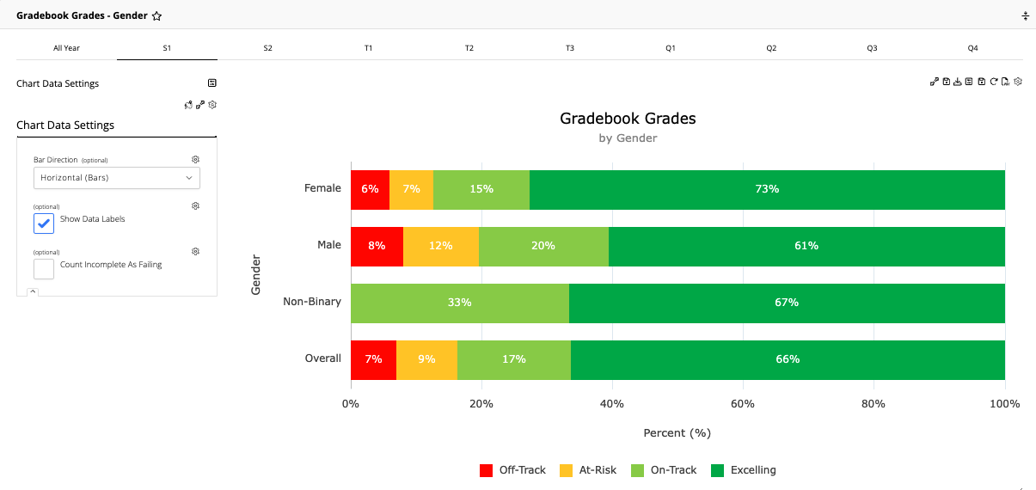
Gradebook Grades
Available by Race, Gender and Program/Service Type, Data Table By Period
Tiers
Excelling: All grades are B or better
On-Track: No Grade below a C
but not all grades are B or better
At Risk: Has at least one D grade
Off Track: Has at least one F grade

Slide 15
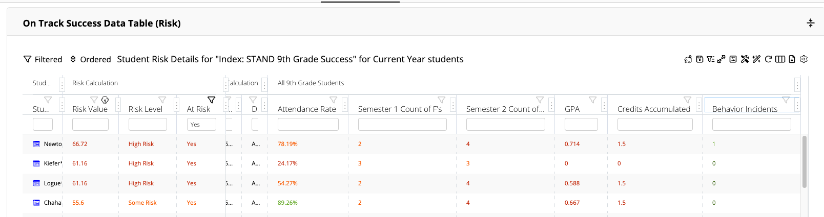
Risk Index
Review Risk Value, Level and the included risk factors (Attendance, Grades, Discipline).
Click the student name to navigate to the student dashboard for more information.

Slide 16
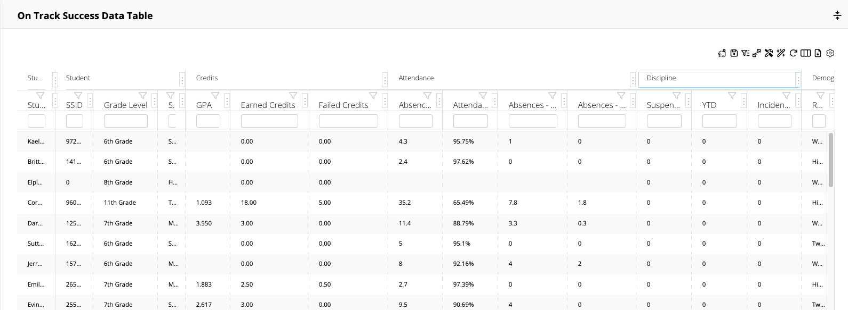
On Track Success Data Table
Includes Credits, Attendance, Discipline, Demographics, Service Statuses, Gradebook Grades by Term
Filter any column to search data

Slide 17
Help

Slide 20
Questions?

