Slide 1
Connect Student Data Grids
Create a New Grid
Part II (Complex)

Slide 2
Adding an Assessment Dataset
Filtering a Dataset
Multiple Record Selection
  Repeated Rows
  Repeated Column Sets
Aggregates

Slide 3
Adding an Assessment Data Set

Slide 4
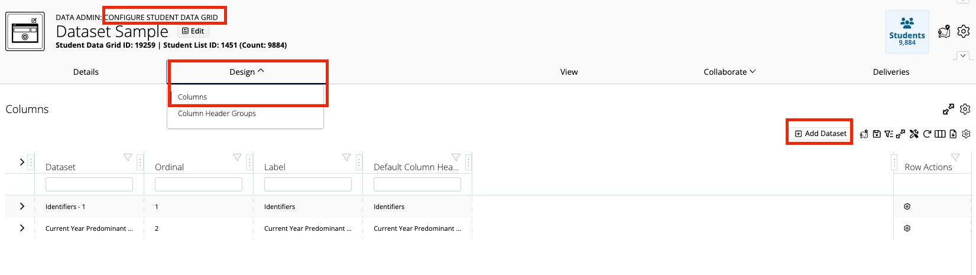
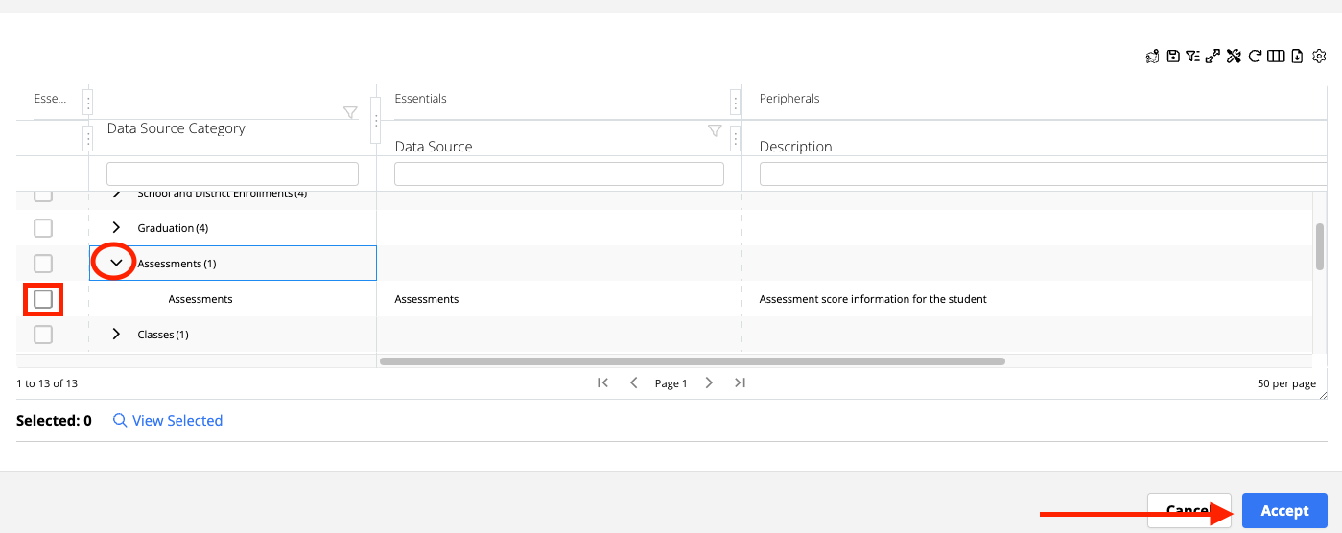
Adding an Assessment Dataset
Click the Design tab : Columns in the Configure Student Data Grid Page
Click Add Dataset
Click arrow to expand Assessments
Click Assessments checkbox

Slide 5
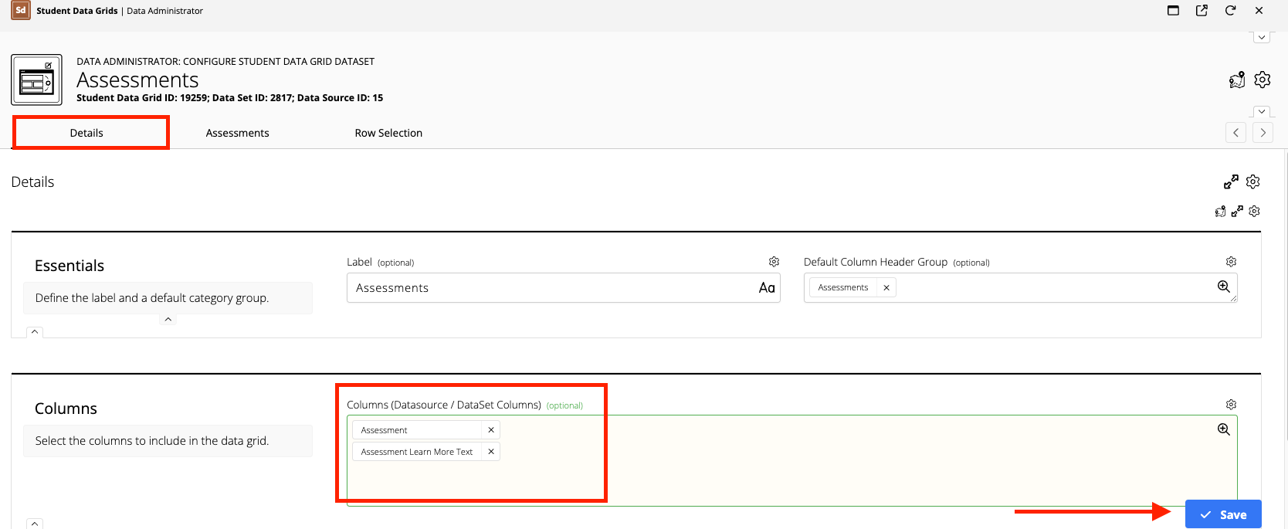
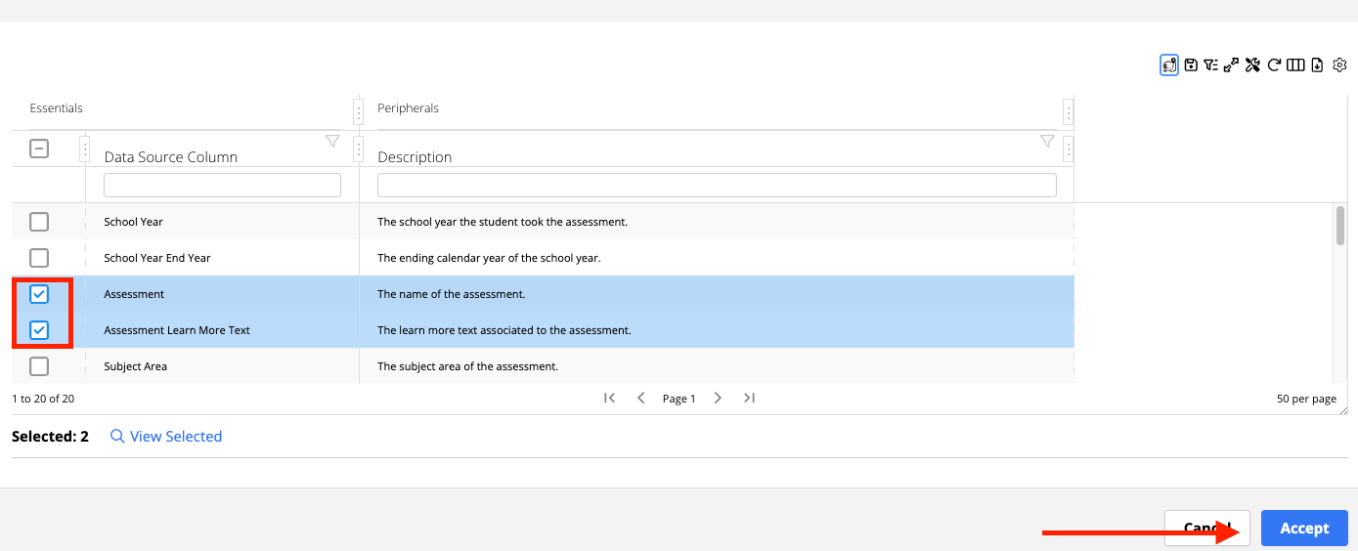
Click Columns field and choose one or more selections, then click Accept
Click Save (You will be returned to the Configure Student Data Grid Dataset page)

Slide 6
Filtering a Dataset

Slide 7
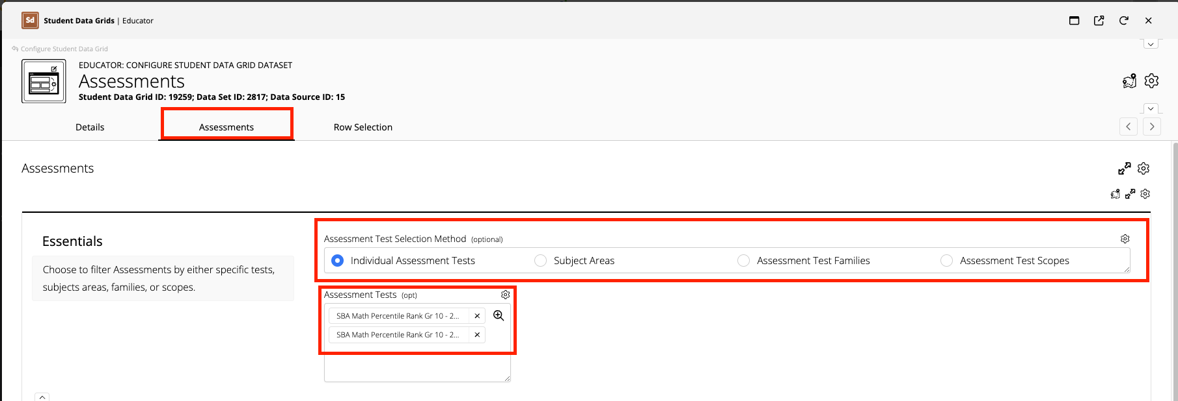
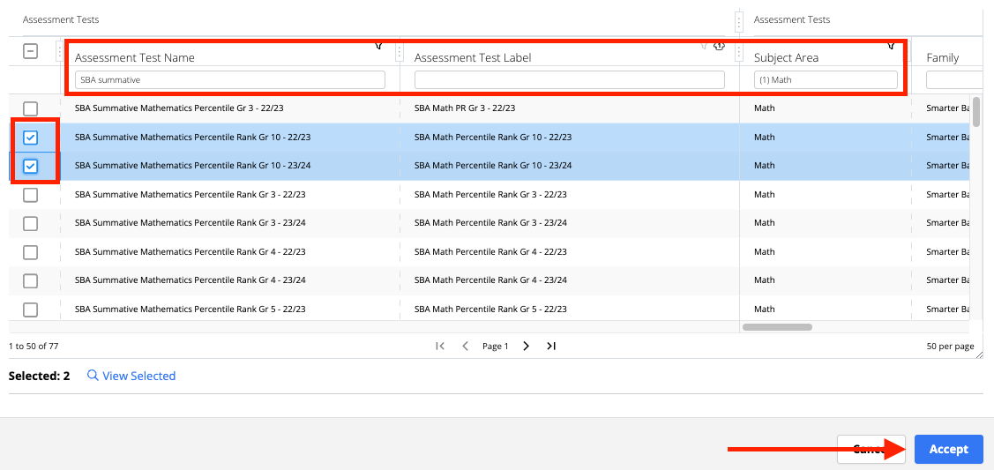
Filtering a Dataset
Use column filters to search and sort
Click the next tab. It will be named after the dataset. (e.g. Assessments)
Choose the Assessment Test Selection Method (Typically Individual Assessment Tests)
Click Assessment Tests field, select assessments, click Accept

Slide 8
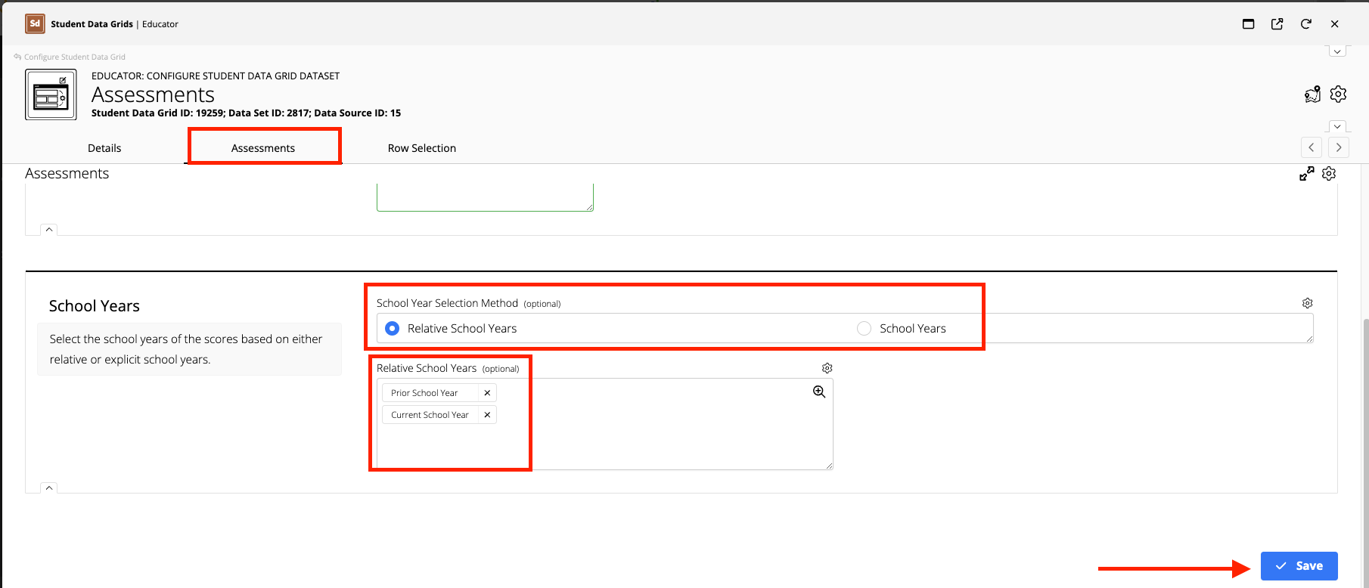
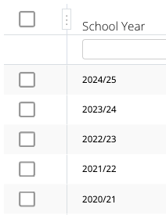
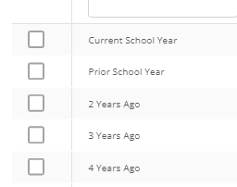
Select the School Year Selection Method
Click the field below to select the School Year options
Click Save (You will be returned to the Configure Student Data Grid Dataset page)

Slide 9
Row Selection Tab:
Multiple Record Selection

Slide 10
Row Selection tab
Datasets with Multiple Records
Assessments and other complex points have the potential of returning multiple records of data.
The Row Selection tab will only show when this is the case.
Row Selection

Slide 11
Multiple Record Considerations
Ordering Properties for a single student
  Ordering Direction (Ascending/Descending)
Anticipated Records
  Number of records to include per student
  Multiple row per student
  Or Repeated column sets

Slide 12
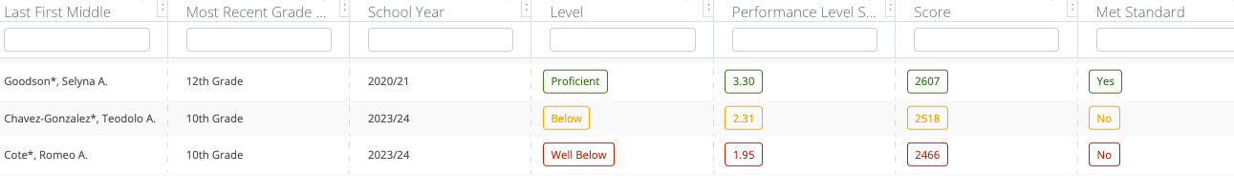
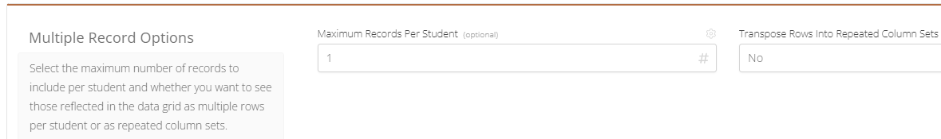
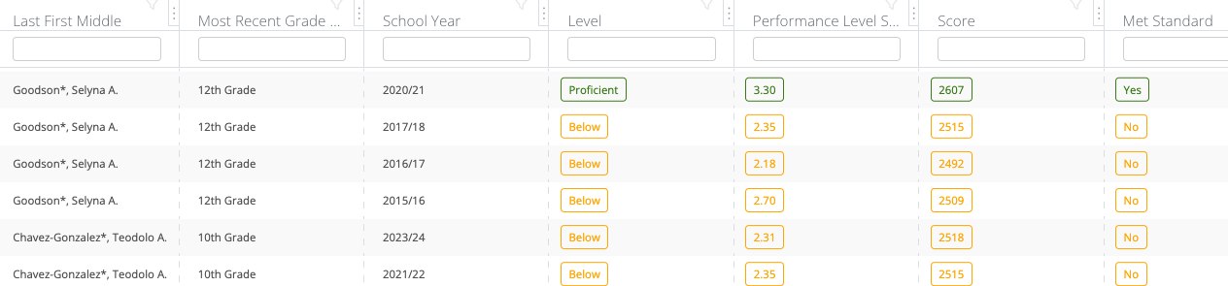
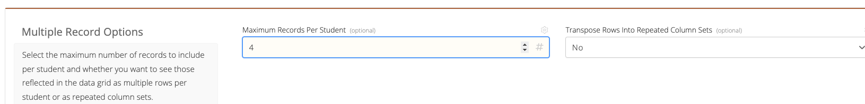
Repeated Rows
One (1) Record (E.g. Assessment score for the student in column
Four (4) Records (E.g. Assessment scores for student in same column, with repeated student names

Slide 13
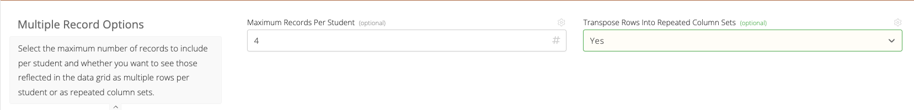
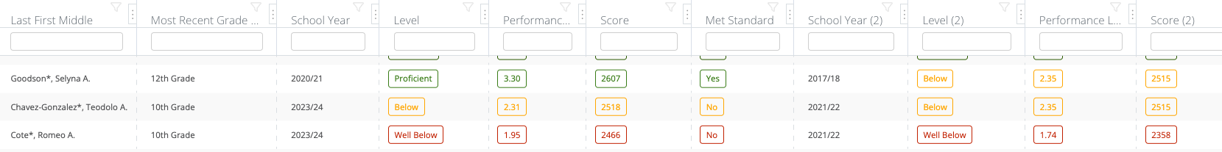
Repeated Column Sets
Four(4) records (e.g. Assessment scores for student in same column, repeated name)
Four(4) records (e.g. Assessment scores for student in four(4) repeated column sets

Slide 14
Aggregates

Slide 15
Aggregates Tab (Sum/Counts)
Grades and Credits
  Class Term Grades
  Gradebook Class Grades
  Gradebook Standard Grades
  Gradebook Assignments
Attendance
  Current School Year District Daily Attendance
  Current School Year School Daily Attendance
  Current School Year School Class Period Daily Attendance
  Current School Year Class Daily Attendance
Behavior
  Current School Year Incident Detail
  Current School Year Referral Detail

Slide 16
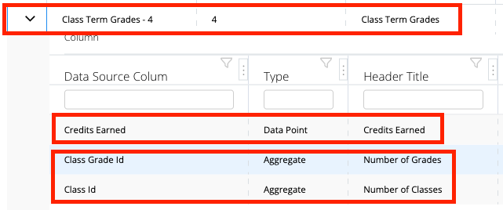
Two Options in Some Datasets
When added, new field of Type to identify
Dataset
Data Point/Column
Aggregates

Slide 17
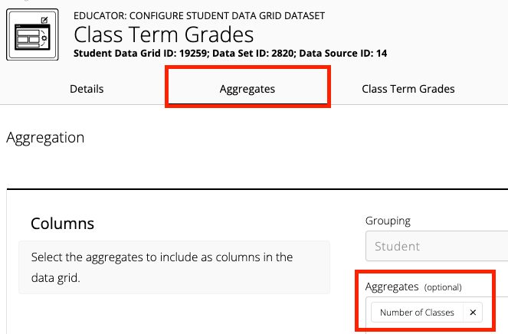
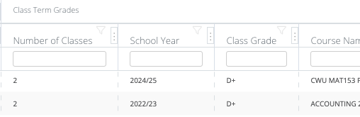
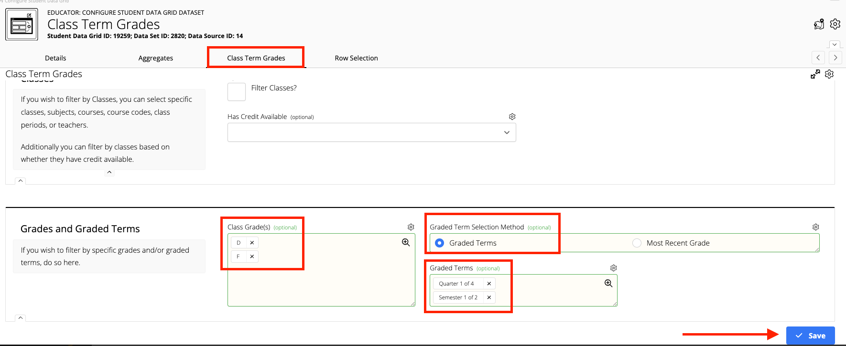
Class Term Grades
Select Grades and Grade Terms
Click Class Term Grades tab
Select Class Grade(s): D’s & F’s
Select Graded Term Selection Method: Graded Terms
Select Graded Terms: Quarter or Semester
Click Save
2
Results
1
Select Aggregate
Click Aggregates tab
Select Columns Aggregates: Number of Classes

Slide 18
QUESTIONS
WHAT ARE YOU HOPING TO WE HAVEN’T YET COVERED?

