Slide 1
Connect Student Data Grids
Creating New Grid
Part I (Simple)

Slide 2
Welcome & Getting Started
Creating a New Grid
Creating a Simple Dataset
  (Design - Columns)
  (Design - Column Header Groups)
View Data Grid Created

Slide 3
go to URL: districtname.schooldata.net/connect/#/student-data-grids

Slide 4


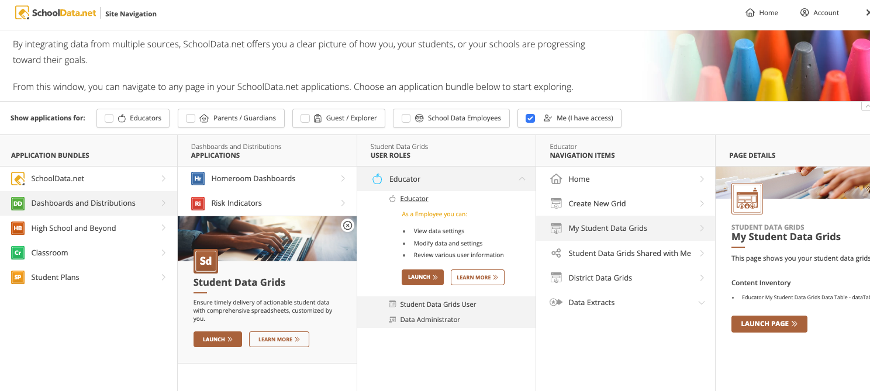
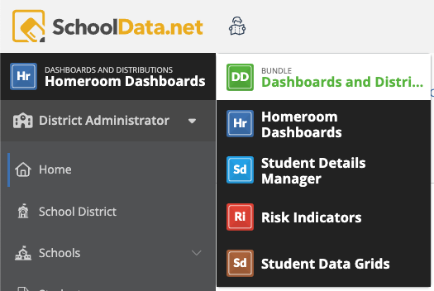
Site Navigation
Click the Site Navigation to start. Click Dashboards and Distributions, then Student Data Grids, then Launch.
If you are already in the DD bundle, click the app name to open a bundle list.

Slide 5
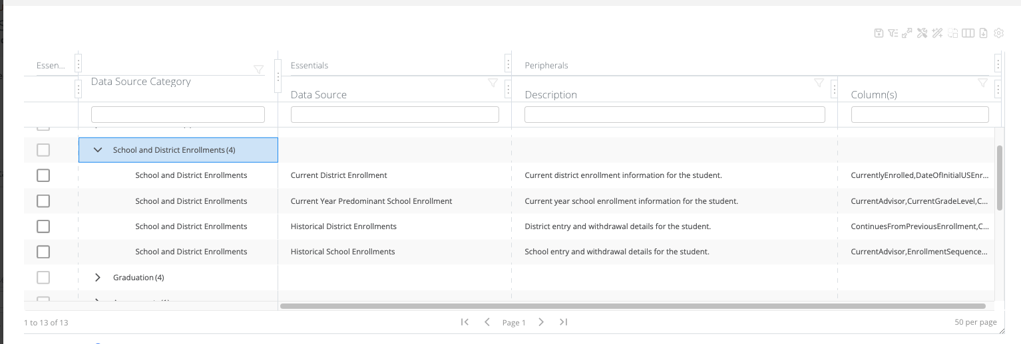
Student Data Grid Column Options
13 Categories
57 Data Sources/Sets
1,300 Data Columns
Link to spreadsheet with columns

Slide 6
Creating a Data Grid

Slide 7
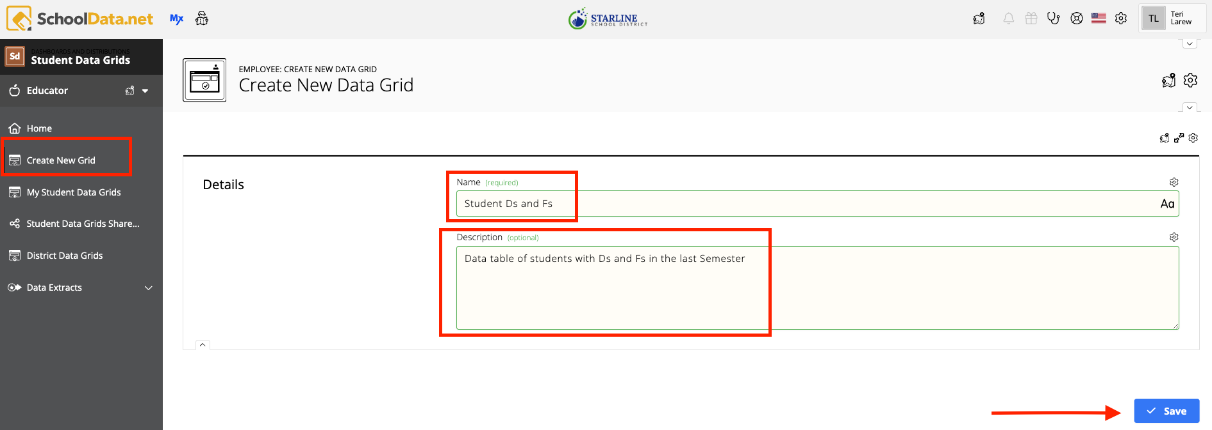
Creating a Data Grid
Click Create New Grid in the left navigation
Enter a Name and Description
then click Save
Notes:
Details page is an important start to naming and give a description so you know what it is being used for. This can always be changed at a later time.

Slide 8
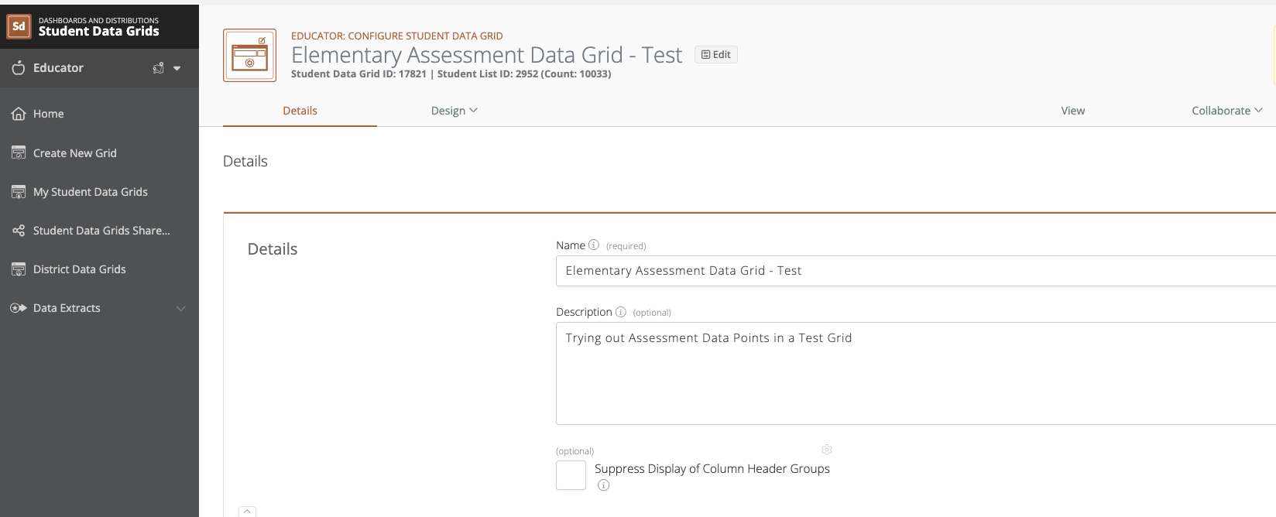
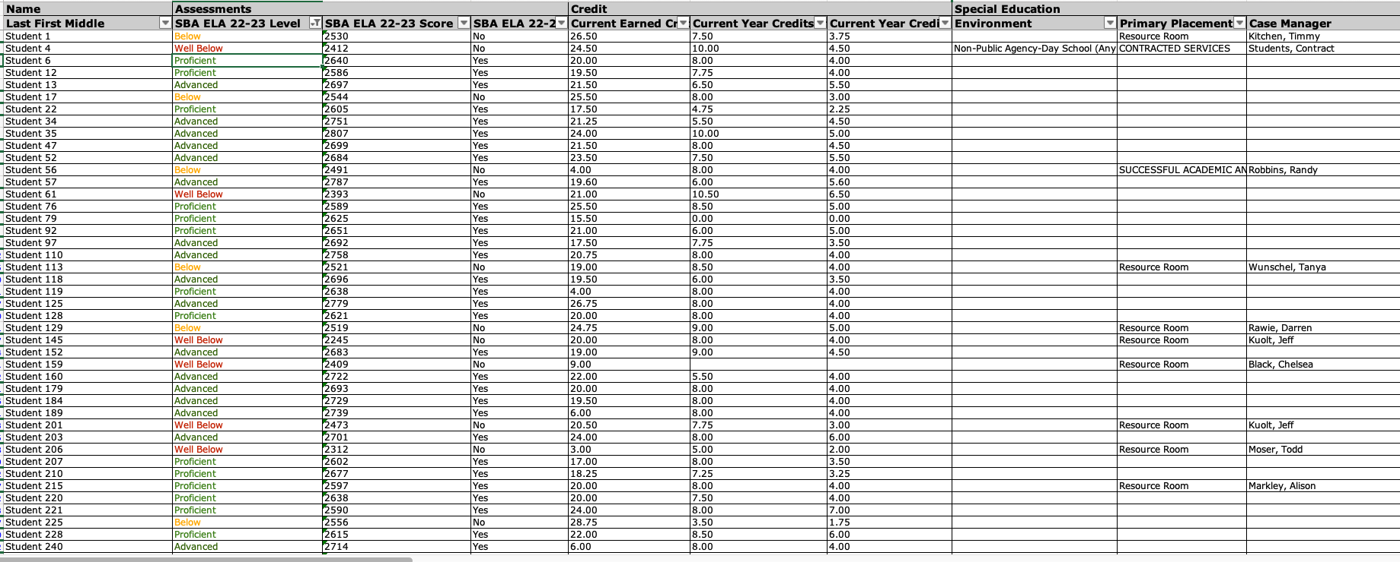
Option for a Data Grid - Column Header Groups
After clicking Save, an optional checkbox appears: Suppress Display of Column Header Groups which makes up the top row on the spreadsheet.
NOTE:
If the Column Header Group doesn’t display, it is still used for ordering and grouping
May be returned to later.
Option unchecked
Option checked

Slide 9
Creating a Dataset
Design Columns

Slide 10
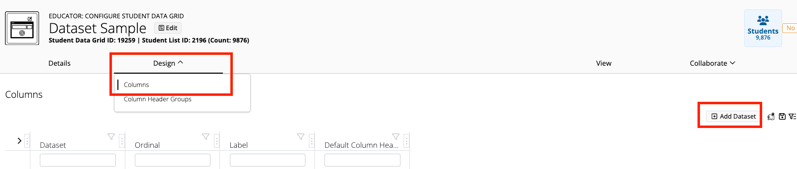
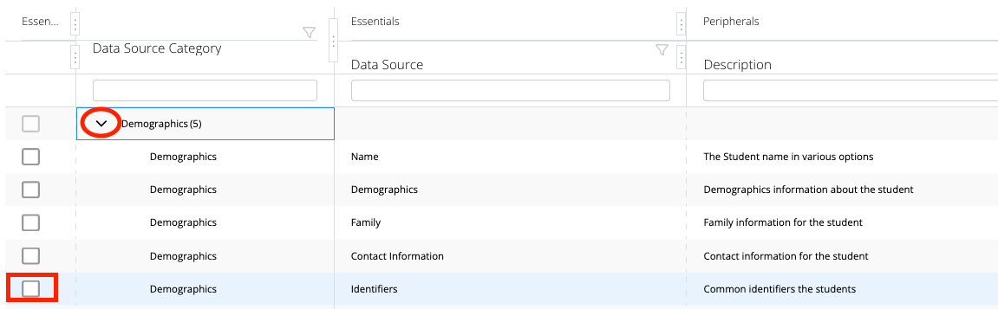
Adding a Dataset - First example: Identifiers (IDs)
Click on the Design tab and choose Columns.
Click Add Dataset.
Expand the category choice by clicking the arrow to the left.
Click an Identifier checkbox.

Slide 11
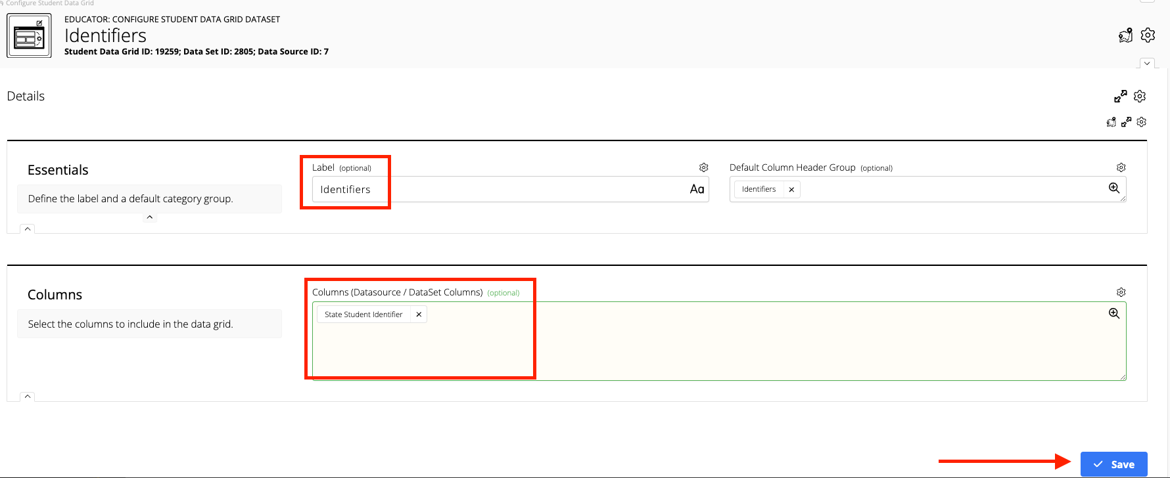
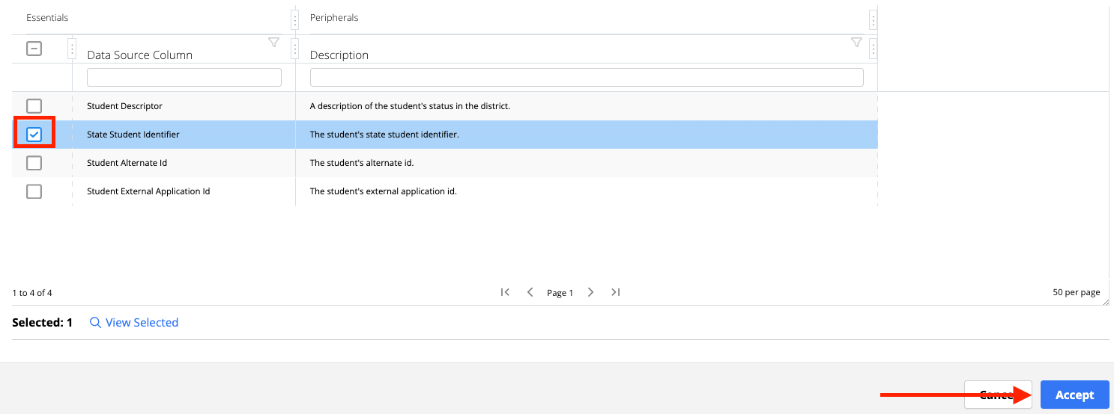
Configure Student Data Grid Dataset - Detail Tab
Click the Column field and choose one or more checkboxes then click Accept.
Click Save and close the window to return to the Design page.

Slide 12
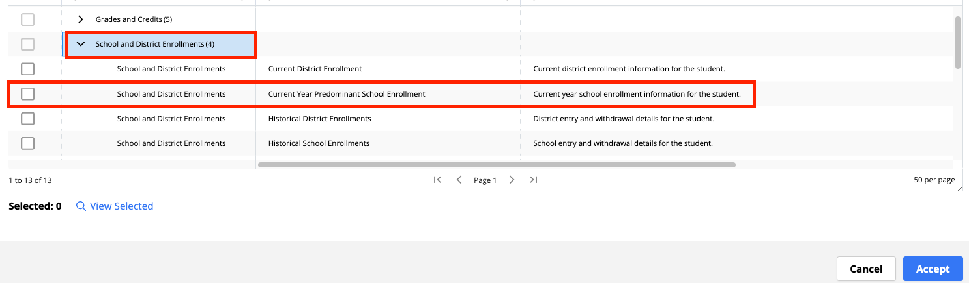
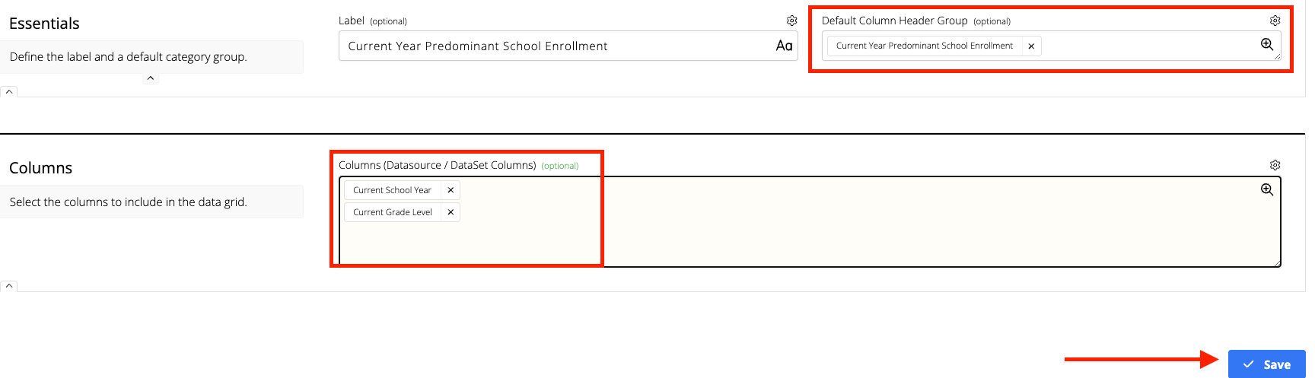
More Examples: Grade Level, School etc.
From the Design page, click Add Dataset (not shown)
Expand the category of School and District Enrollments.
Checkmark Current Year Predominant School Enrollment
On the next screen (not shown), checkbox selections in the Columns field and click Accept.
Click Save and close the window to return to the Design page.

Slide 13
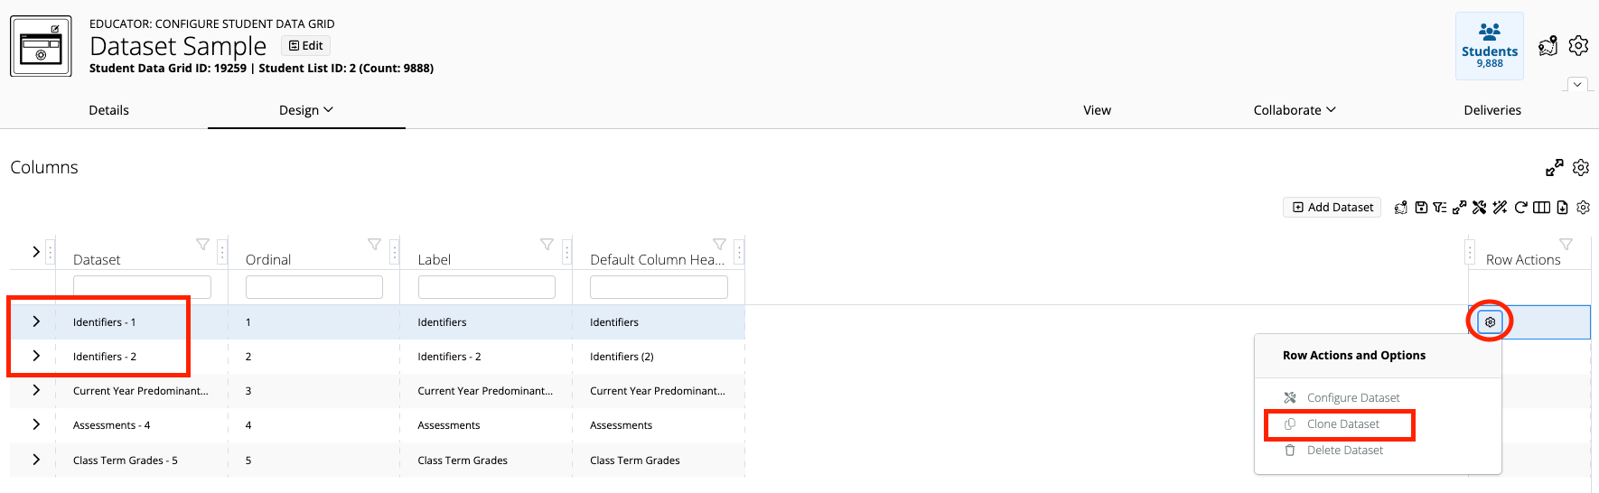
Clone a Data Set
Click Row Action Gear and choose Clone Dataset
NOTE: Column Header Groups can not be duplicated. Will be amended with a number

Slide 14
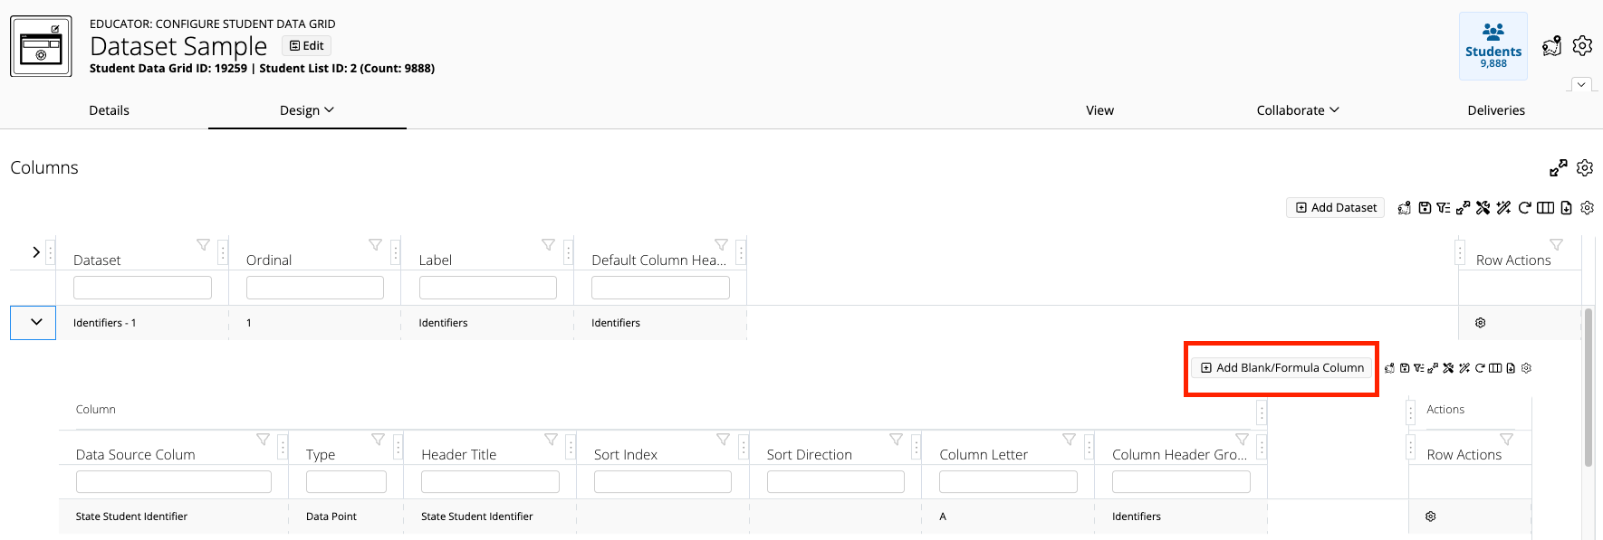
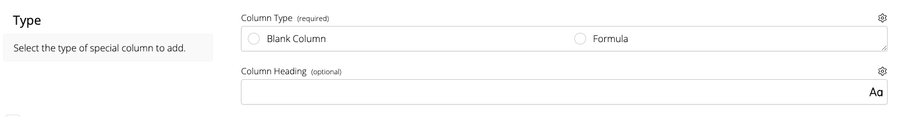
Blank or Formula Column
Click Add Blank/Formula Column
Blank Column (e.g. Placeholder for when someone downloads the file)
Formula Column (e.g. Enter in a formula to be used when the file is downloaded into an Excel spreadsheet)

Slide 15
Creating a Dataset
Design Column Header Groups

Slide 16
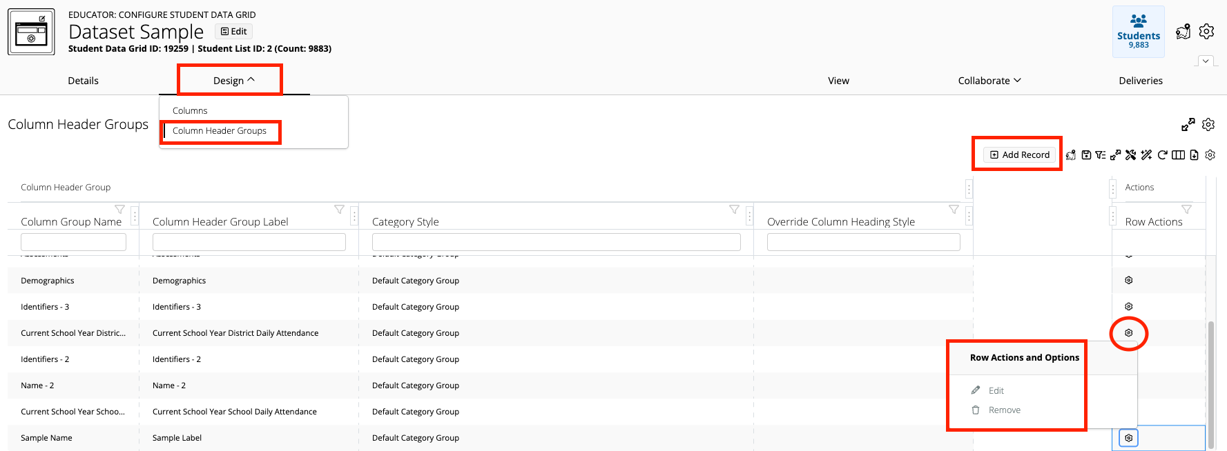
Design Tab - Column Header Groups
Click the Design tab and choose Column Header Groups
Click Add Record
Click Row Action Gear to Edit or Remove

Slide 17
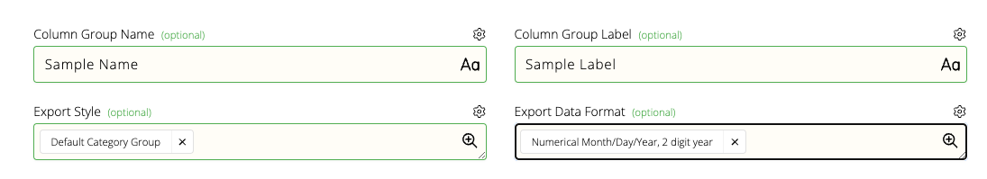
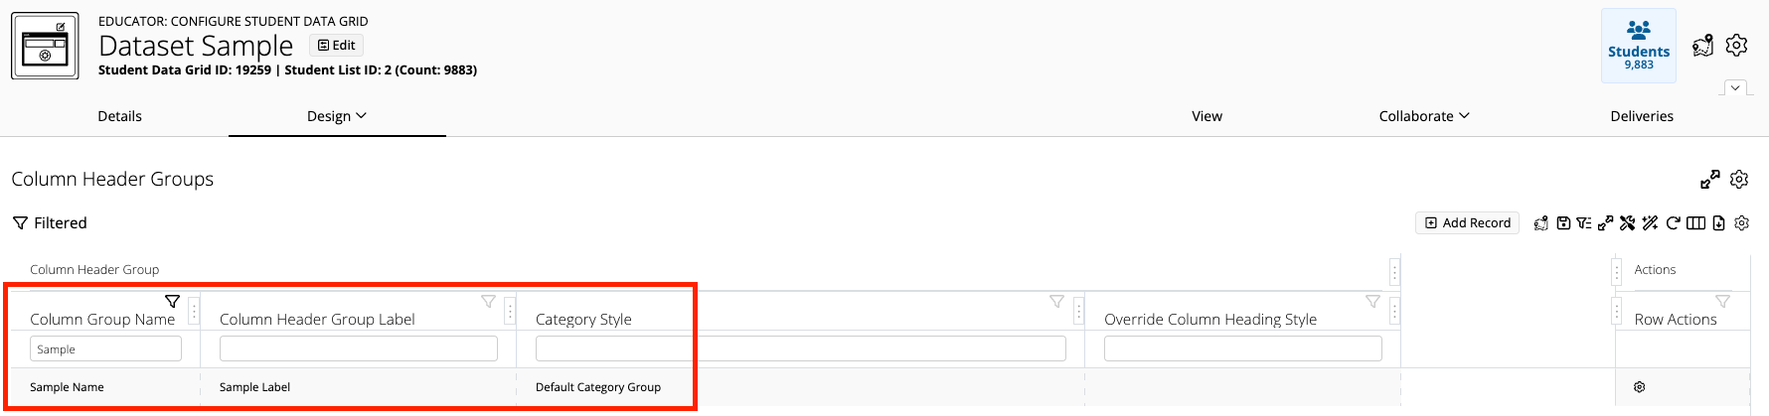
Design Tab - Column Header Groups
Fill in the Column Group Name and Label
Select the Export Style and Format
Click Save and close the window

Slide 18
View Data Grid Created

Slide 19
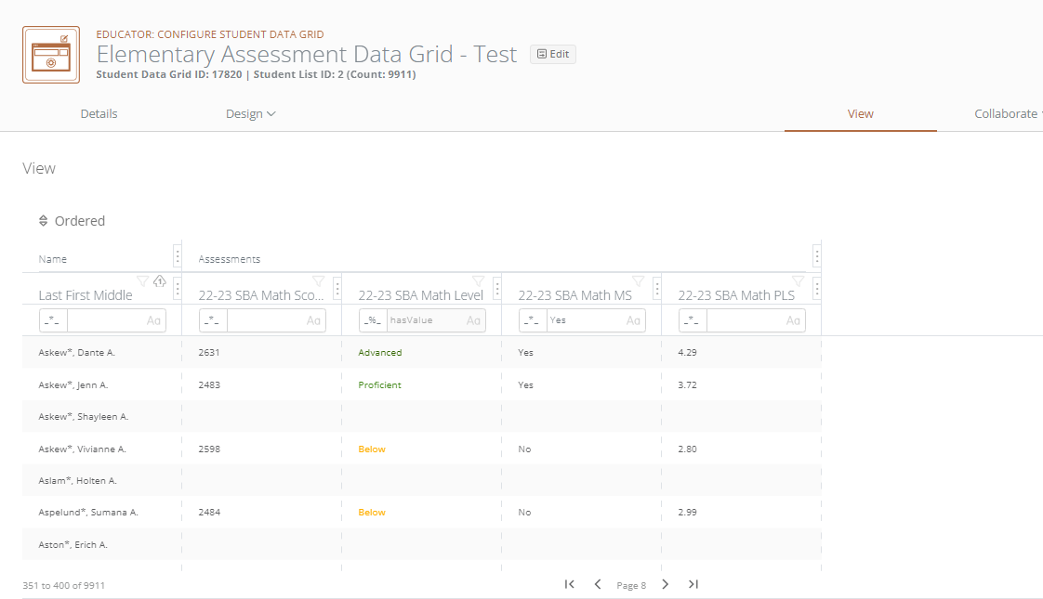
View Data Points
Click the View tab
Review set-up
Return to the Design page to edit or add additional data points

Slide 20
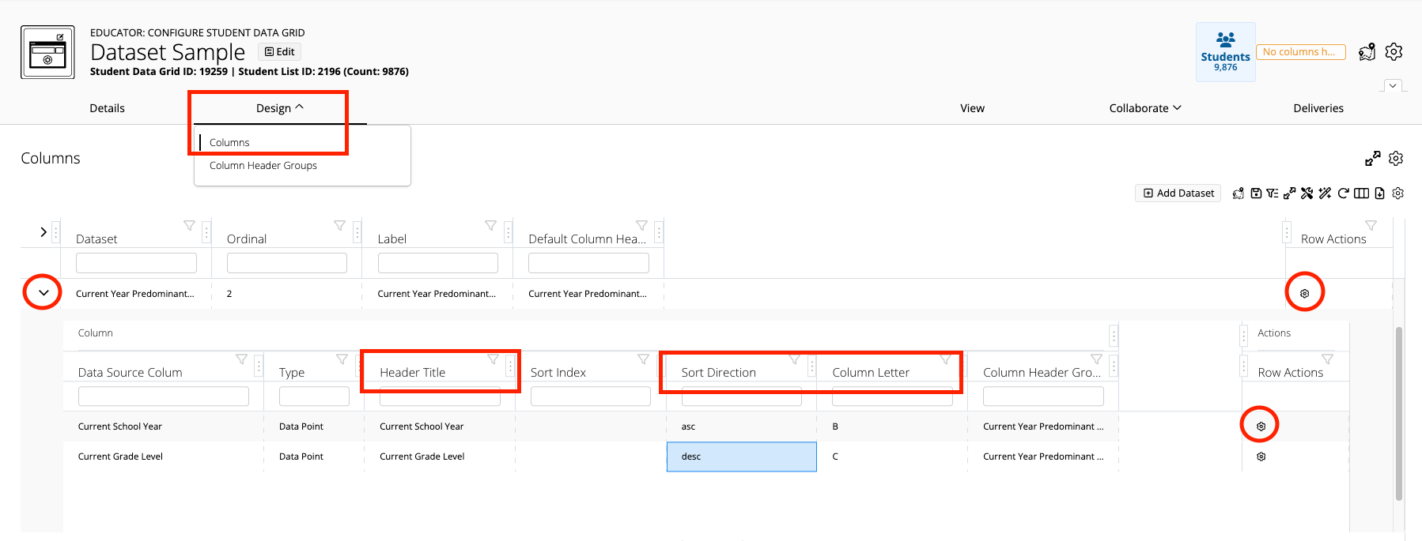
Dataset Tables
Columns:
In cell editing
Column Header Titles can be relabeled
Order/Direction the columns
Click the Row Action Gear to Edit, Configure, Remove
Dataset:
Click the Row Action Gear to Configure, Clone, Delete

Slide 21
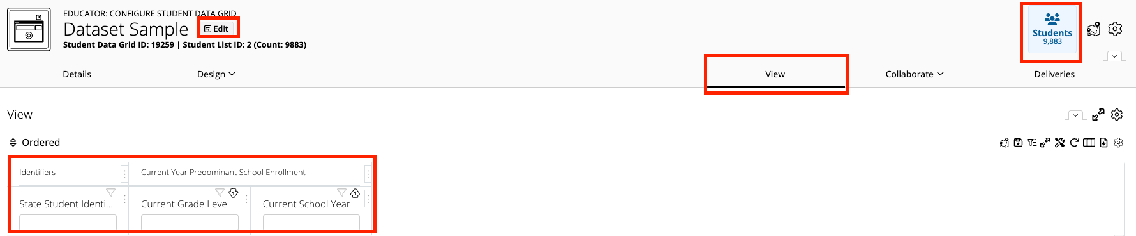
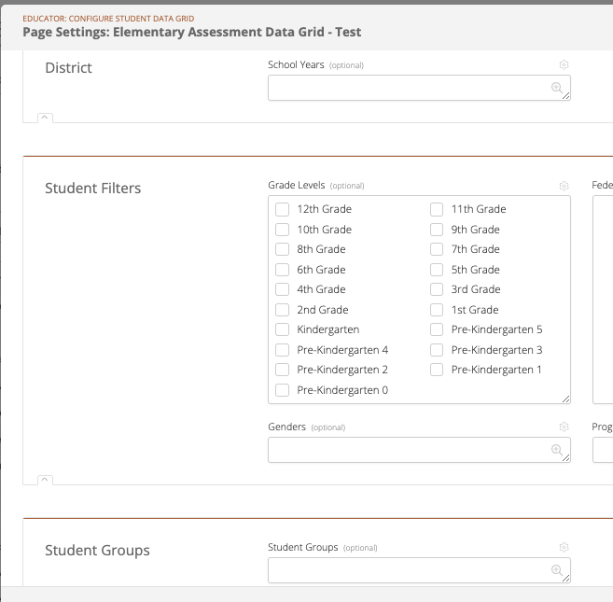
Changing the Students in View
In the View tab:
Click the Edit Page Data Settings button
Or click the Students button
Filter and Sort
  NOTE: Changes DO NOT affect the column setup.

Slide 22
QUESTIONS
WHAT ARE YOU HOPING TO DO WE HAVEN’T YET COVERED?

