Slide 1
Connect Student Data Grids Basics

Slide 2
Welcome & Getting Started
What is a Data Grid?
Understanding the Parts of a Data Grid

Slide 3
go to URL: districtname.schooldata.net/connect/#/student-data-grids

Slide 4


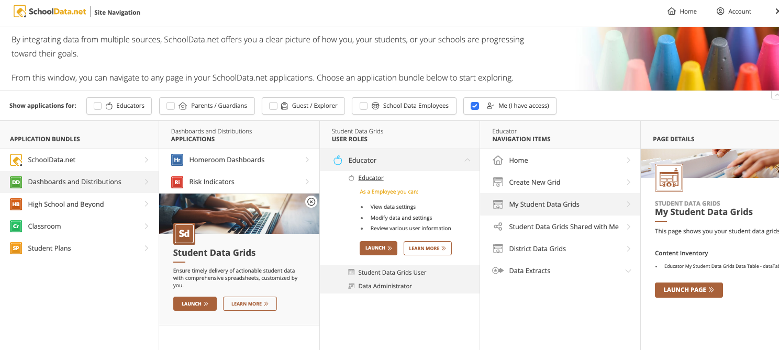
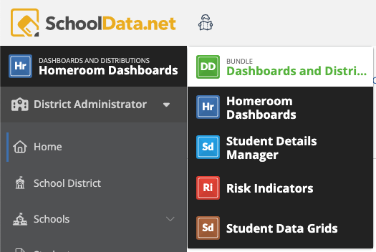
Site Navigation
Click the Site Navigation to start. Click Dashboards and Distributions, then Student Data Grids, then Launch.
If you are already in the DD bundle, click the app name to open a bundle list.

Slide 5
What is a Data Grid?

Slide 6
Student Data Grid
Collection of data points about students defined by the user
Table/Spreadsheet:
  Surface on a Homeroom Dashboard
  Accessed in the Student Data Grid Application by other users
  Distributed to user inboxes securely as needed or on a scheduled basis.
Combine disparate data points (e.g. demographics, assessment scores, attendance, grades, graduation requirements, discipline)
Notes:
V2 Student Data Grids do not port over to Connect, concept is the same but much more flexible and many more pre-configured data sets to choose from in Connect.

Slide 7
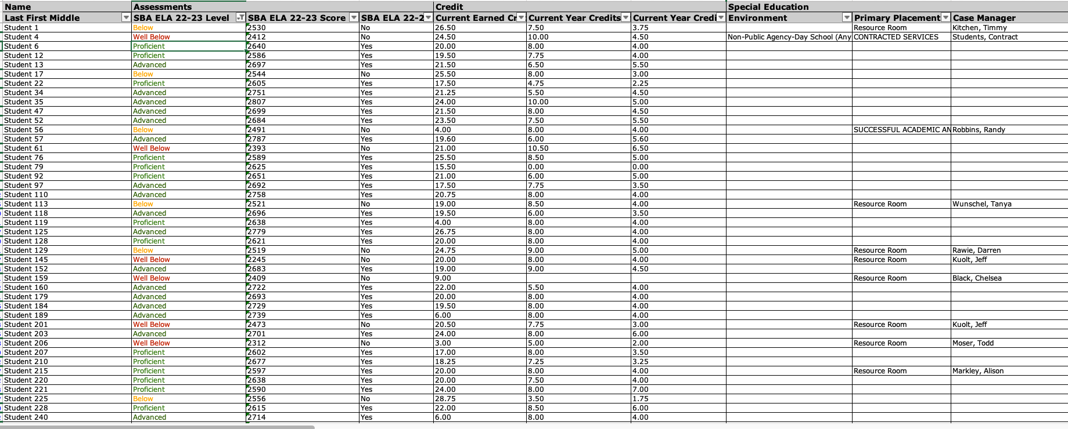

Slide 8
Parts of a Data Grid

Slide 9
A Dataset is where the data to be used in the columns is identified and filtered.
Use the Dataset to:
Select data points and/or aggregate columns
Filter desired data records
Display data point records as multiple rows or as column sets
Ordinal order
Identify Default Column Header Groups
Edit, Clone or Delete
Dataset / Data Source

Slide 10
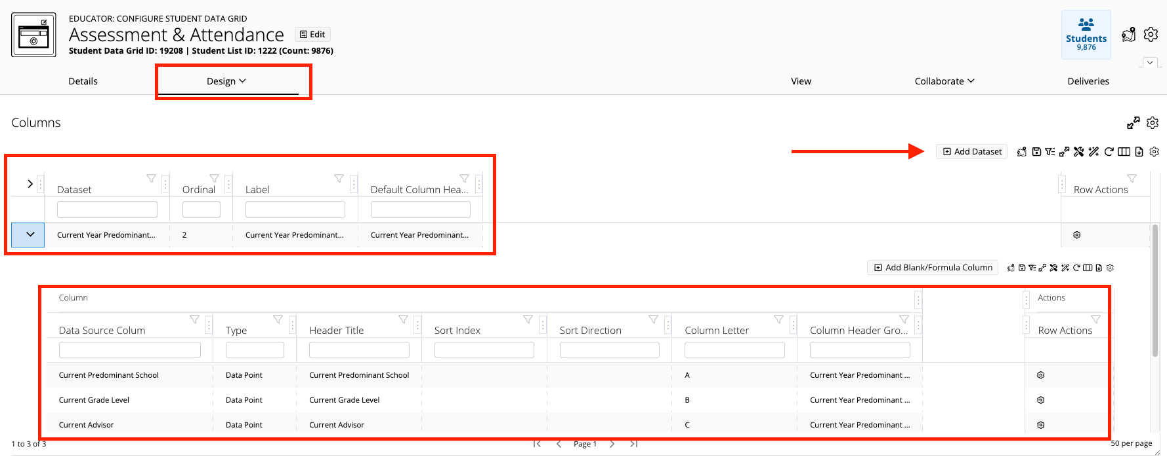
Dataset/Data Source
Dataset Added
Columns linked to display with the dataset

Slide 11
Column Tables
Column Tables display any data point and/or aggregate column linked to the dataset above it.
Using the Column Tables:
In cell editing
Column Header Titles can be relabeled
Order/Direction the columns
Click the Row Action Gear to Edit, Configure, Remove
Column Tables

Slide 12
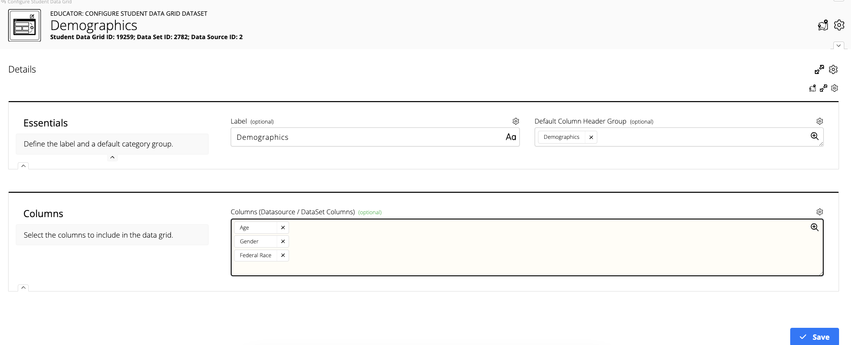
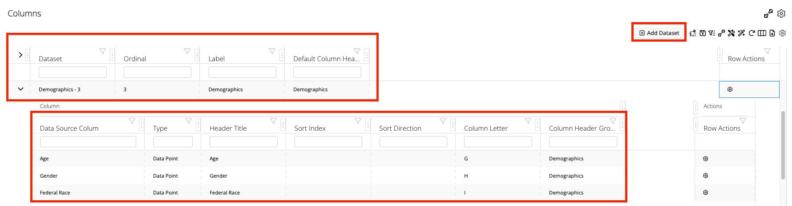
Simple Example
Data Point type columns are added from the Details tab.
Dataset Added
Columns linked to display with the Dataset

Slide 13
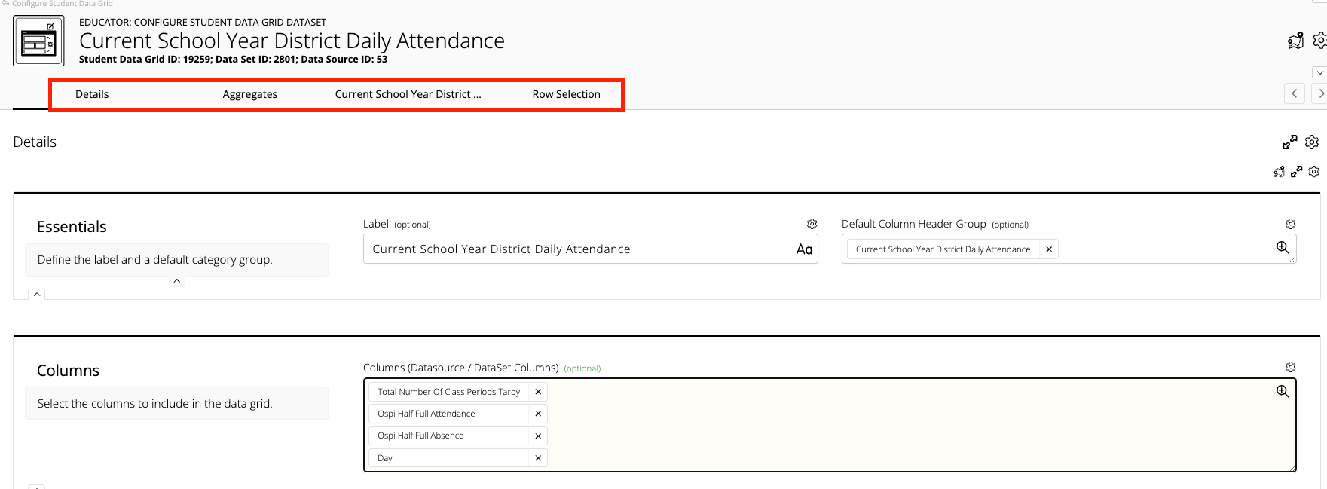
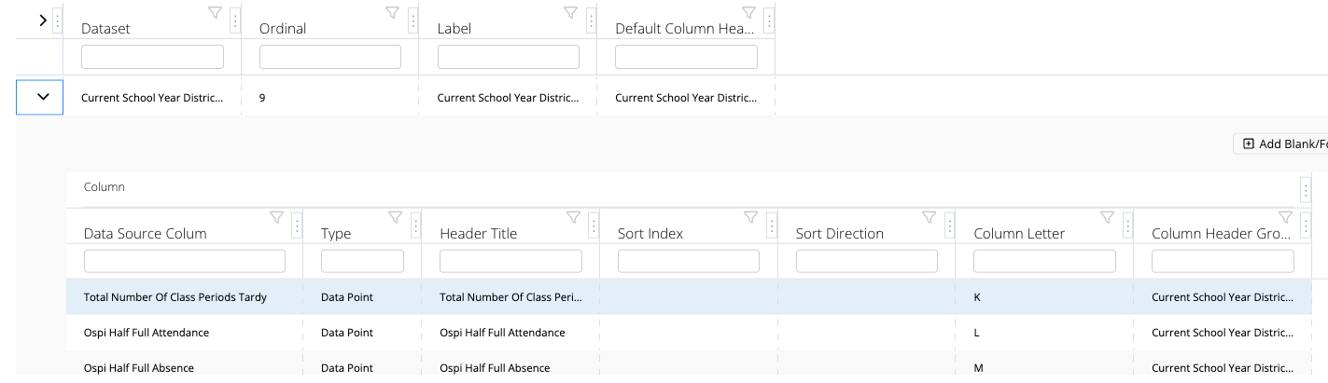
Complex Example
Multiple Tabs:
Aggregates: Add Aggregate type columns
Tab with same name as dataset for filtering data
Row Selector: Manages multiple records
Dataset Added
Columns linked to display with the Dataset

Slide 14
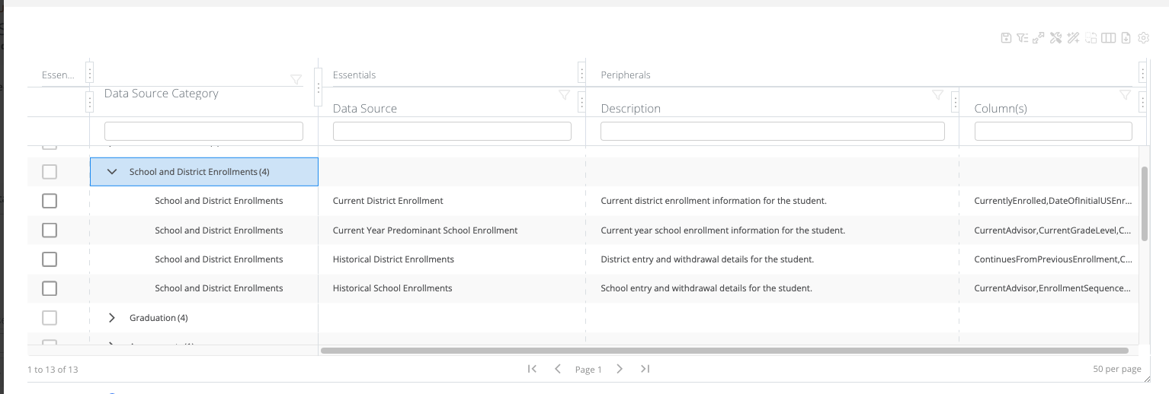
Student Data Grid Column Options
13 Categories
57 Data Sources/Sets
1,300 Data Columns
Link to spreadsheet with columns

