Slide 1
Connect Student Data Grids
Using Data Grids

Slide 2
Welcome & Getting Started
Downloading
Collaborate:
  Copy To
  Sharing With Others
Deliveries
Data Administrators

Slide 3
Downloading

Slide 4
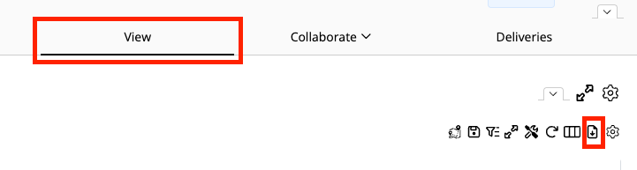
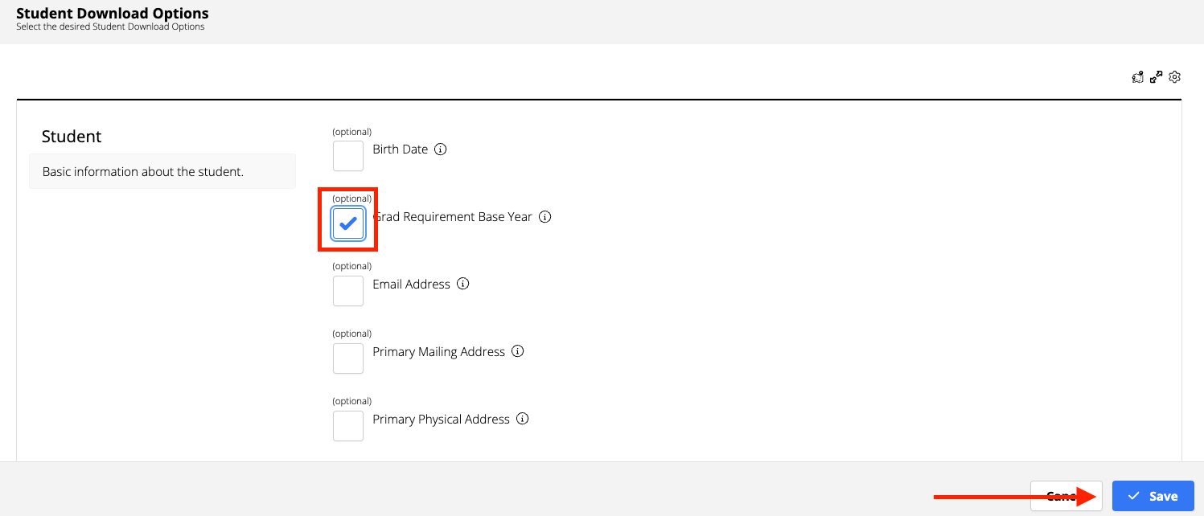
Downloading
Click the View Tab
Click the Download Data Table icon
Select the desired student download option by clicking the checkboxes.
Click Save
TIP: To generate a spreadsheet with files names differently, use the Deliveries tab.
Notes:
The Data Table present here is the same that is surfaced in Homeroom.

Slide 5
Collaborate

Slide 6
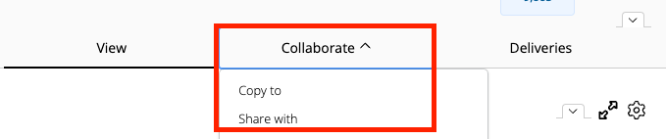
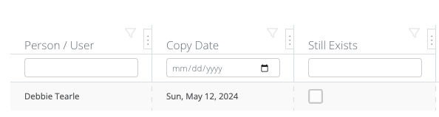
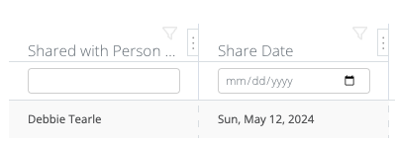
Copy To/Share With Other Users
Configure Student Data Grid page:
Click the Collaborate tab and choose one of the following:
  Copy To: Duplicate grid is sent to user that can be independently edited
    Row Action Gear allows Configure or Delete
  Share With: Duplicate grid is sent to user that allows viewing of future edits
    Row Action Gear allows View or Copy to Me
    TIP: To edit a shared copy, first Copy to Me
Table below logs users copied to/shared with and date.

Slide 7
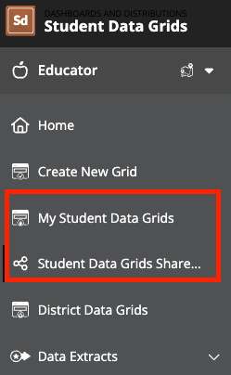
Copy To/Share With Other Users
Locate Created grids in My Student Data Grids
Locate Copied To grids in My Student Data Grids
Locate Shared With grids in Student Data Grids Shared with Me

Slide 8
Deliveries

Slide 9
Automated Deliveries
Send the same Student Data Grid to different groups of users on different delivery schedules
View and track a list of processing/completed deliveries
Access recipient delivery files from the delivery table
Deliveries

Slide 10
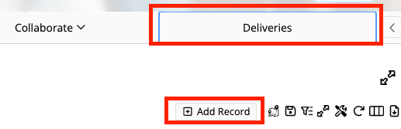
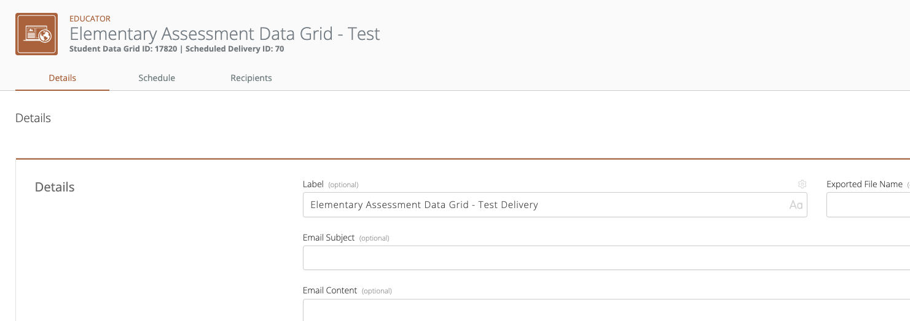
Create a Delivery Record
Click the Deliveries tab
Click Add Record
Give the delivery record a Label (name) and Save
In the Details tab:
Optional but recommended:
  Exported File Name
(do not enter a file extension)
  Email Subject
  Email Content (reminder of use)

Slide 11
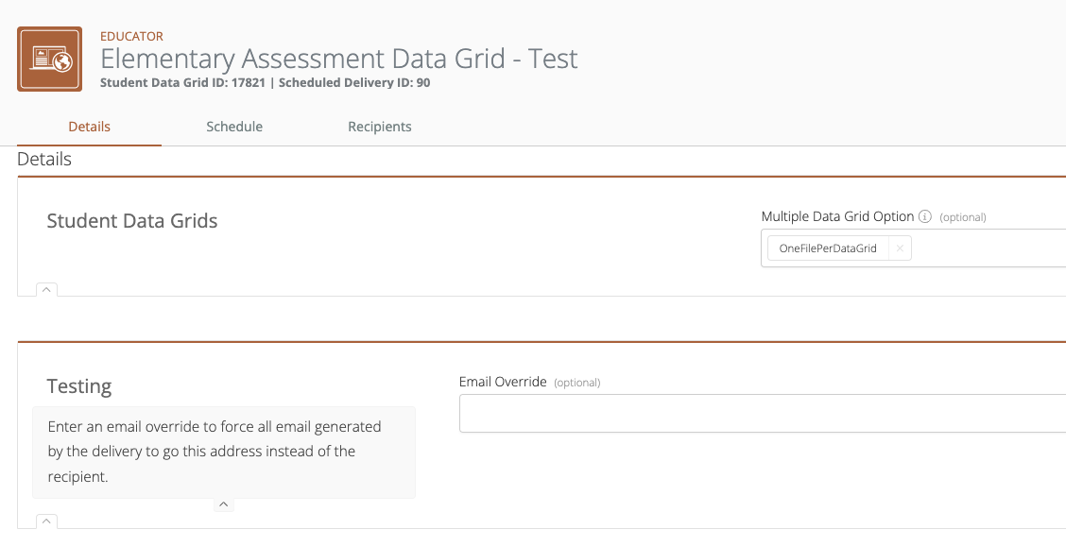
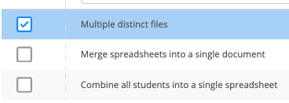
Additional Optional Areas
Multiple Data Grid Option
  Multiple District files
  Merge
  Combine
Email Override
  Testing

Slide 12
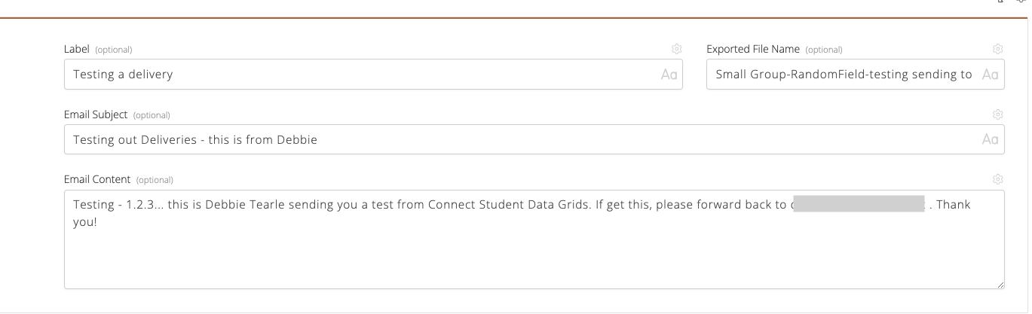
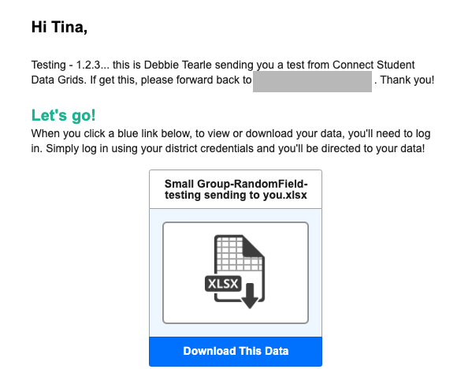
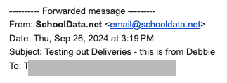
Automated Delivery - Example Email Setup

Slide 13
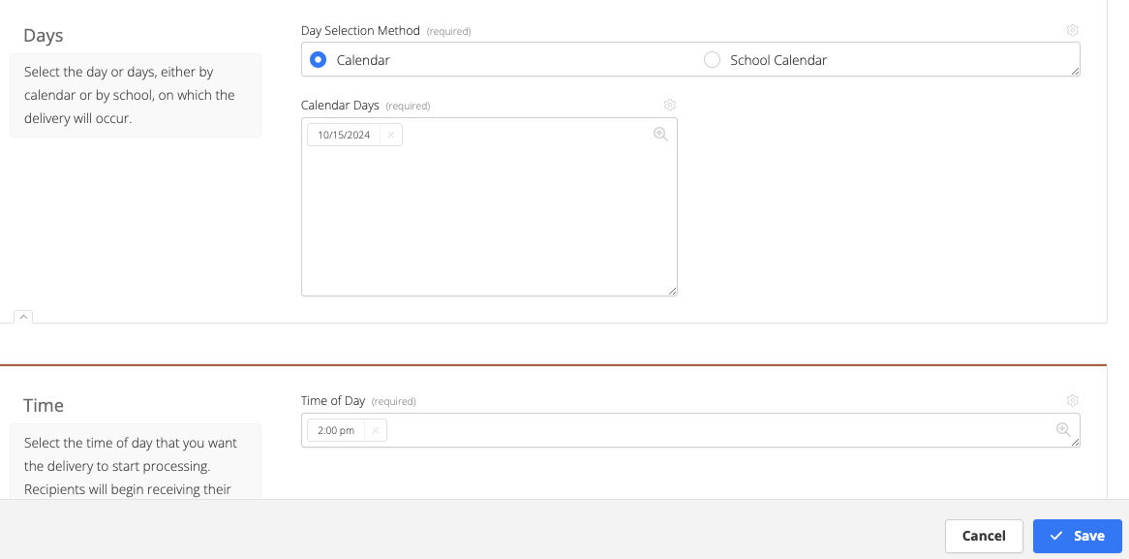
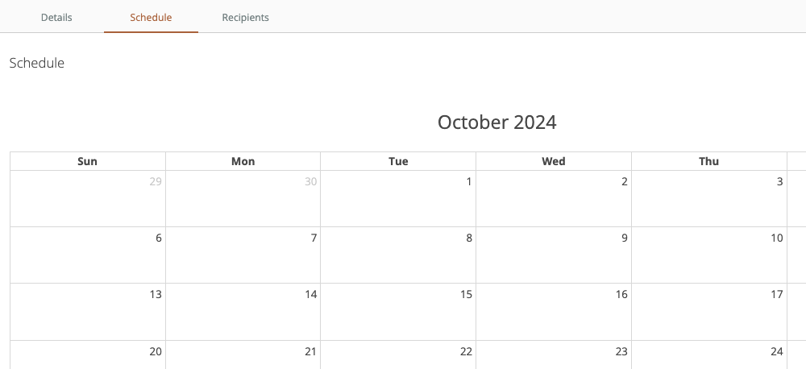

Schedule Deliveries
Click the Schedule tab
Click a date
Select a time and Save.
Notes:
Currently, there is a bug to add from the calendar page, but on the delivery record there is a setting to Add Days.

Slide 14
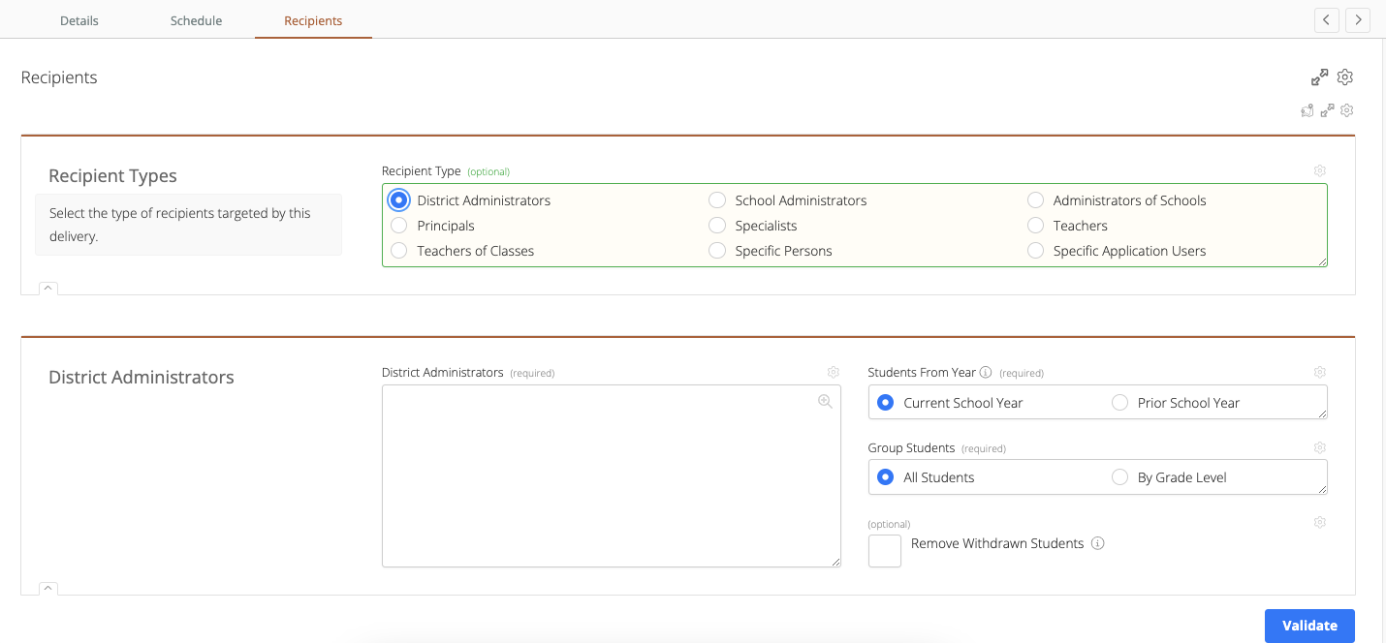
Select a Recipient
Click the Recipient tab
Select a Recipient Type
Fill in the required field
(dependent on the type selected)
Click Save

Slide 15
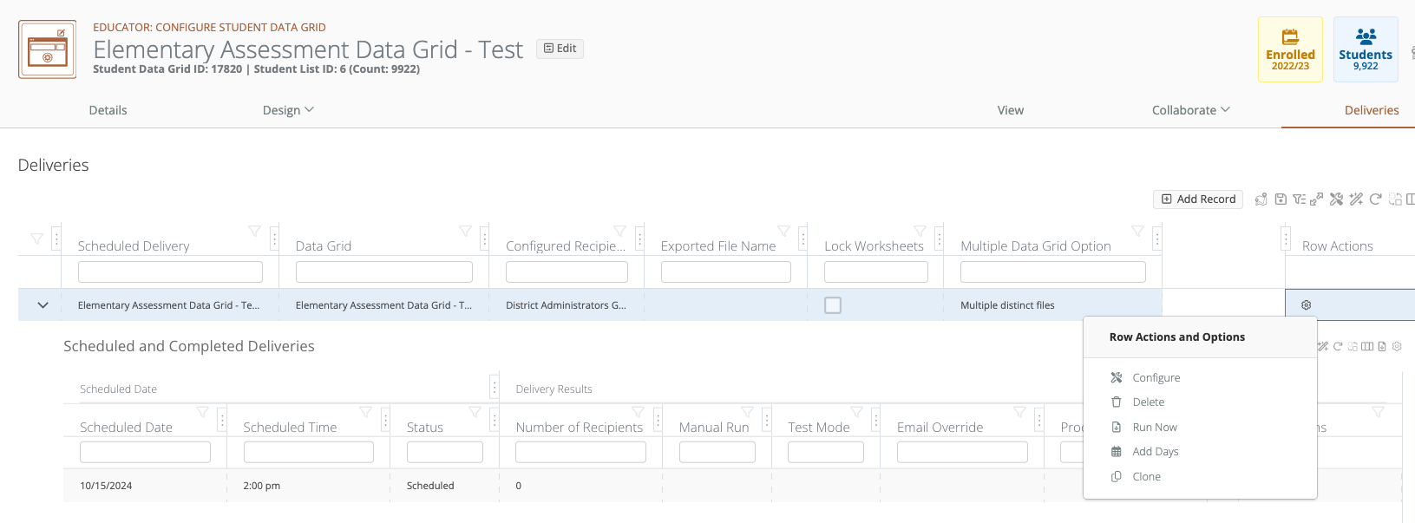
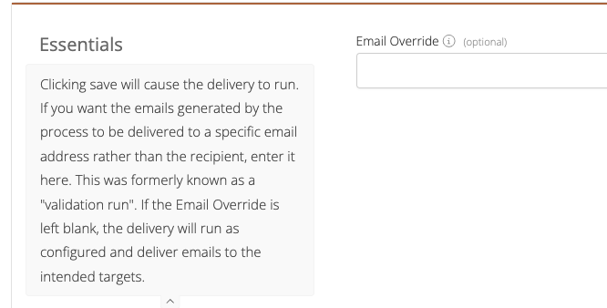
Testing:
After Recipients Setup, close the delivery record
Click the Row Actions Gear and choose Run Now
Enter YOUR email in the Email Override.
Note: If you do not it will send to all recipients!
Click Save.
A Data Delivery Validation Package will be send to your email.
  Click the Download Now button to download the file.
Tips: Other Row Actions Gear Options:
Configure
Delete
Add Dates: add one or more dates at once
Clone: Clone to another type

Slide 16
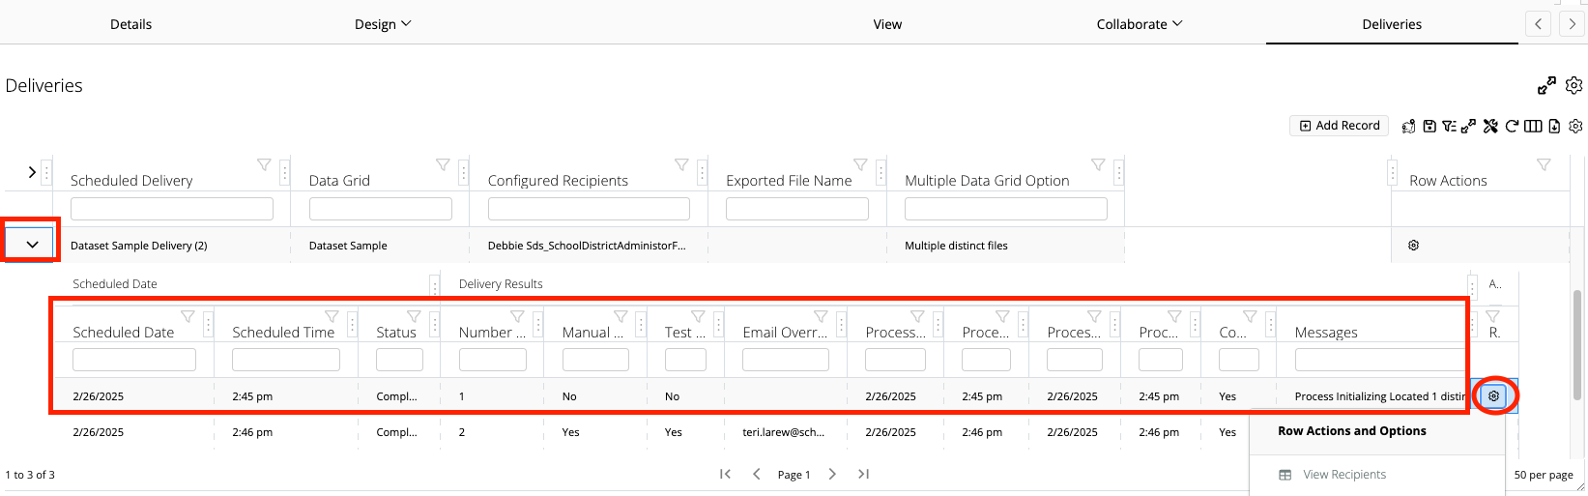
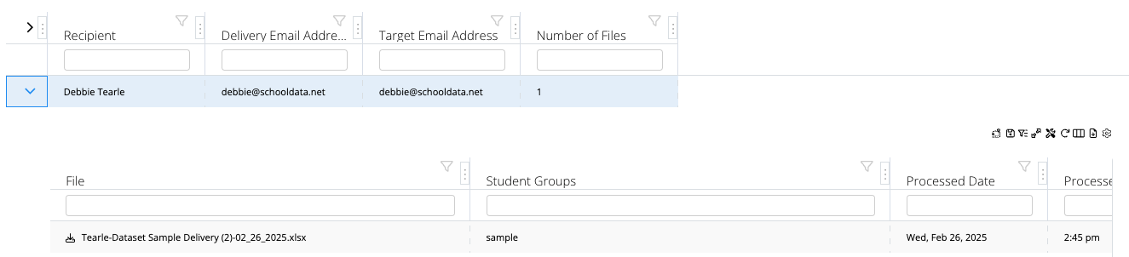
Tracking Scheduled/Completed Deliveries
A Data Delivery Completion Summary will be sent to your email address.
  Click the Download Now button to authenticate and download the file.
Click the arrow to view scheduled and completed deliveries.
Click the Row Actions Gear to View Recipients
  Click the arrow to download file sent

Slide 17
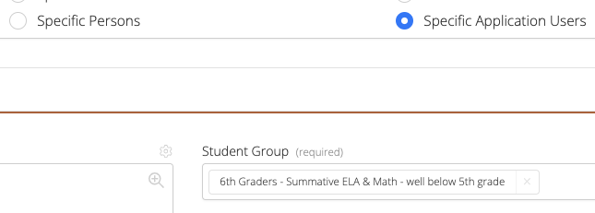
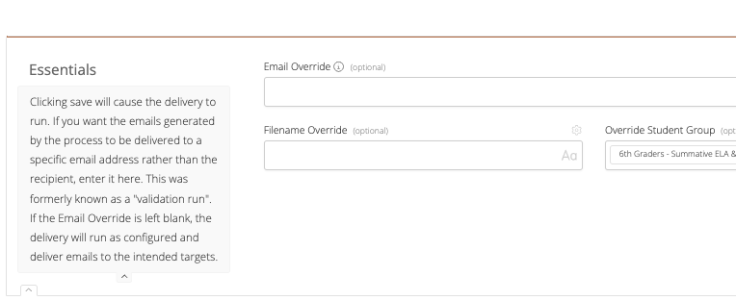
Download Reports with Varied File Names and Groups
Create Delivery Record with Recipients as:
  Specific Persons
  Specific Application Users
Click the Row Action Gear and choose Run Now
Fill in the form as needed
(If the email created is only you - no need for Email override )
Repeat step 2 & 3 for each
3
1
2
Notes:
This is in response to the missing option that was in V2 some users used to generate reports sent to themselves

Slide 18
Data Administrators

Slide 19
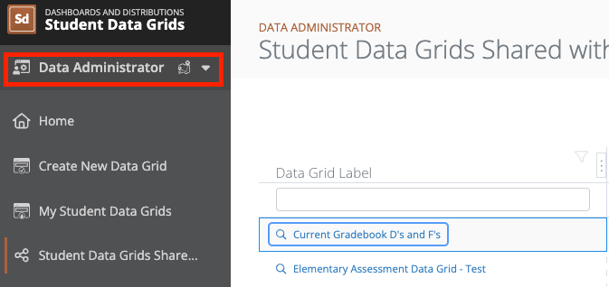
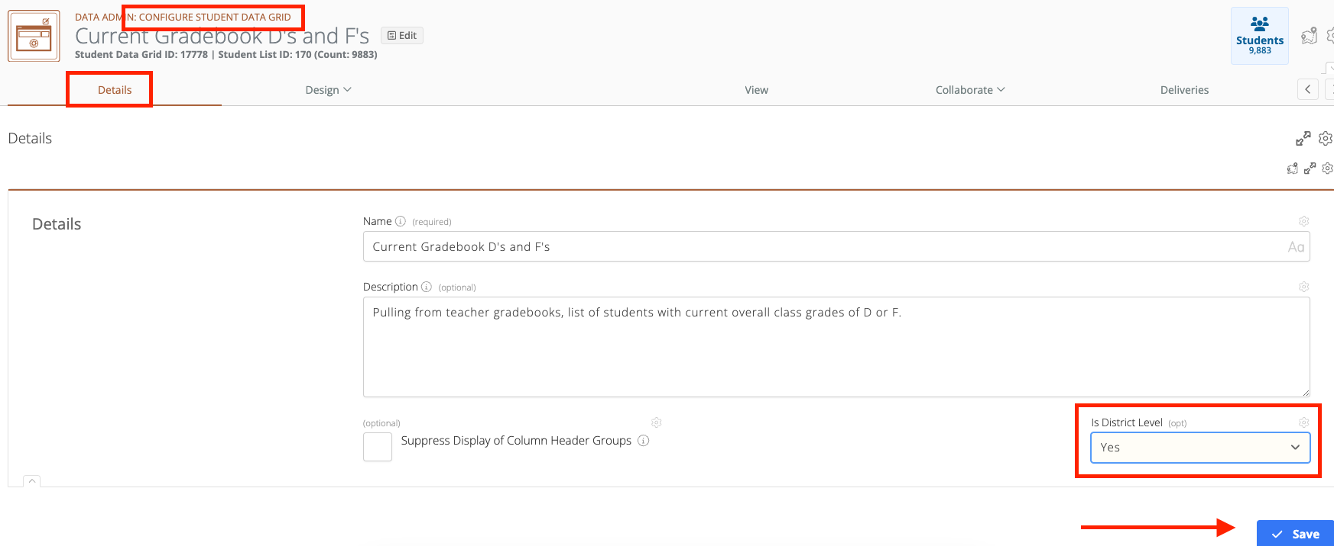
Set as District Data Grid
Users with SDG Data Administrator permissions can set a student data grid as a District Data Grid available to all
From the Configure Student Data page on the Details tab, set Is District Level to Yes and click Save
Users with SDG Data Administrator permissions can edit any District Data Grid
Notes:
If you do not have access and feel you need it, reach out to your District’s Homeroom Data Administrator

Slide 20
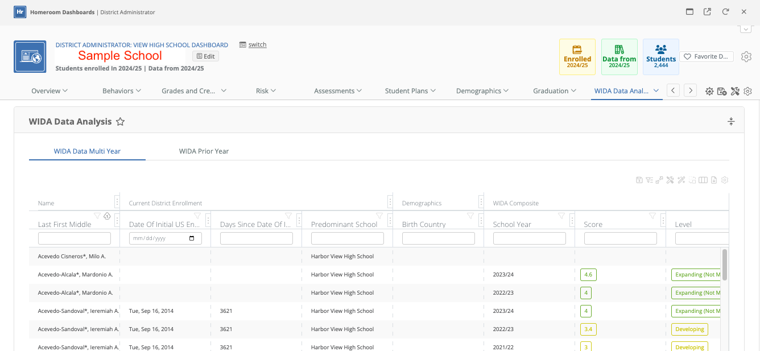
Homeroom Dashboard
Once a Student Data Grid is created send a ticket to support@schooldata.net requesting it be added to your Homeroom Dashboard.

Slide 21
QUESTIONS
WHAT QUESTIONS EMERGED?
WHAT ARE YOU HOPING TO DO WE HAVEN’T YET COVERED?

