Slide 1



Welcome
Creating Student Groups Training
Notes:
Put name, district and your role at the district in the chat.

Slide 2


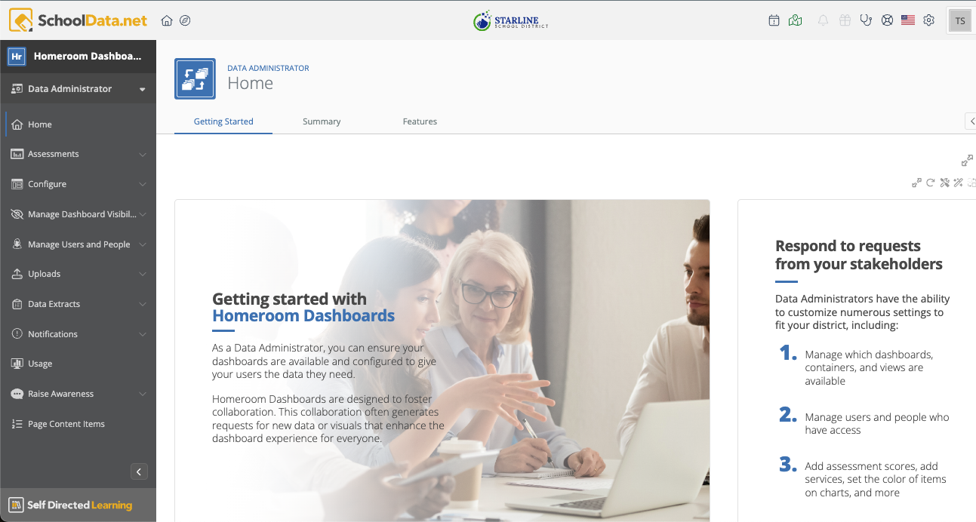
Agenda
Welcome & Getting Started
How to make a student group
How to manage student groups
Practice making groups
Q & A

Slide 3
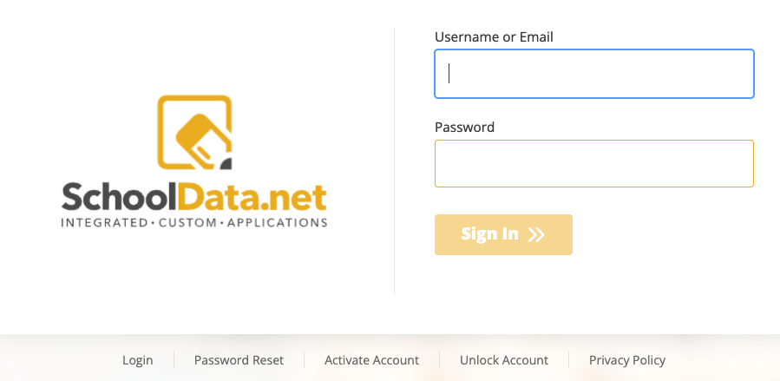
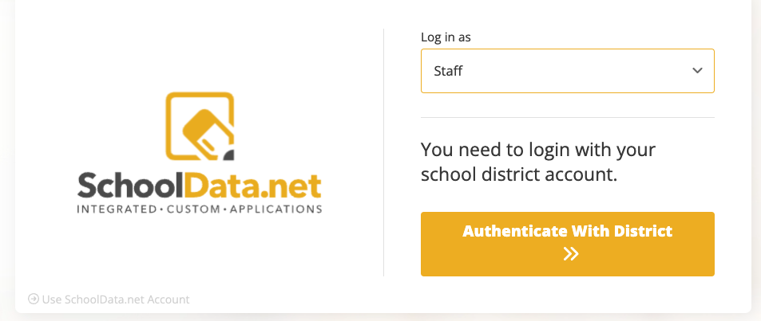
How to Log In
Go to URL: districtname.schooldata.net/connect/#/homeroom
The login page will be one of these examples:
Enter username or email from the SIS
OR
Click Authenticate With District
*Note: Use Reset Password option, if necessary
Notes:
https://support.schooldata.net/hc/en-us/articles/13547641538323-Login-Activate-Reset-Password-Logout

Slide 4


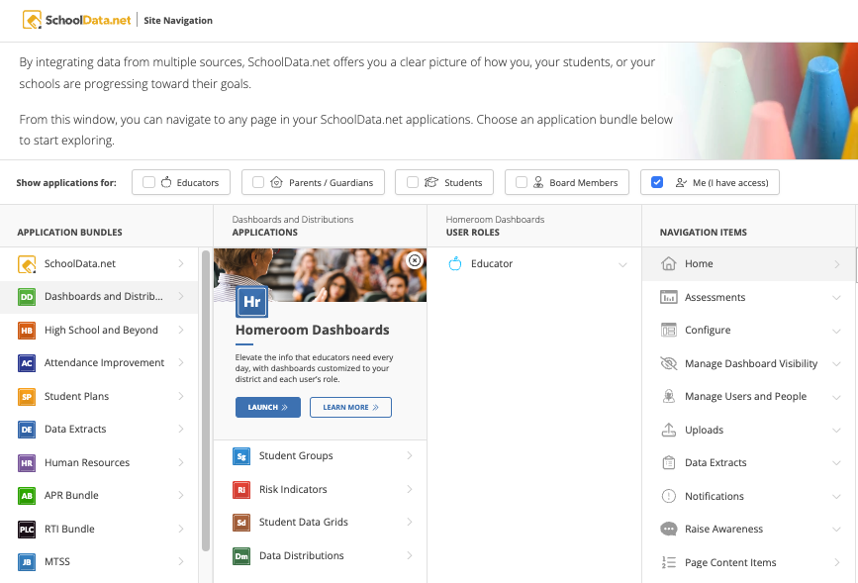
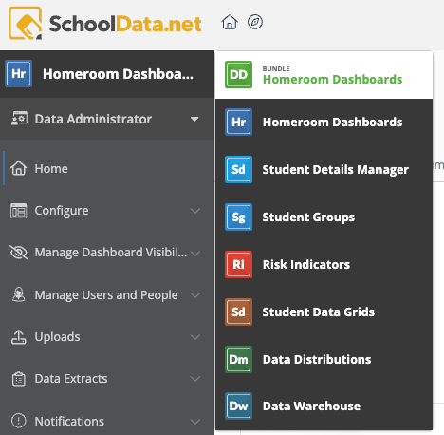
Site Navigation
Click the navigation icon to start. Click Dashboards and Distributions, then Homeroom Dashboards, then Launch.
If you are already in the DD bundle, click the app name to open a bundle list.

Slide 5
Student Groups

Slide 6
Benefits of Creating Student Groups
Examples:
Students frequently in the health room
Track students in the counseling office
Break a large group into multiple smaller groups. (advisory, reading levels etc.)
Update SIS current service or program enrollments such as Title I, LAP and ELL
Collect data from a customized group for reporting
Customization: Personalized views
Accessibility: Different access levels ensuring relevant data visibility.
Data-driven Decision Making: Informed decisions based on real-time student data and analytics.
Copy/Share: Copy or share groups with others

Slide 7
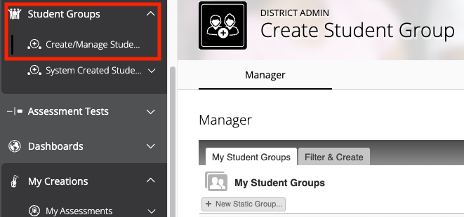
Student Groups
There are two types of groups available to create in Homeroom:
Static - this is a specific list of students that does not change unless you manually add or remove the students. (track the same set of students over time.)
Smart - pulls dynamically every night, is always in flux and changes according to the filter criteria you use to define the group.
To start, select Student Groups from the left navigation menu then choose Create / Manage Student Groups.
You will see two tabs:
My Student Groups (Static Group)
Filter & Create (Smart Group)
Notes:
https://support.schooldata.net/hc/en-us/articles/360046573653-Student-Groups

Slide 8
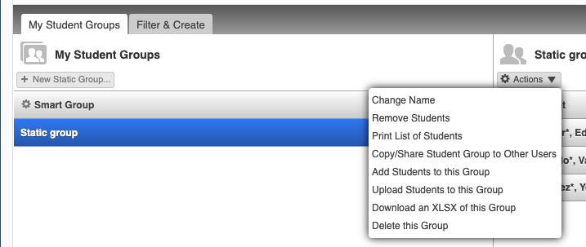
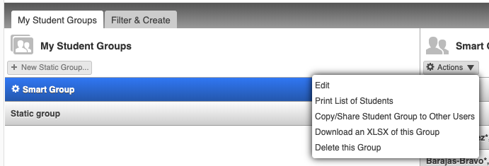
Differences in the tools
Once a group is saved, Static and Smart groups each have different tools under Actions.
Static Group tools
Smart Group tools

Slide 9
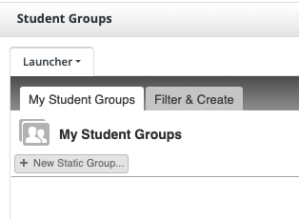

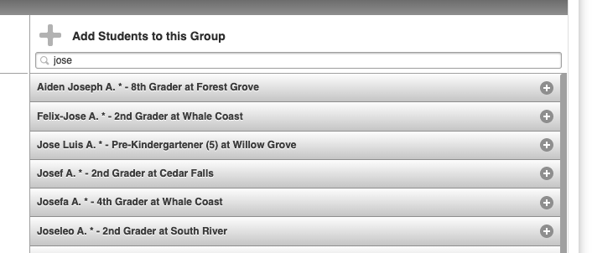
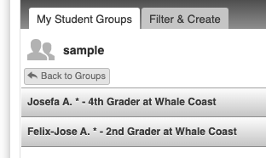
Static Groups
Static groups are useful either because there are no data points to identify a student’s membership or you don’t want the membership to change.
Click the + New Static Group button to get started.
Give the group a name and click Save & Edit, but if you will be uploading students (next slide) to the group you can just click Save.
From the Add Students to this Group area, type in the part of a name and hit enter to search.
Click each name in the list to add them to the group. Names are added automatically
Click Back to Groups when done.
Notes:
https://support.schooldata.net/hc/en-us/articles/31252467658131-Create-and-Manage-a-Static-Student-Group

Slide 10
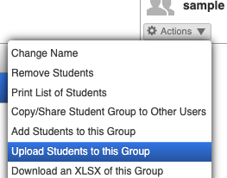
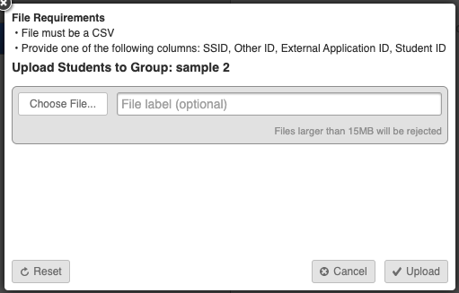
Static Groups, Uploading a List
If you have a lot of students you want in a group, but you don’t want the membership to update, uploading a list of IDs is an easy way to create a group. To create a group this way, you will need a CSV file prepared in advance with a list of student IDs (see ‘File Requirements’ below) only in the CSV.
Click the + New Static Group button to get started.
Give the group a name and click Save.
Once saved, click Actions on and choose Upload Students to this Group
Click Choose File to locate the file on you saved in advance with IDs.
Click Upload
Notes:
https://support.schooldata.net/hc/en-us/articles/13623225028627-Student-Group-from-a-File-Upload

Slide 11
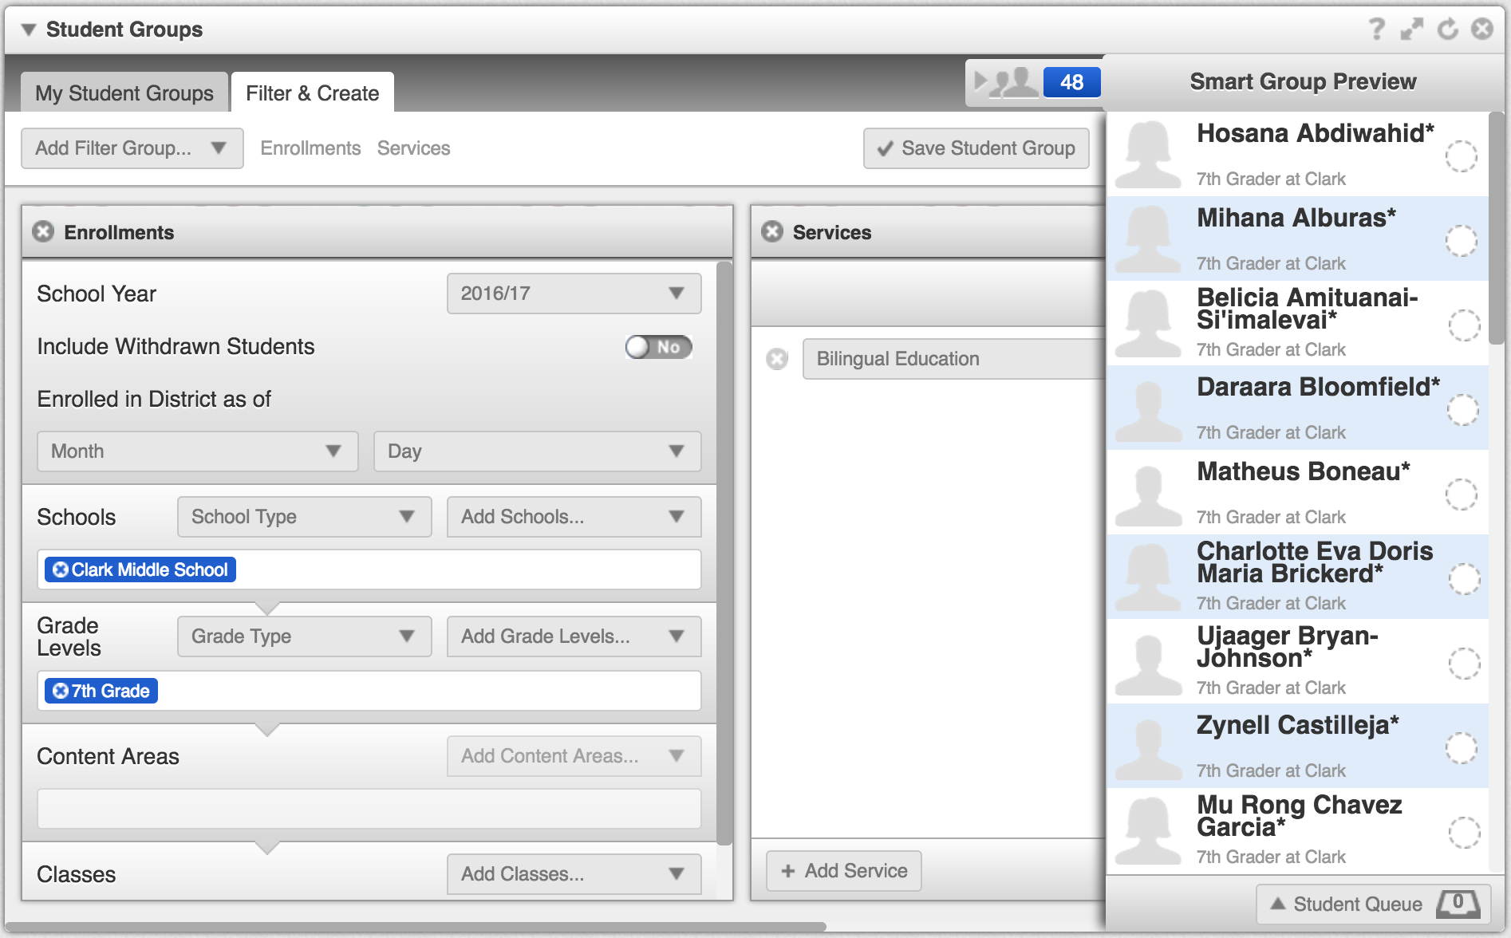
Smart Groups
Creating a dynamic group, always add the Enrollments Filter Group and select your school.
Click the Filter & Create tab to get started.
Select Filter Groups to further select data points to identify students.
Click the silhouette next to the number to view the filtered student names.
When done and ready to use on a Dashboard, click Save Student Group
Notes:
https://support.schooldata.net/hc/en-us/articles/360056259614-Create-and-Manage-a-Smart-Student-Group

Slide 12
Sample Student Groups
Static > Watch list
Smart > Current SPED Students K-5
Smart > Gr 5 students below standard on i-Ready Reading
Smart > Male, Hispanic 9th Graders in services

Slide 13
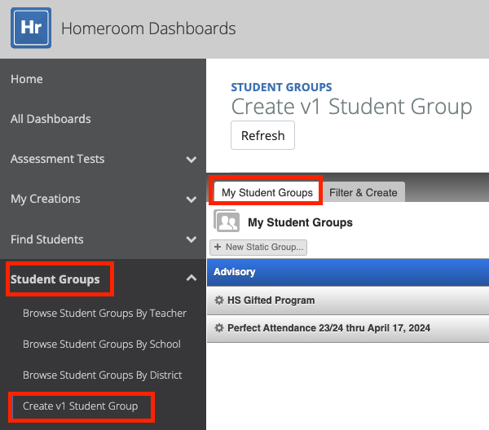
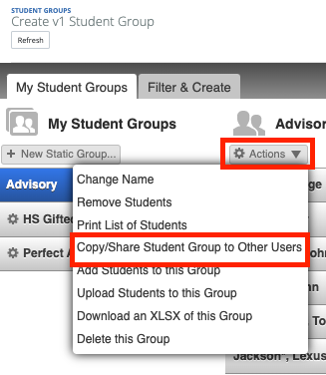
Copy/Share Student Group to Other Users
Select a Static or Smart Group from the My Student Groups tab.
Select the Action Gear and choose Copy/Share Student Groups to Other Users.

Slide 14
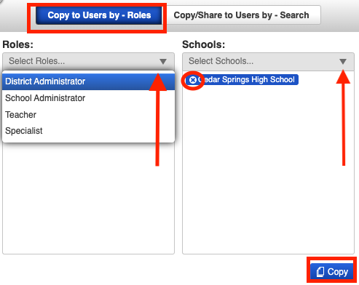
Copy to Users by Roles
Recipient’s Have their own copy to edit/delete without impacting the original.
Select Roles (based on permissions)
Select Schools
Click Copy
The duplicate group will appear the next time the receiving user logs into Homeroom.
Notes:
https://support.schooldata.net/hc/en-us/articles/13625526309267-Copy-Share-Student-Groups-to-Other-Users

Slide 15
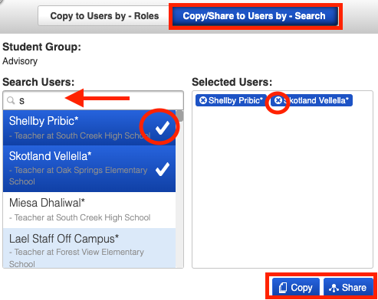
Copy/Share to Users by Search
Search letter or keyword.
Select one or more users.
The duplicate group will appear the next time the receiving user logs into Homeroom.
Copy: Recipient will have their own copy to edit/delete without impact to the original.
Share: Edit/delete will affect the original.
Notes:
https://support.schooldata.net/hc/en-us/articles/13625526309267-Copy-Share-Student-Groups-to-Other-Users

Slide 16
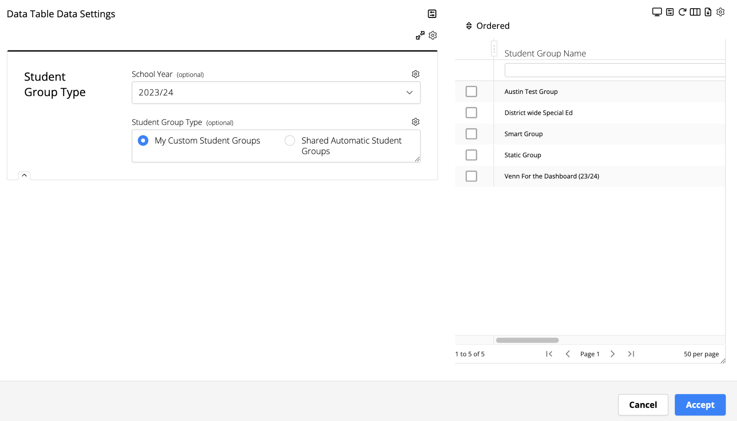
How to use a Student Group
Dynamic or Static groups can be accessed anywhere you see a My Groups list in Homeroom (or any other SchoolData.net Applications).

Slide 17

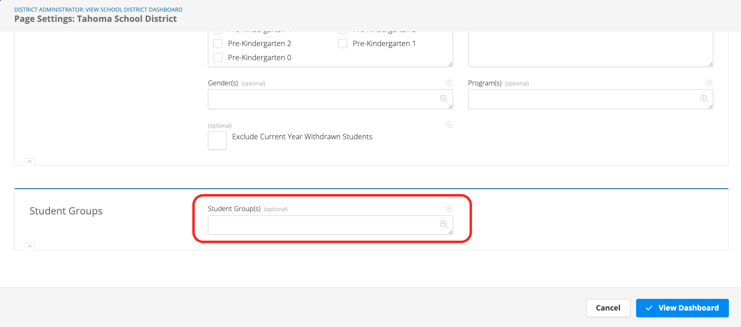
Dashboards: Changing a Student Group
Click edit and scroll to the bottom to see Student Groups

Slide 18
Student Groups – At Rollover (Early August)
Static Groups
Static groups remain the same
Smart Groups
A snapshot of each smart group is taken and saved as a static group (with date of snapshot appended to name)
Smart group remains and continues to look at current year students.
Smart groups need to be updated if date ranges in filters are used

Slide 19
Questions?
What are you hoping to do
that we haven’t yet covered?

