Slide 1



Homeroom Dashboards Connect Assessment Training
Welcome
Notes:
Put name, district and your role at the district in the chat.

Slide 3


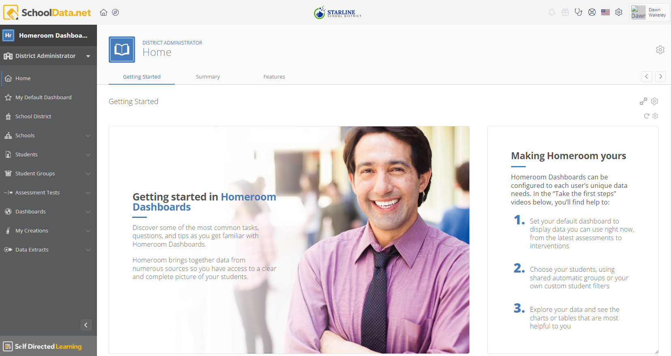
Agenda
Welcome and Introductions
All Assessments
Assessment Sets
Student Growth
Q & A, Practice

Slide 4
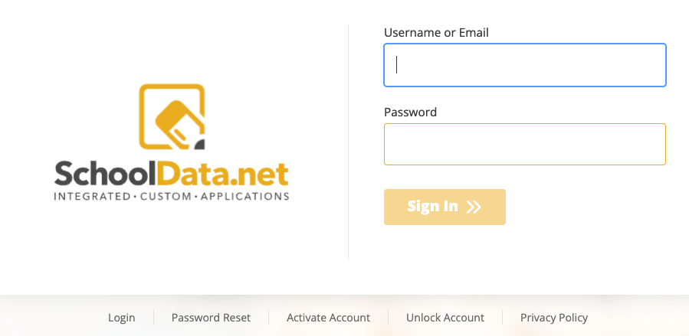
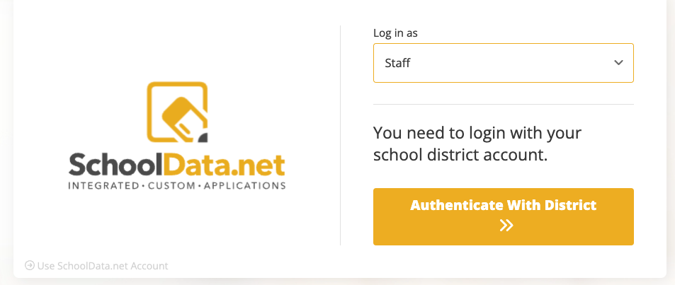
How to Log In
Go to URL: districtname.schooldata.net/connect/#/homeroom
The login page will be one of these examples:
Enter username or email from the SIS
OR
Click Authenticate With District
*Note: Use Reset Password option, if necessary
Notes:
https://support.schooldata.net/hc/en-us/articles/13547641538323-Login-Activate-Reset-Password-Logout

Slide 5
Assessments

Slide 6
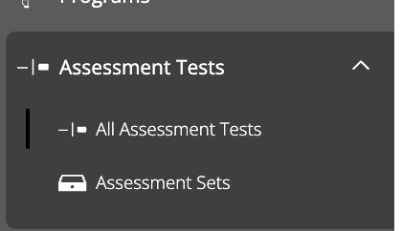
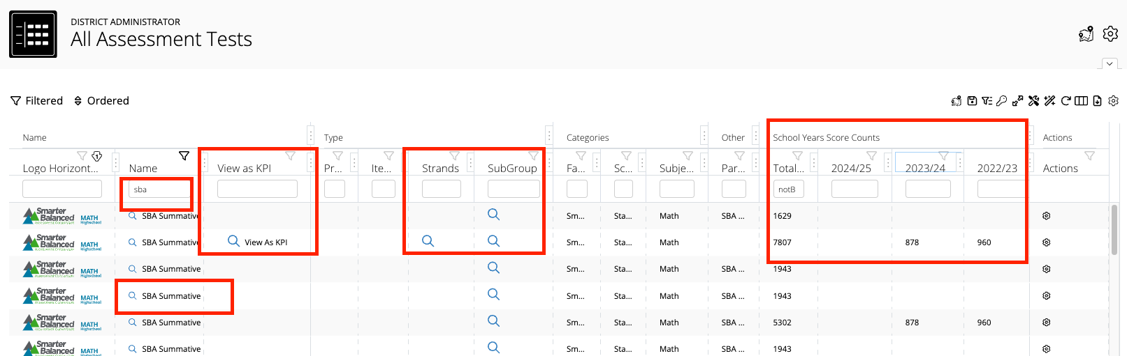
All Assessment Tests
Left Navigation > Assessment Tests > All Assessment Tests
Use the filter to locate an assessment
Click to see KPI, Strands, Subgroups
Views school year counts
Notes:
https://support.schooldata.net/hc/en-us/articles/36606682493459-Hr-Assessment-Tests-Connect

Slide 7
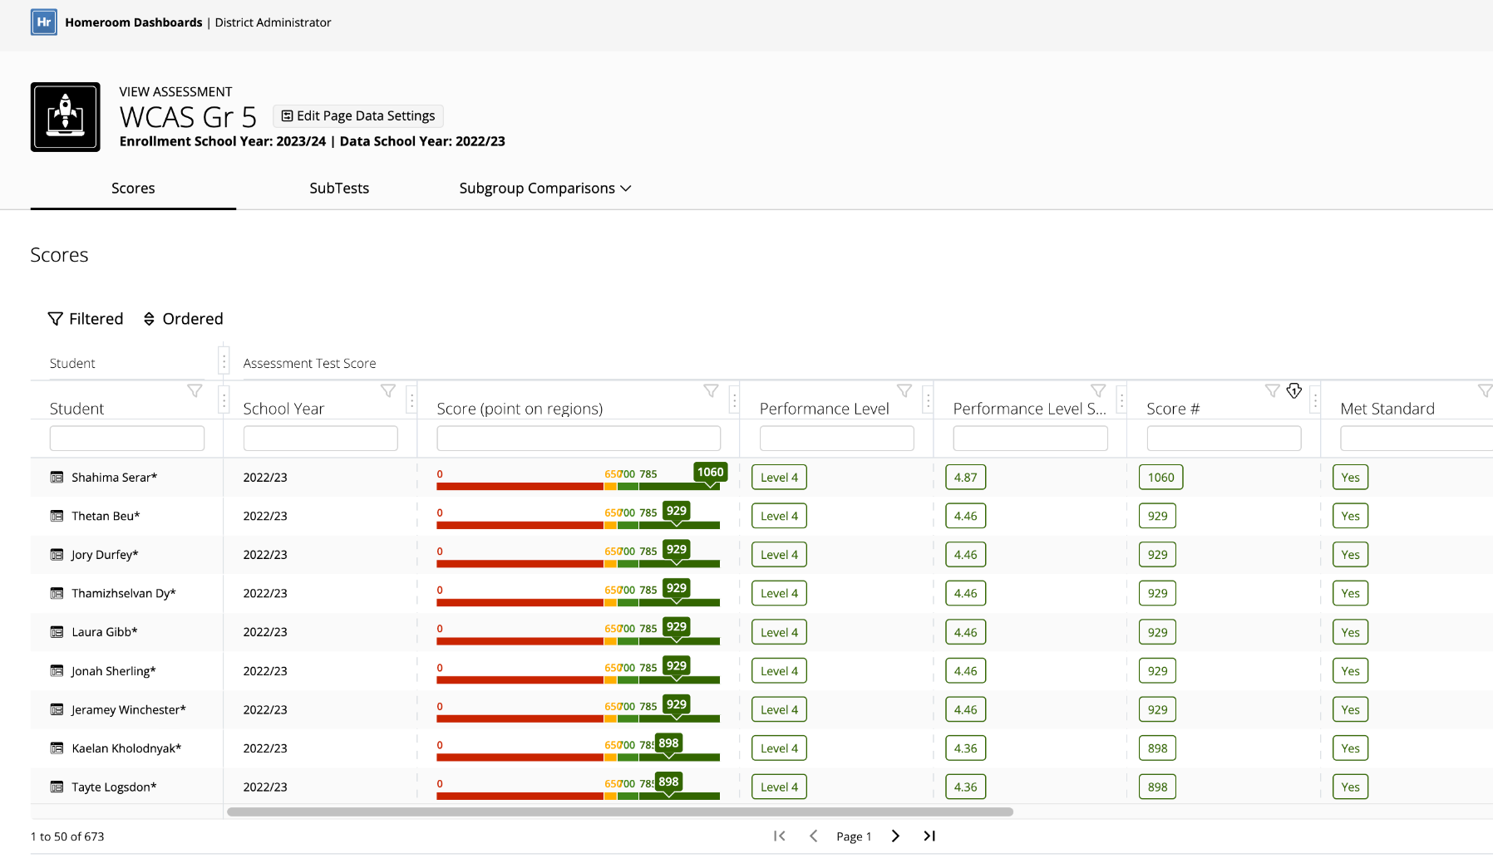
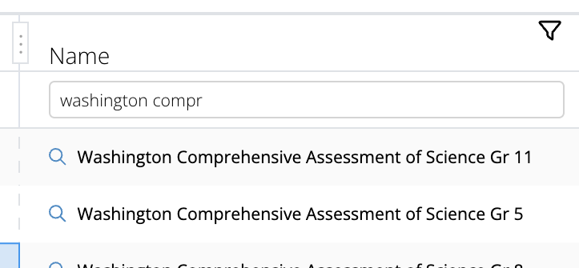
Assessment Detail
Clicking on the name of the Assessment brings up a pop-over providing detail for all students on that assessment.
Use the Edit Page Data Settings to adjust the type of students, enrollment status, and/or data year.

Slide 8
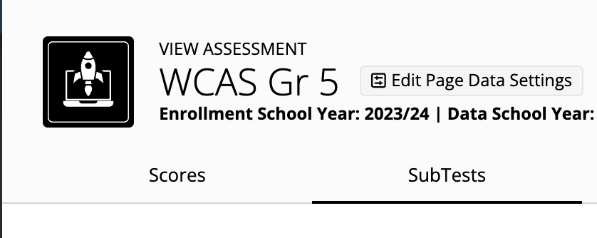
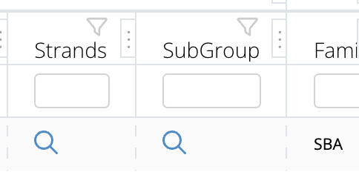
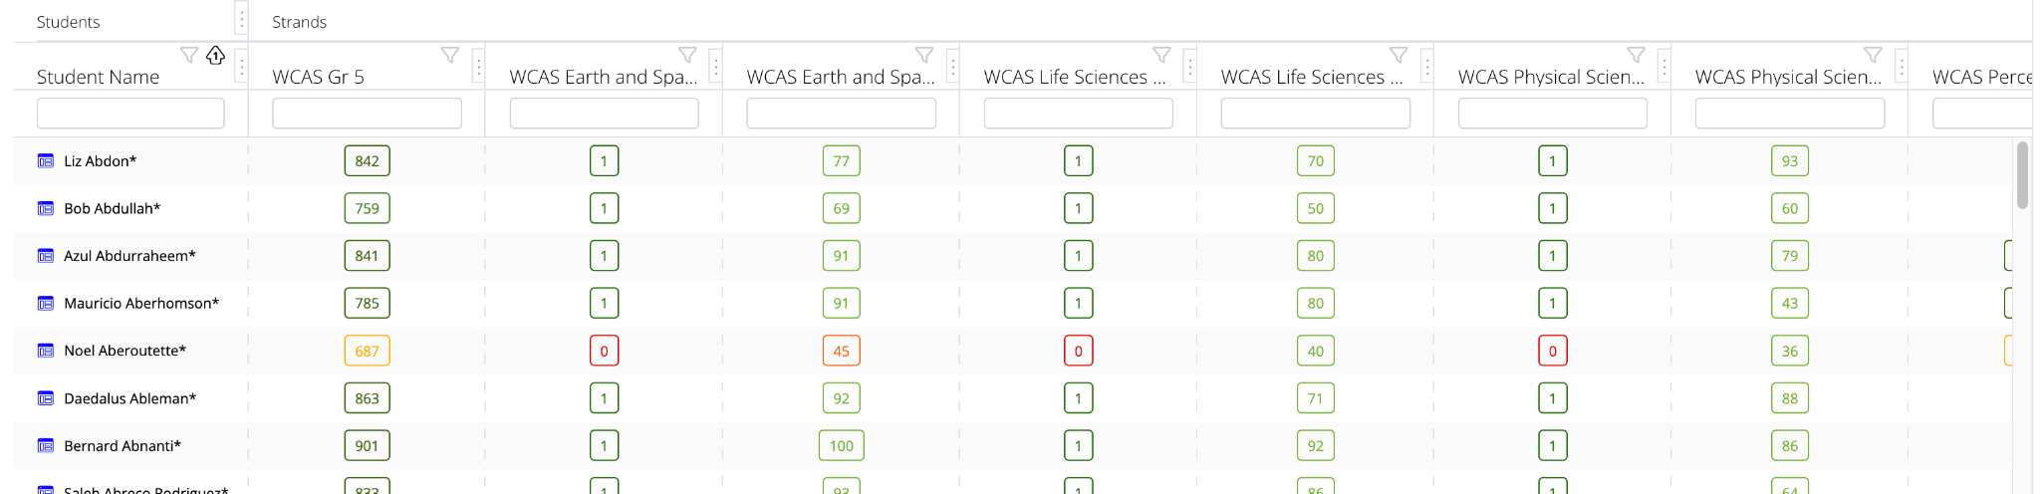
Assessment SubTest
Click Strands from the list of assessments, or SubTest tab when viewing all scores. This will brings up all the scores and the linked assessment strands/subtests.

Slide 9
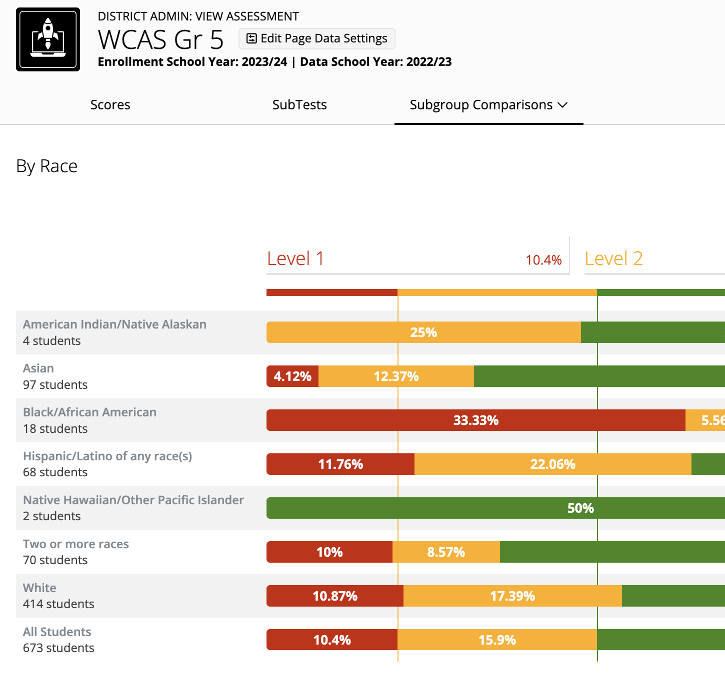
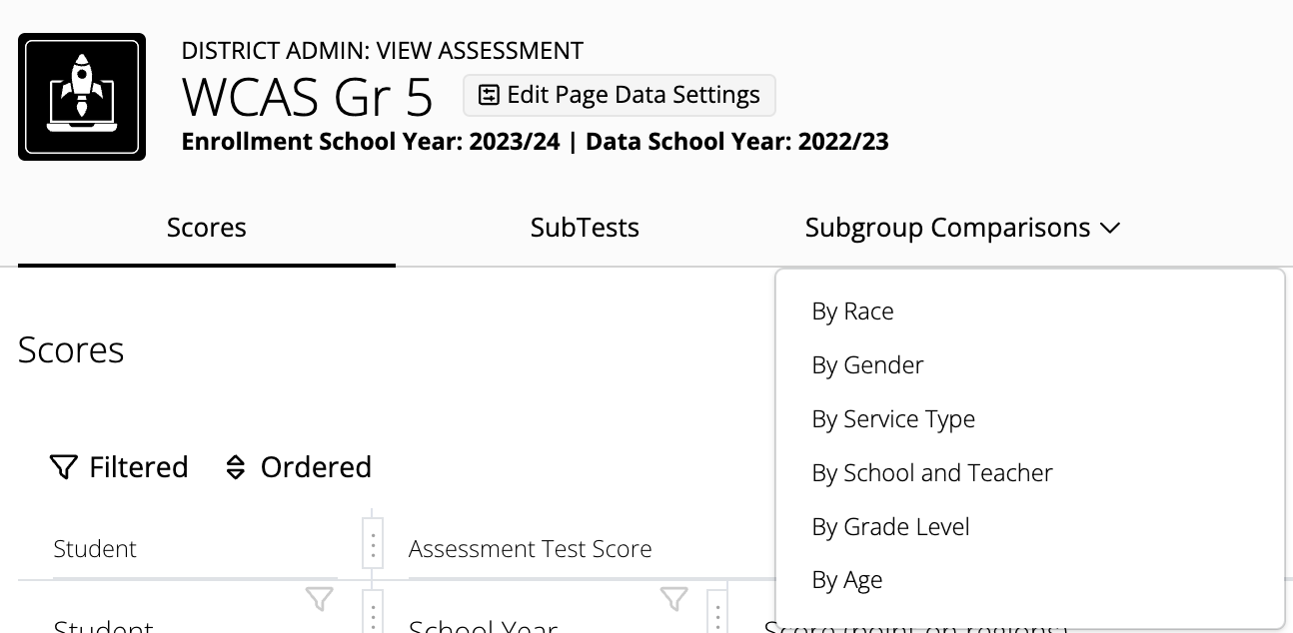
Assessment Sub-Group Comparisons
Click Sub-Group from the list of assessments, or Subgroup Comparisons tab when viewing all scores. This brings up a comparison by whichever selection of sub-group.
Click the Subgroup Comparisons dropdown to switch to another SubGroup view.
Sub-Group by Race
Click on any bar to see the students that make up the section of the chart.

Slide 10
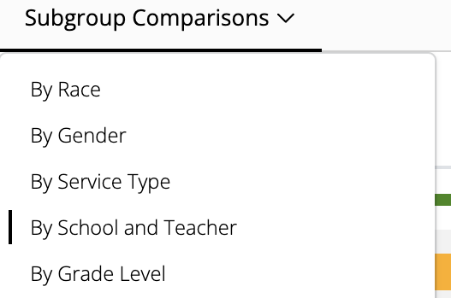
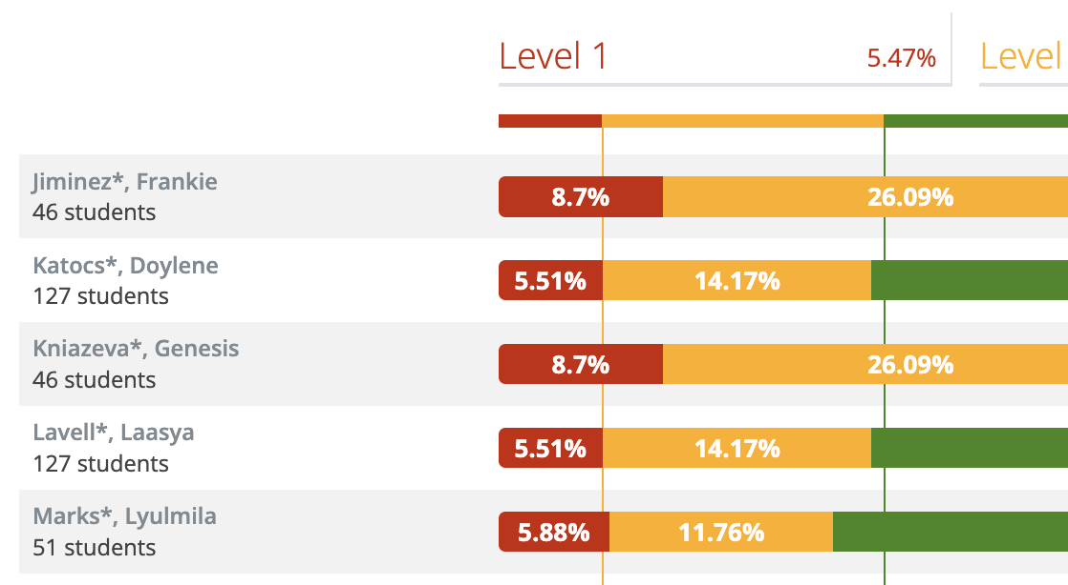
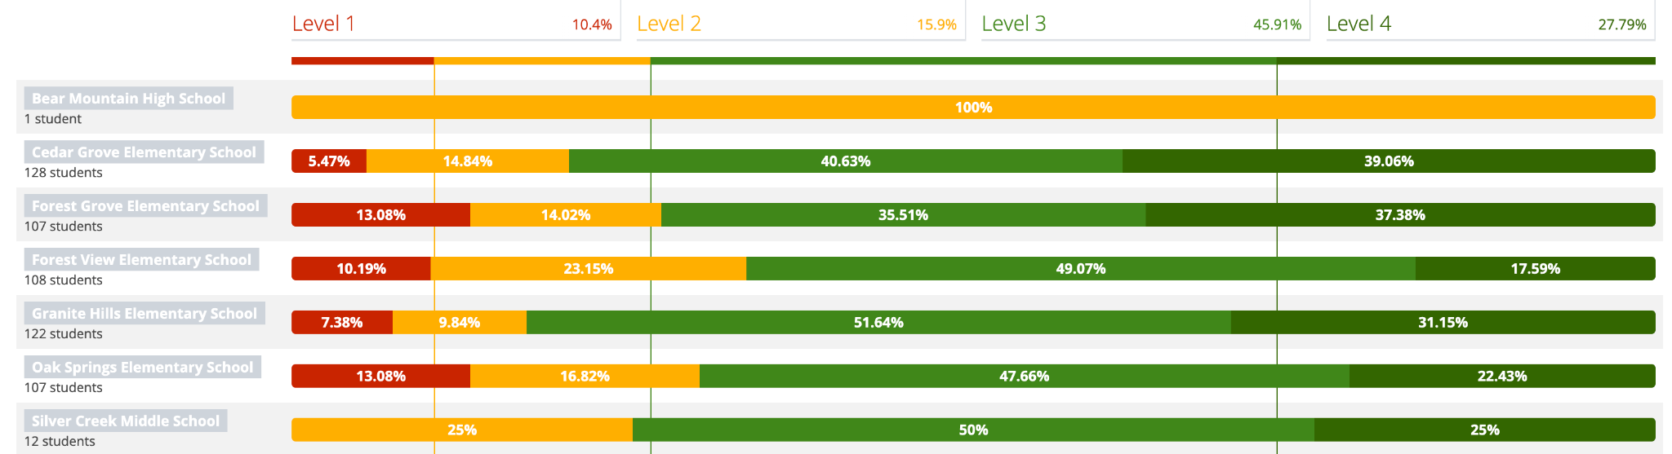
Assessment Sub-Group Comparisons
Sub-Group by School and Teacher
Click the school name to see a breakdown of the Teachers at the school
Click on any bar to see the students that make up the section of the chart.

Slide 11
Assessment Sets

Slide 12
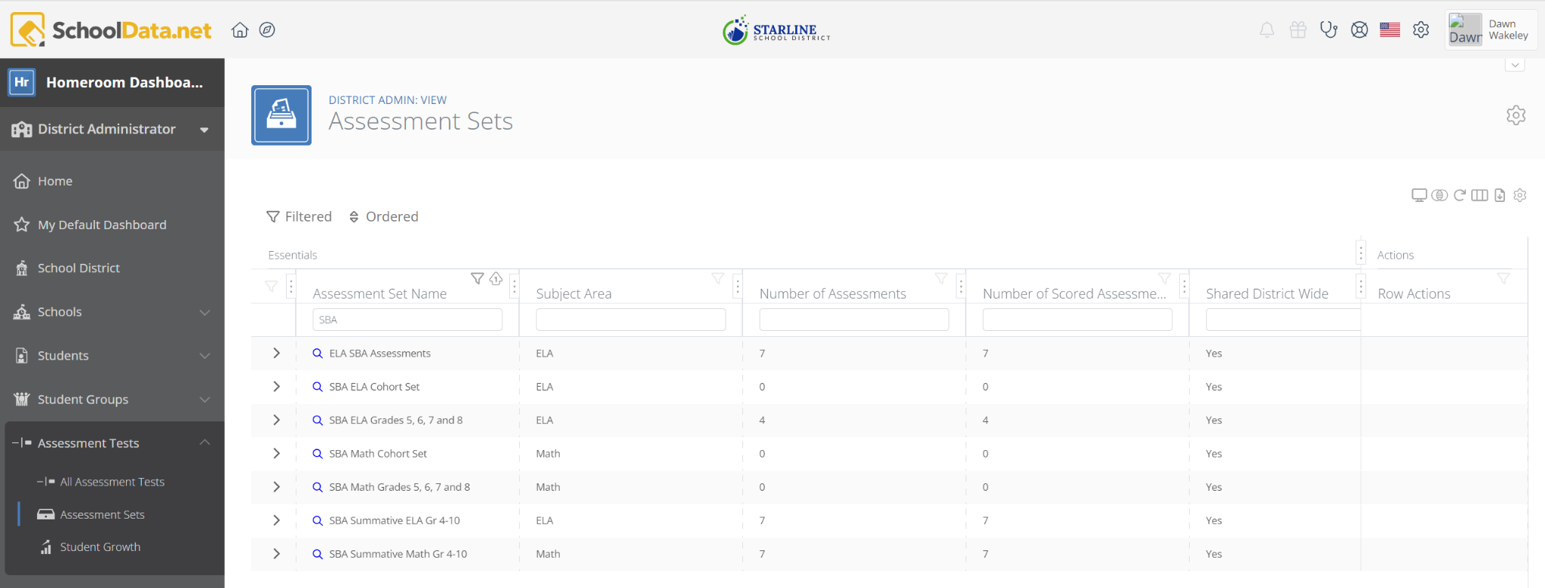
Assessment Sets
Left navigation Assessment Tests > Assessment Sets
Click magnifying glass to see data for Assessment Set.

Slide 13
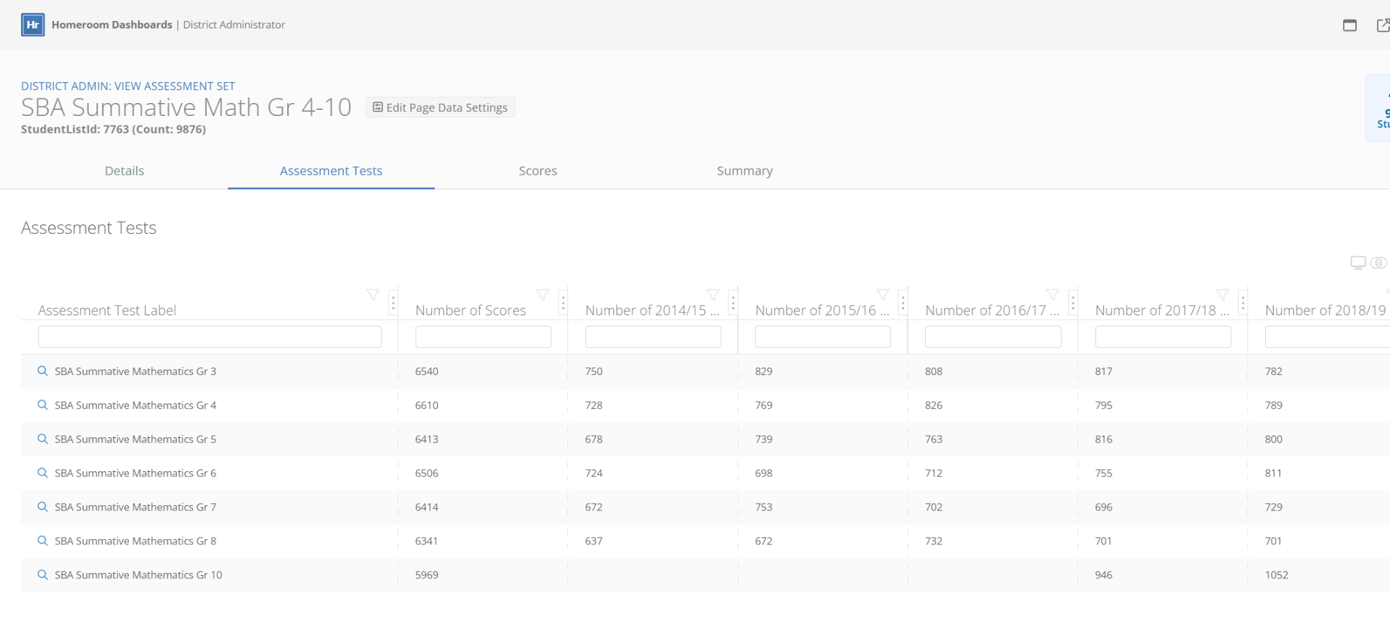
Assessment Set - Tests and # of Student Scores by Year

Slide 14
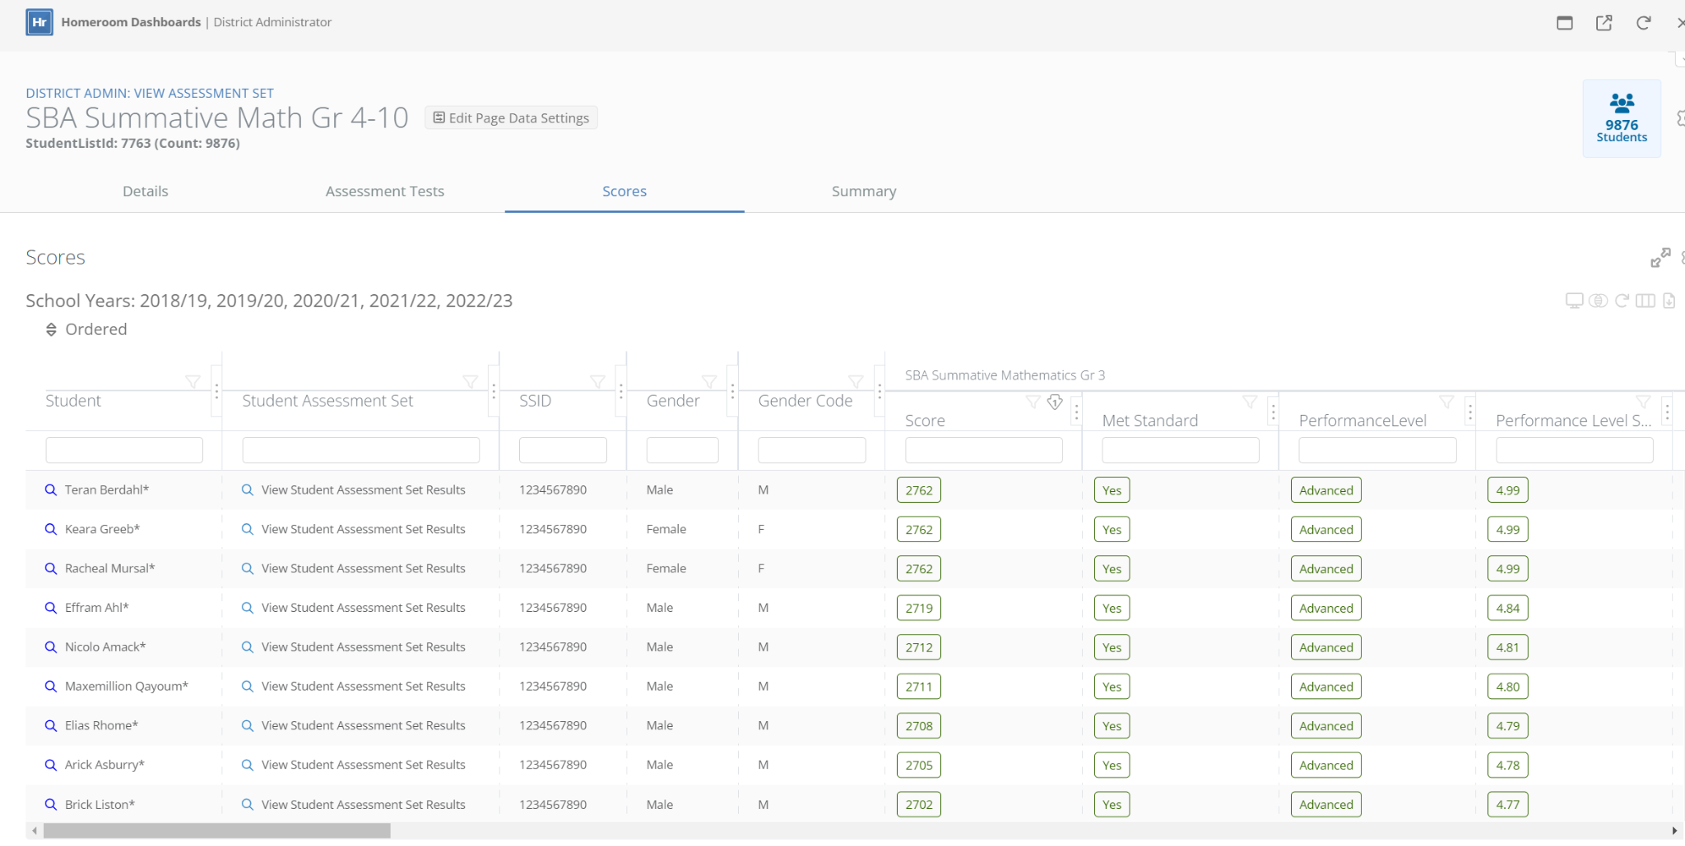
Assessment Set - Student Specific Data
Adjust Page Data Settings as needed to select students of interest and years for assessment scores based on assessments selected
Click the magnifying glass to see
data over time for an individual student.

Slide 15
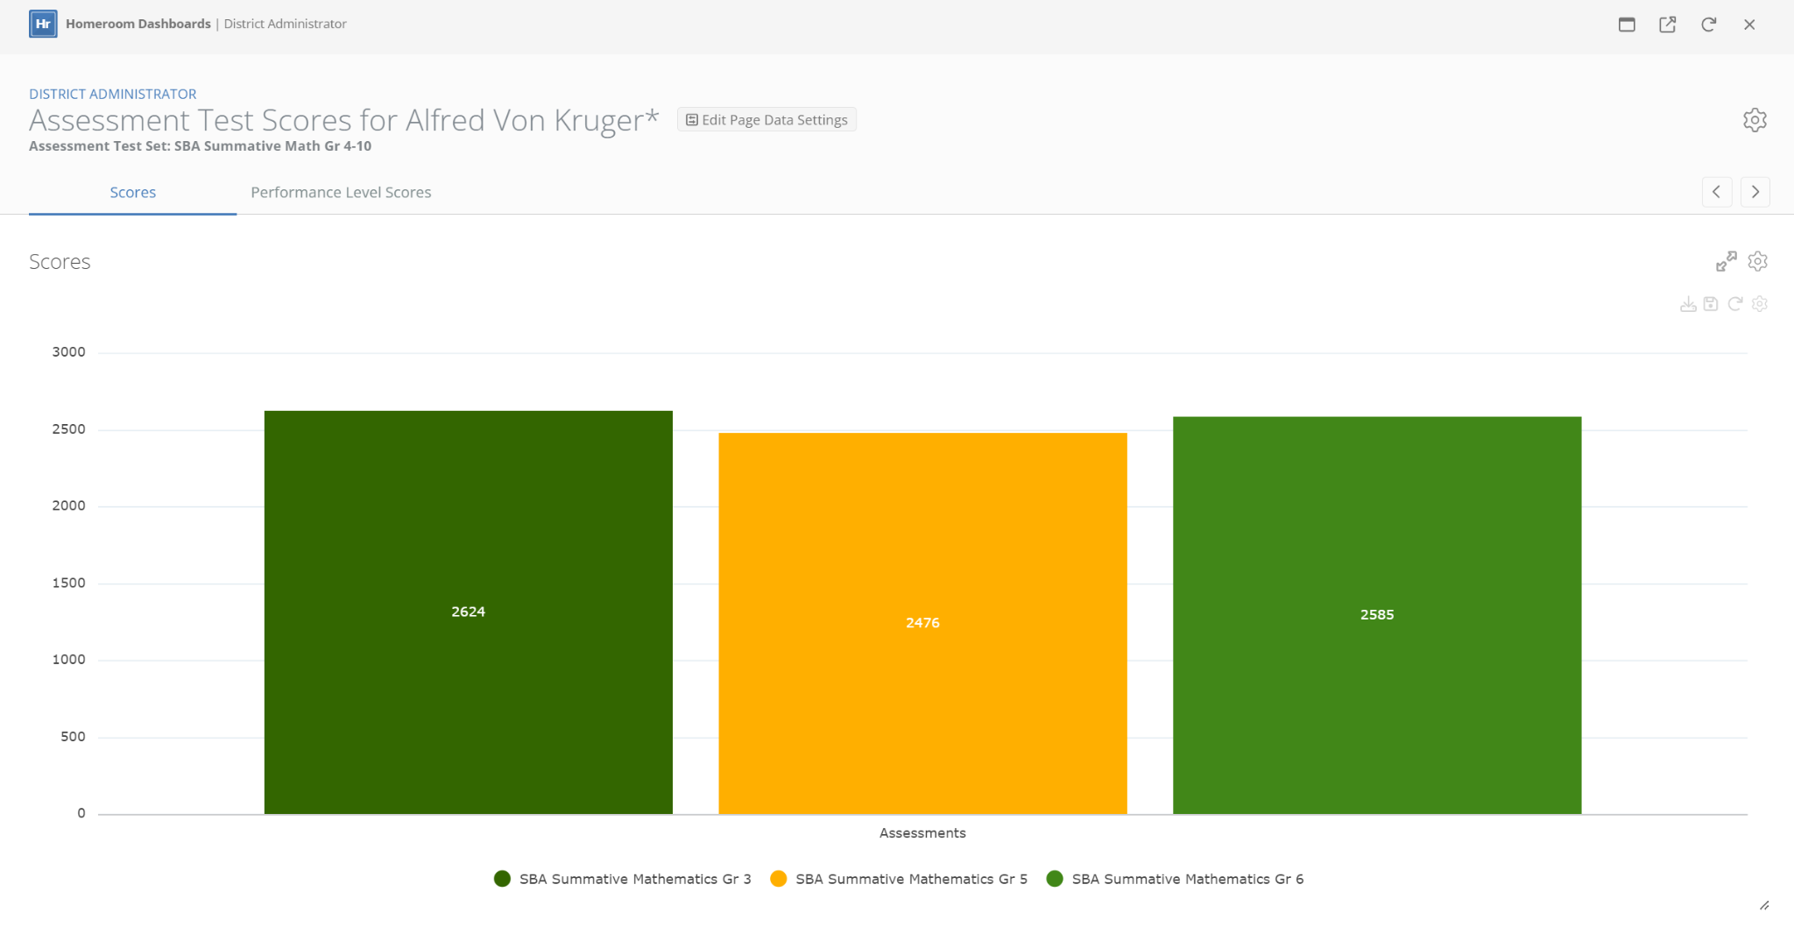
Assessment Set - Student Raw Score Bar Chart
2624
2476
2585

Slide 16
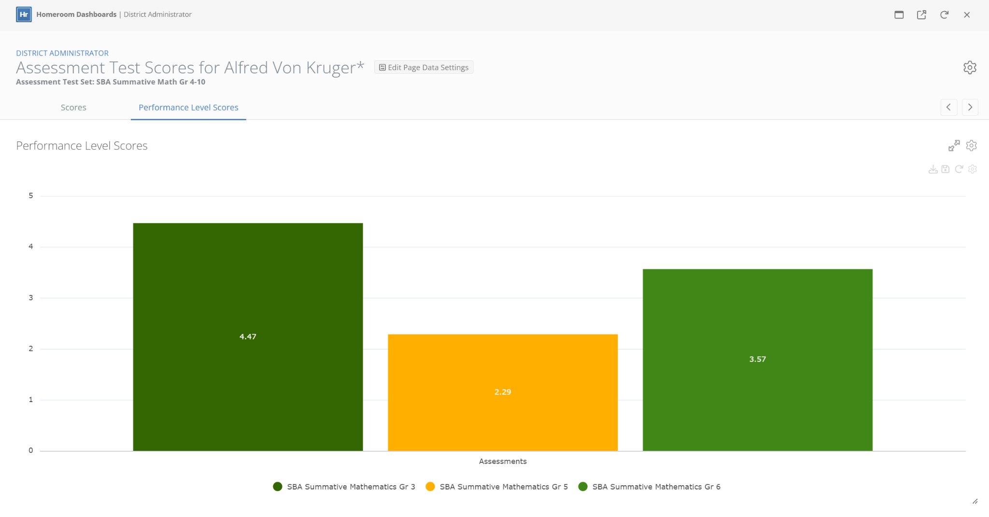
Assessment Set - Performance Level Scores (PLS)
Performance Level Scores
Normalizes scores across different scales
Performance Level Score Interpretation
Whole number indicates level, decimal gives percent toward next level
Level 2 29% of the way between level 2 and level 3
4.47
3.57
2.29

Slide 17
Student Growth

Slide 18
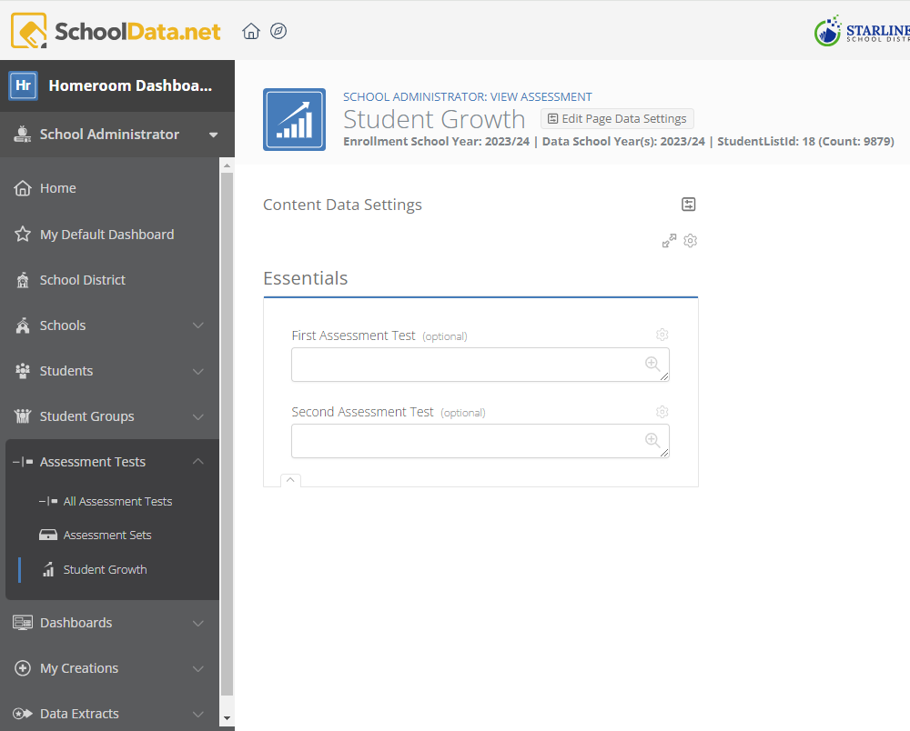
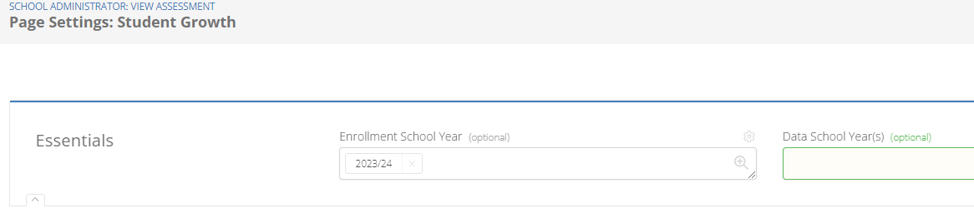
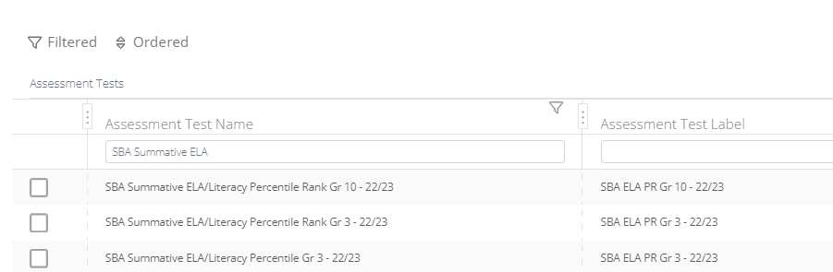
Student Growth
Set the school year of students you want to see and the specific years for the data of the two assessments you are going to select
Select the two assessments you wish to compare growth between, they should be in chronological order (First Assessment Taken then Second Assessment Taken)

Slide 19
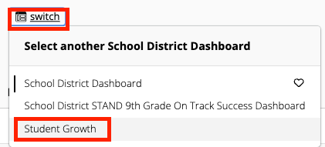
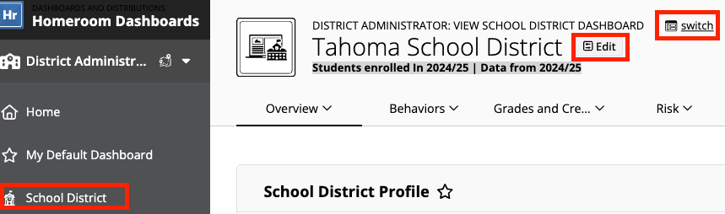
Student Growth Dashboard
Select the School Dashboard
In the left navigation.
Click the Switch button and choose the Student Growth Dashboard.
Use the Edit Page Data Settings to filter the data.

Slide 20
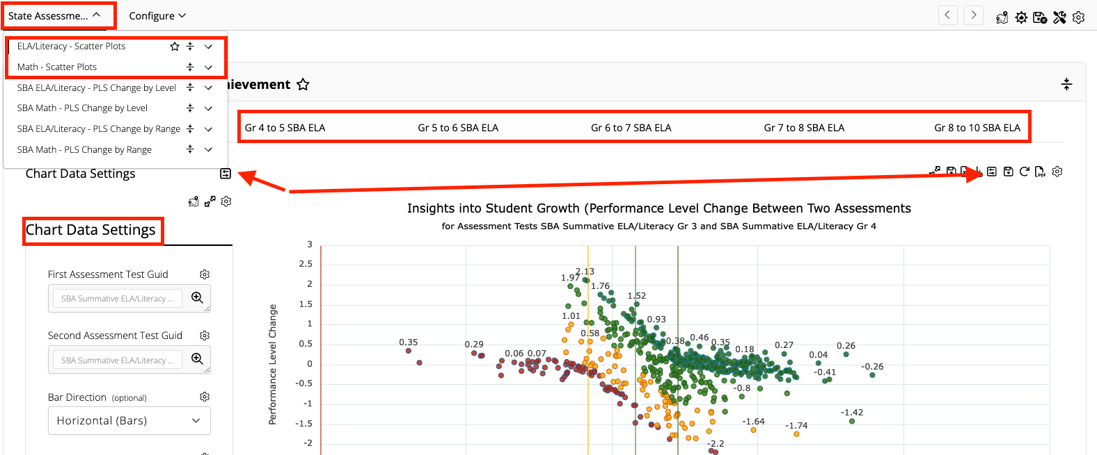
Scatter Plots
Use the State Assessment Tab or Sub-Page tabs to view the chart and screenview of your choice.
Click the Chart Data Settings icon to close and provide more real estate for viewing.
Hover over each plot to reveal detailed information.
Click the plot point to open the student dashboard.
Notes:
https://support.schooldata.net/hc/en-us/articles/36562451172371-Hr-Student-Growth-Dashboard-Connect

Slide 21
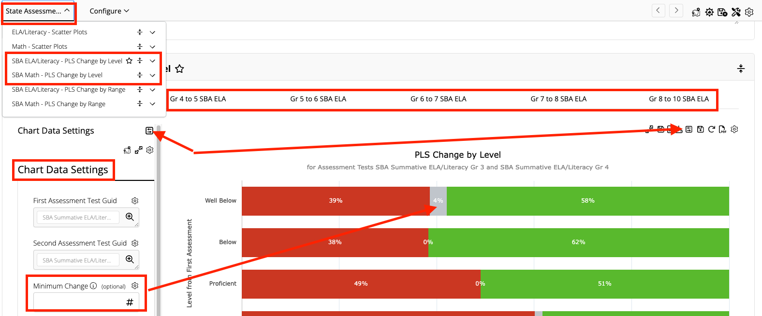
PLS Change By Level
Use the State Assessment Tab or Sub-Page tabs to view the chart and screenview of your choice.
Fill in Minimum Change field to alter the chart.
Click the Chart Data Settings icon to close and provide more real estate for viewing.
Hover over each bar to reveal detailed information.
Click the bar to open the student dashboard.

Slide 22
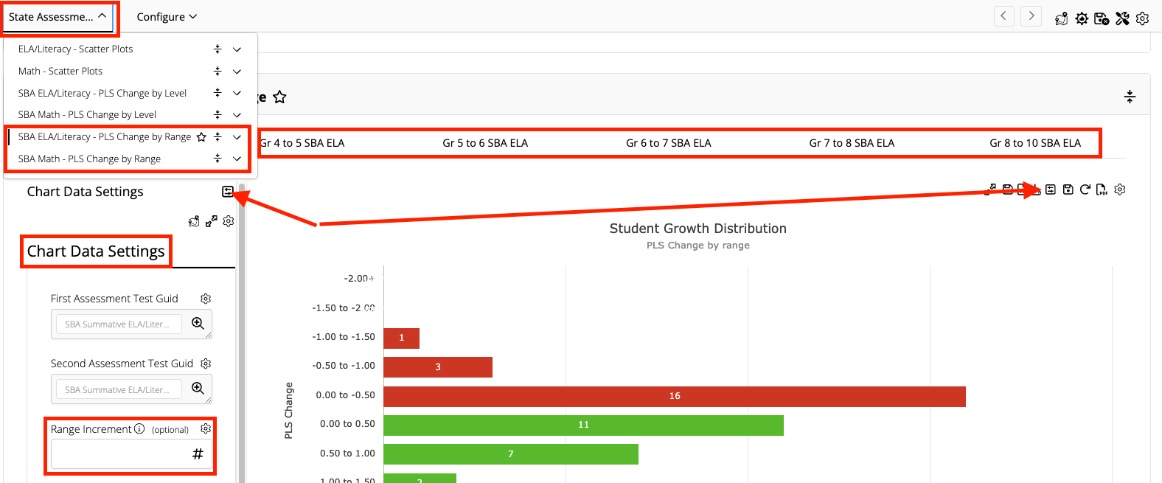
PLS Change by Range
Use the State Assessment Tab or Sub-Page tabs to view the chart and screenview of your choice.
Fill in Range Increment field to alter the chart.
Click the Chart Data Settings icon to close and provide more real estate for viewing.
Hover over each bar to reveal detailed information.
Click the bar to open the student dashboard.

Slide 23
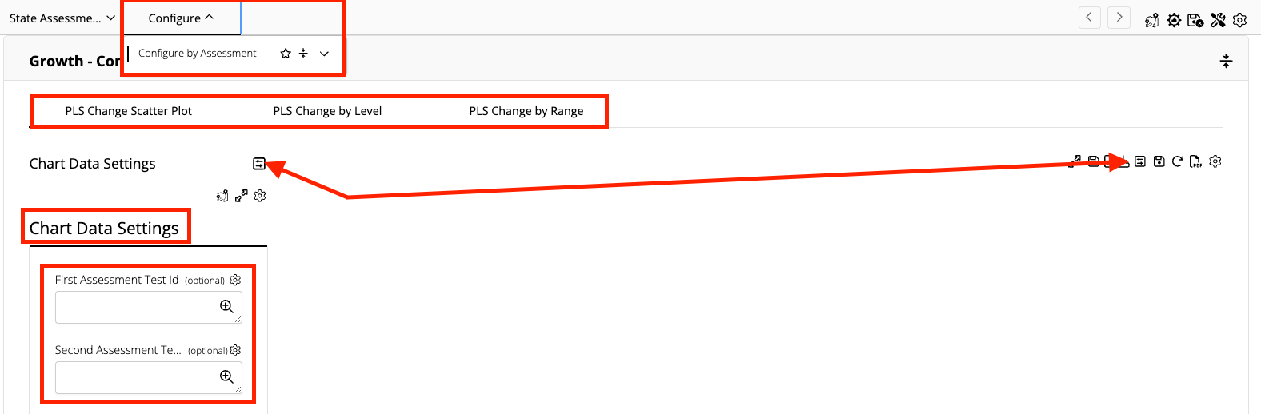
Configure By Assessment
Similar to the left navigation selection, configure your student growth performance level change between two assessments as a scatter plot, PLS Change of Level or PLS Change of Rannge.

Slide 24
Scavenger Hunt
Assessments:
Choose a grade band or class. What percentage of students met the standard?
Find three students who scored below grade level.
Find two students with upward trends in an assessment.
Risk: Explore two students who are at risk.
What are the challenges?
What achievable goal could you set to develop improvement?
How could you track and monitor progress for a specific group?
Demographic: Find two students with a Home Language other than English.
What are the challenges?
What achievable goal could you set to develop improvement?
How could you track and monitor progress for a specific group?
Student Spotlight: Select a student
Are they enrolled in any special programs?
What are their weaknesses/strengths?

Slide 25
Questions?
What was an ah-ha moment?

Slide 26
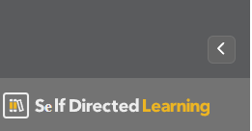
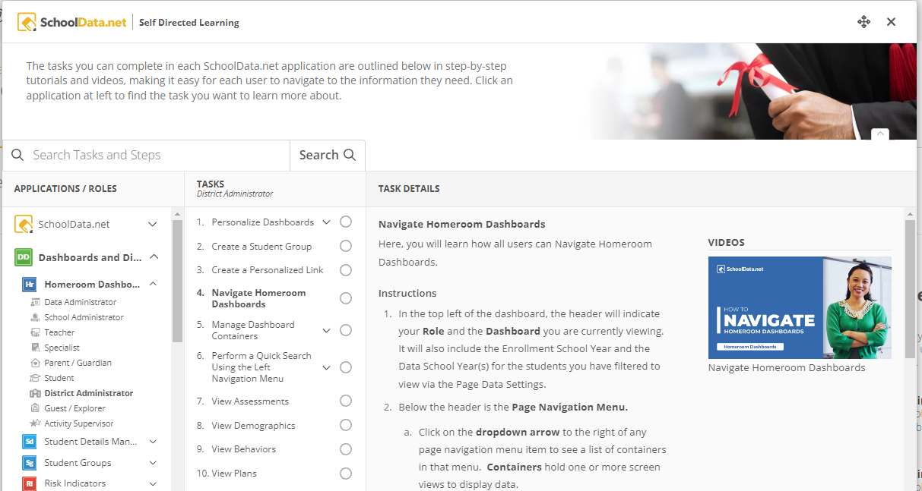
Self Directed Learning
To access Self Directed Learning, click the bottom left corner on the left navigation:
Written directions will describe tasks. Some tasks include short videos.
Contents are searchable.
Tasks can be checked off to the far right as completed or bookmark.

Slide 27
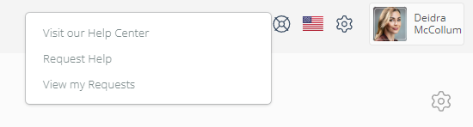
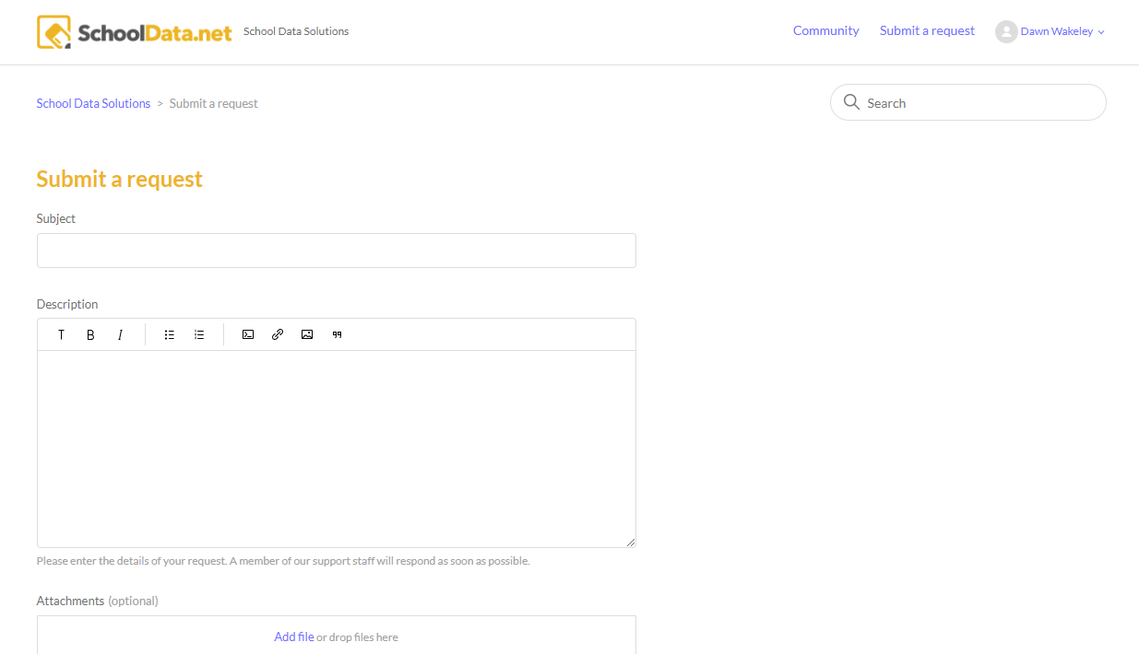
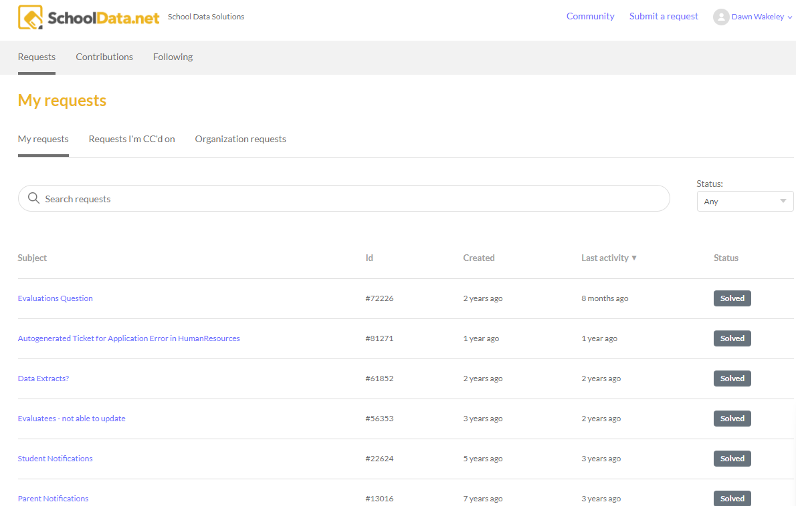
Help Desk
Access our Help Desk by clicking on the life preserver icon in the top right corner.
Visit our Help Center (Help Articles)
Request Help (Email, Create Ticket)
View my Requests (List of all your tickets in the system)

Slide 28
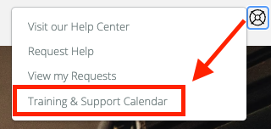
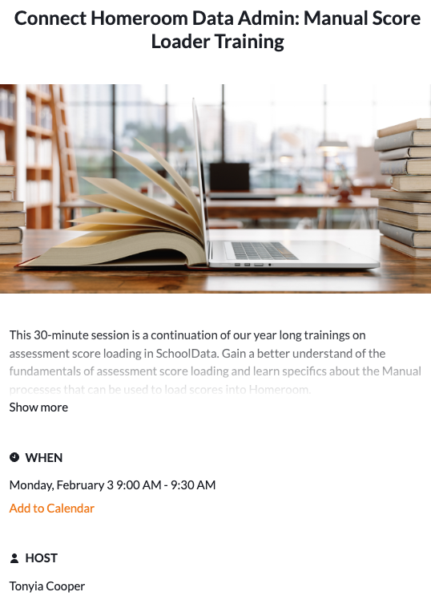
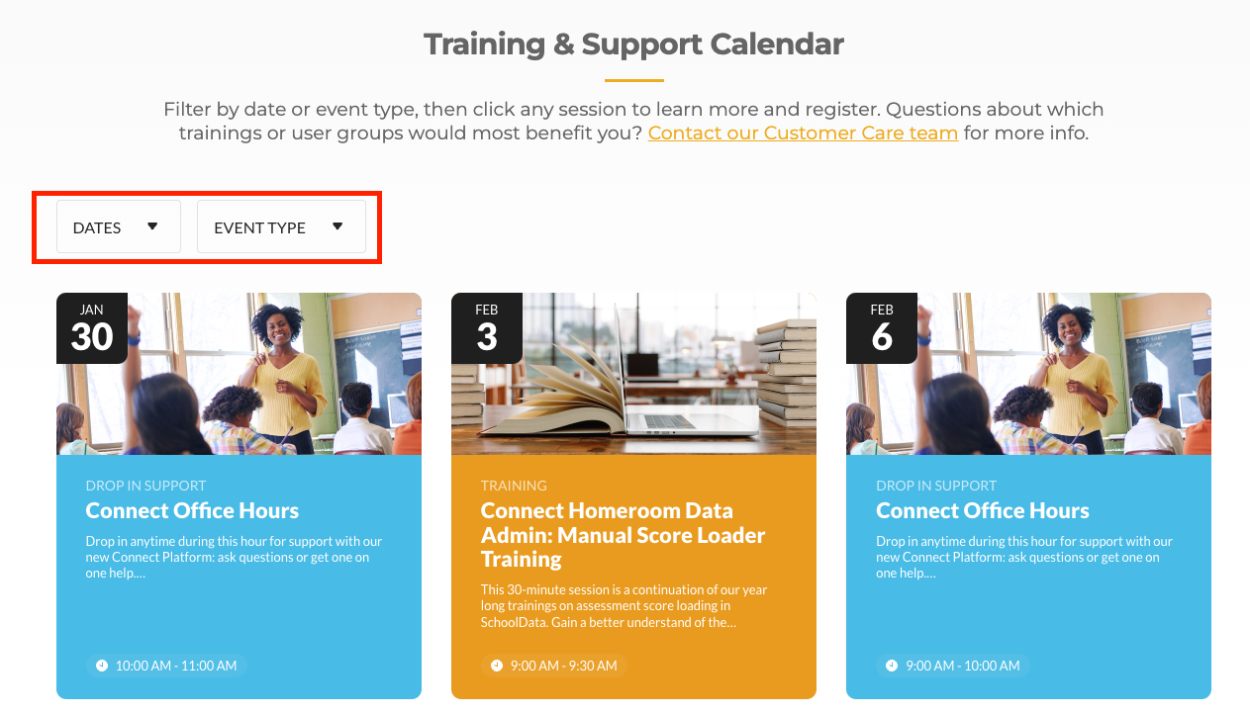
Help Desk - Training & Support Calendar
Newly added to the Help Desk
Filter by Date
Filter by Event Type
Click the title to view further details and add to your calendar.

