Slide 1



Welcome
Homeroom Dashboards
Connect Basic Training
Notes:
Put name, district and your role at the district in the chat.

Slide 2






Welcome!
Your name, district, role and at least one thing you are hoping to walk away with from today’s training.
Notes:
Who’s with us today?

Slide 3


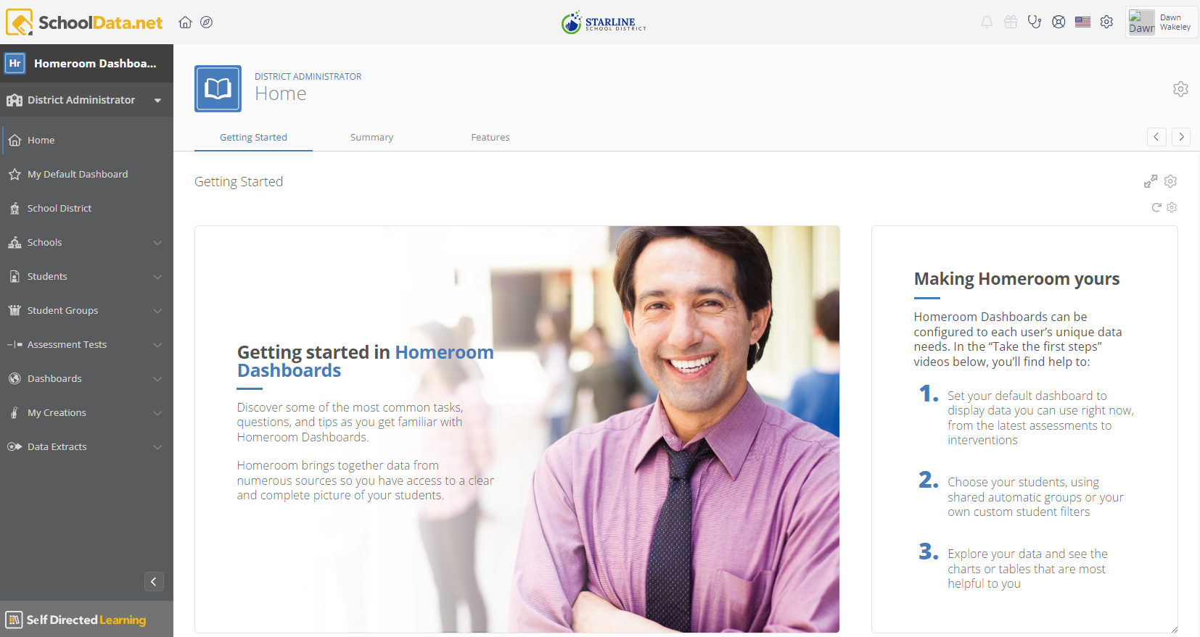
Agenda
Welcome and Introductions
Getting Logged In & General Navigation
  Help Desk, User Account, Help
  Setting your Default Dashboard
Basic Dashboard Functionality
Q & A, Practice

Slide 4
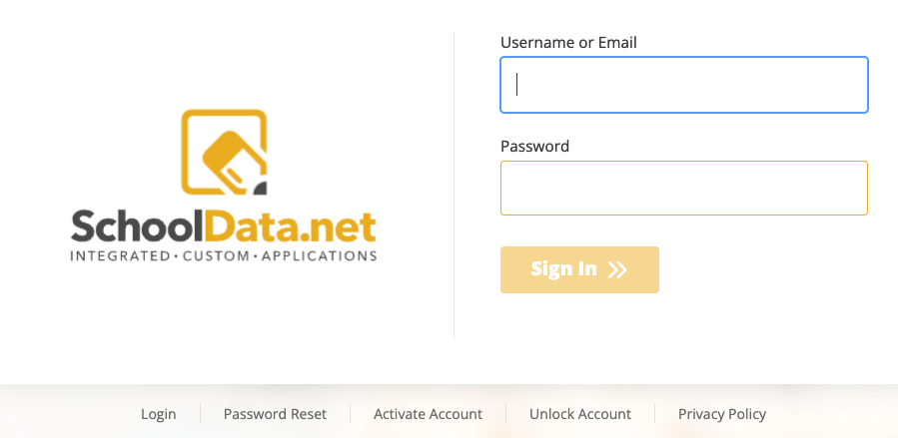
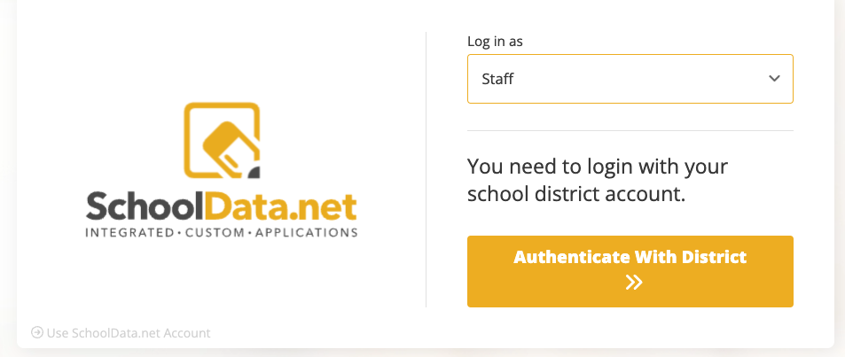
How to Log In
Go to URL: districtname.schooldata.net/connect/#/homeroom
The login page will be one of these examples:
Enter username or email from the SIS
OR
Click Authenticate With District
*Note: Use Reset Password option, if necessary
Notes:
https://support.schooldata.net/hc/en-us/articles/13547641538323-Login-Activate-Reset-Password-Logout

Slide 5
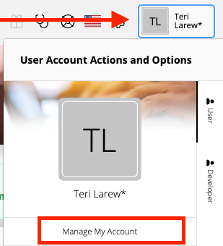
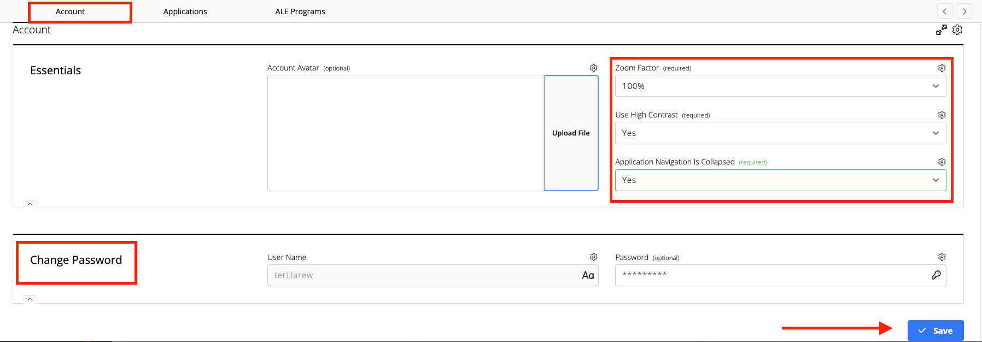
Manage My Account
Click your Name and choose Manage My Account.
Select Screen Settings: Zoom Factor, High Contrast, Application Navigation is Collapsed (Information or Directions) for easy page.
Change Password

Slide 6

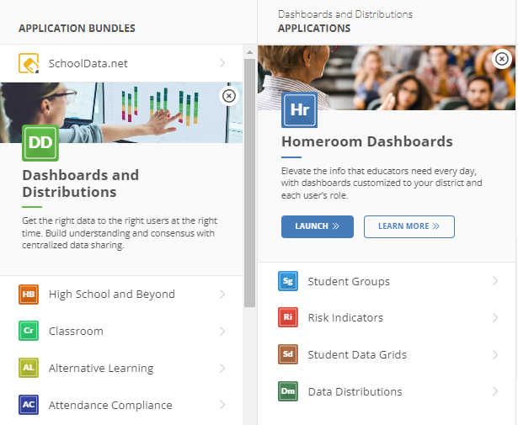
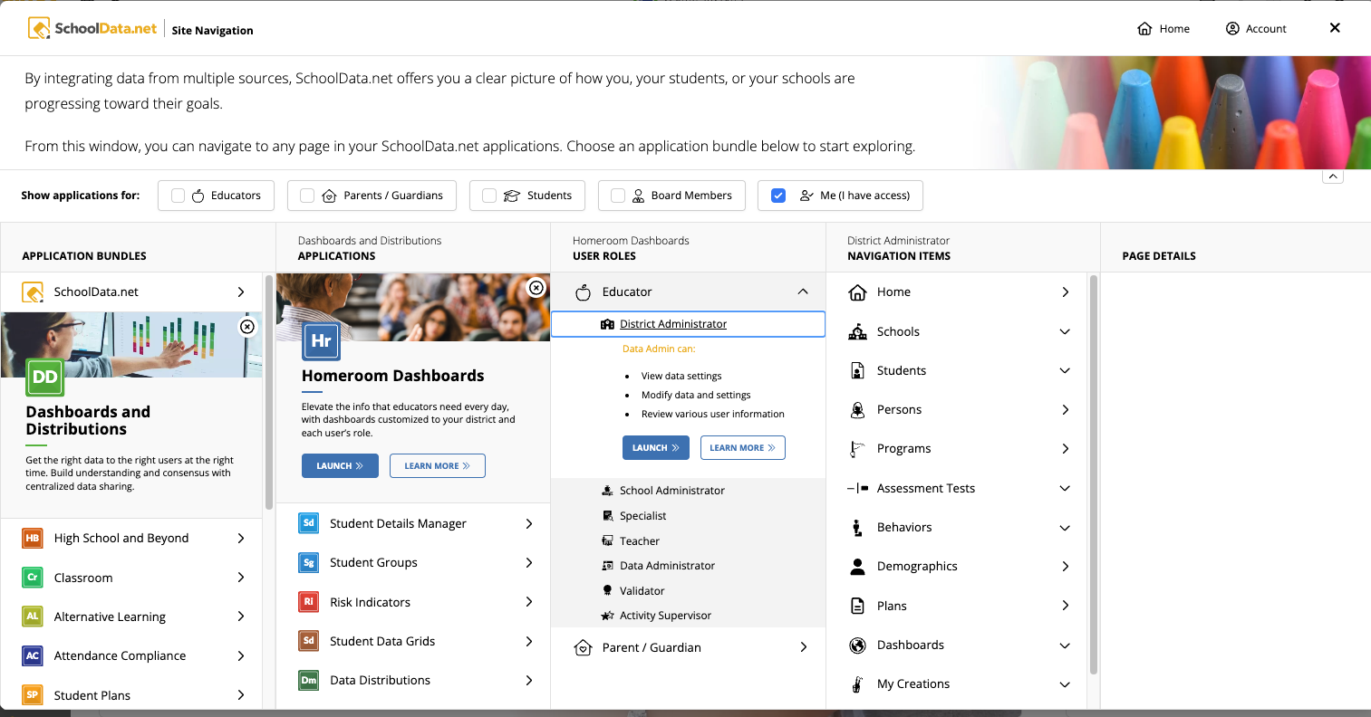
Site Navigation
Click the Site Navigation icon to start. Click on Dashboards and Distributions, next click Homeroom Dashboards, then click Launch.

Slide 7

What is Homeroom Dashboards (SchoolData.net)?
Homeroom is a customized student data portal that combines information from numerous sources and presents it in a clear, consistent format.
Nightly loaded (automatic):
Skyward: Student Demographics, Attendance, Discipline, Gradebook & Posted Grades, GPA & Credits, Services, Guardian info, Health Information, Educational Milestones, Class and School/District Enrollments
Periodically loaded (user initiated):
State Assessments
District Assessments

Slide 8
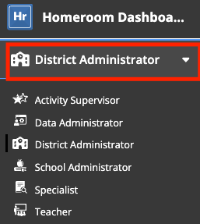
Dashboard Background
Homeroom delivers two kinds of dashboards:
Dashboards populated with data related to you, the user.
Dashboards populated with data related to some other person or some other thing. For example, data about another teacher or about a school (formerly referenced as Spotlights).
The difference relates to your data access permissions, and how we determine what data you should be able to see.
Select your Role from the dropdown menu.
Notes:
https://support.schooldata.net/hc/en-us/articles/13589932456979-Roles-and-Permissions

Slide 9
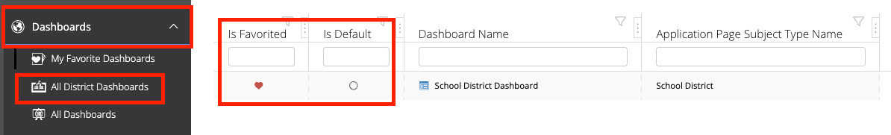
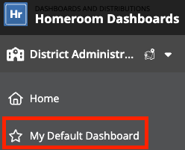
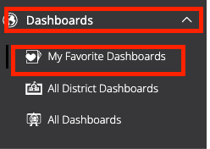
Set Default and Favorite Dashboards
Set Default Dashboard and Favorites in All Dashboards found in the left navigation.
Locate in:
My Default Dashboard
My Favorite Dashboards
Notes:
https://support.schooldata.net/hc/en-us/articles/36532712524179-Hr-Dashboard-Selection-Data-Settings-Connect

Slide 10
Change Dashboard Data Settings
Click Edit Page Data Settings next to the dashboard title.
Dashboard Filters
School Year (Student Enrollment)
School Years (Student Data)
Schools
Additional Student Filters
Student Groups
Tips:
Exclude Current Year Withdraw Students Checkbox
Alternately click the Dashboard Identifier Icons to edit dashboard data.

Slide 11
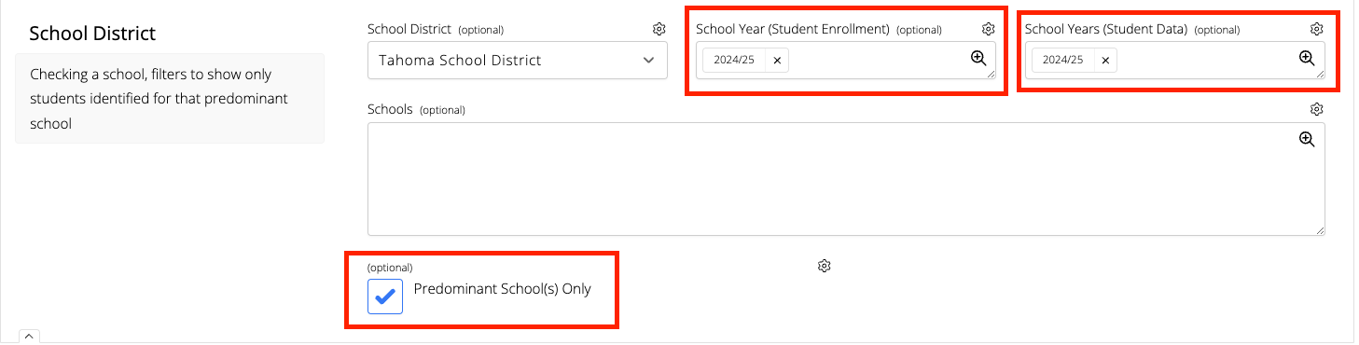
Edit Page Data Settings
(Student Data) View one or more years of data for the students you selected in the previous step.
(Student Enrollment) Select the current year or a historical year.
Add
Show only students identified for the predominant school. For example if a student is enrolled in more than one school.
Notes:
https://support.schooldata.net/hc/en-us/articles/36532712524179-Hr-Dashboard-Selection-Data-Settings-Connect

Slide 12
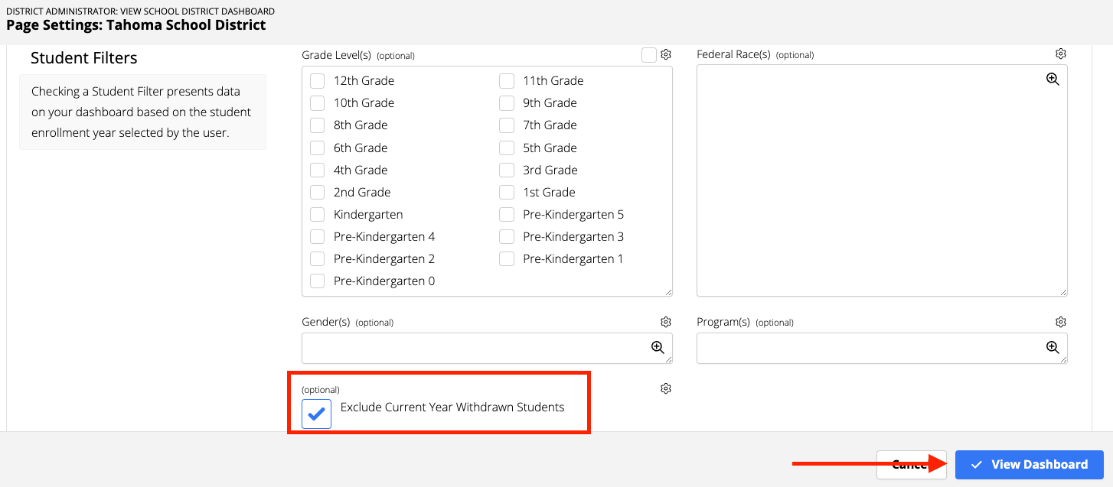
Edit Page Data Settings
Exclude Current Year Withdrawn Students: Check box to exclude.
Add
Select the View Dashboard button when finished.
Notes:
https://support.schooldata.net/hc/en-us/articles/36532712524179-Hr-Dashboard-Selection-Data-Settings-Connect

Slide 13
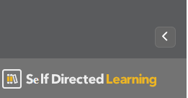
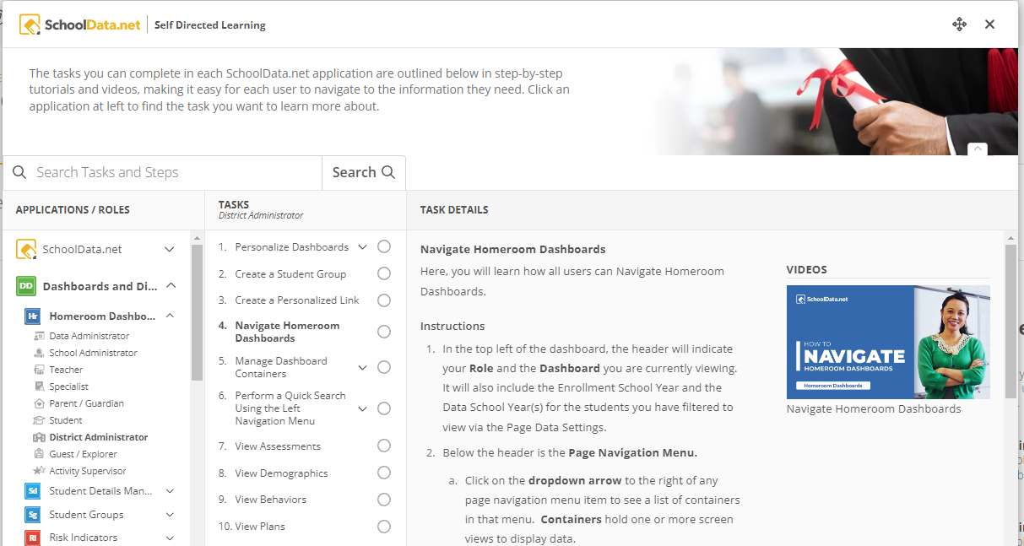
Self Directed Learning
To access Self Directed Learning, click the bottom left corner on the left navigation:
Written directions will describe tasks. Some tasks include short videos.
Contents are searchable.
Tasks can be checked off to the far right as completed or bookmark.

Slide 14
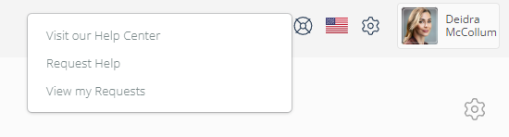
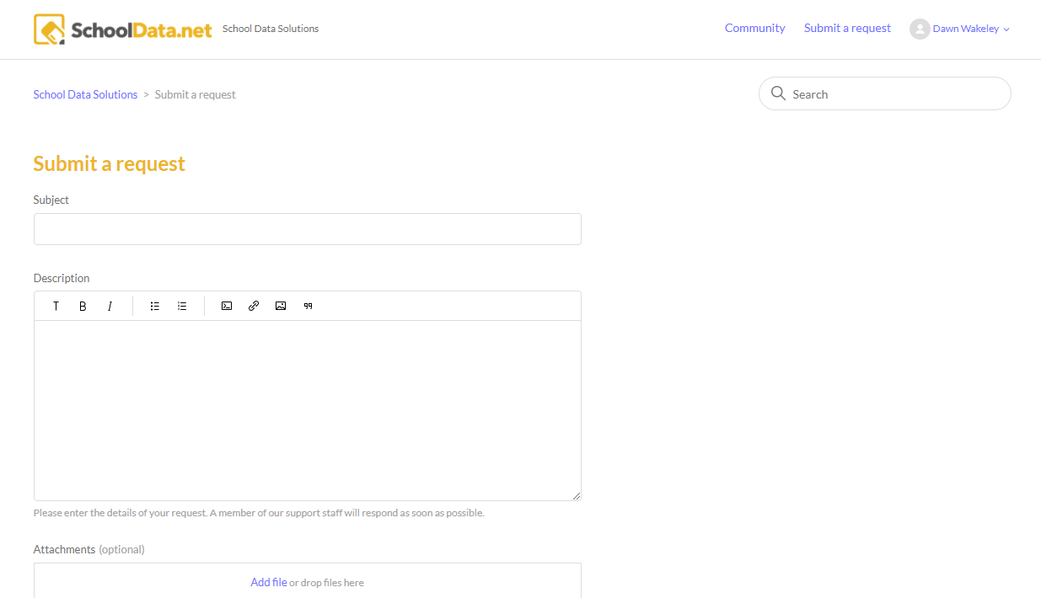
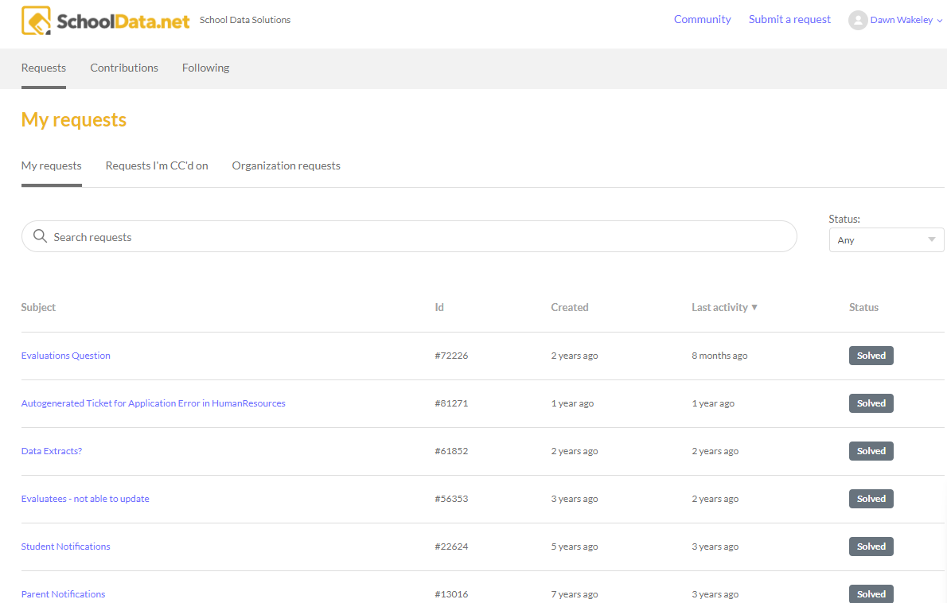
Help Desk
Access our Help Desk by clicking on the life preserver icon in the top right corner.
Visit our Help Center (Help Articles)
Request Help (Email, Create Ticket)
View my Requests (List of all your tickets in the system)

Slide 15
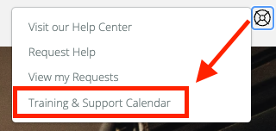
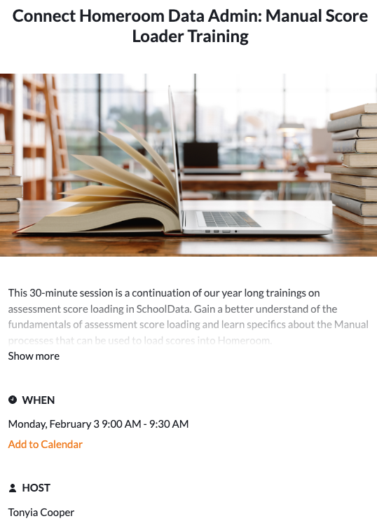
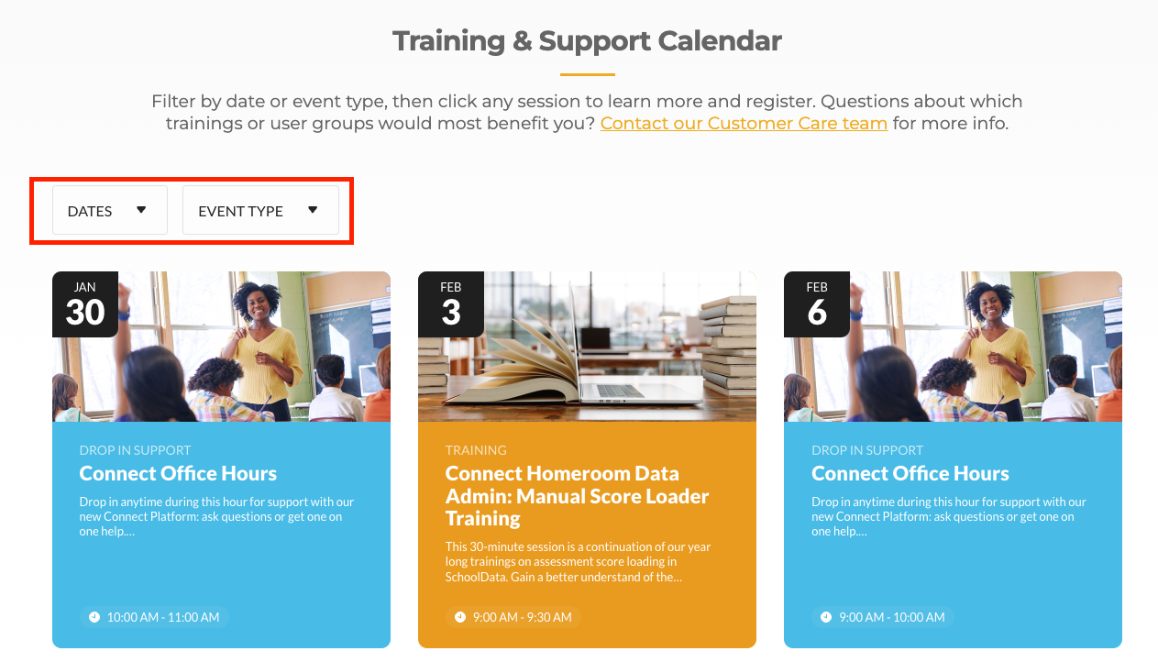
Help Desk - Training & Support Calendar
Newly added to the Help Desk
Filter by Date
Filter by Event Type
Click the title to view further details and add to your calendar.

Slide 16
Questions?
What do you wonder?

Slide 17
General Navigation

Slide 18
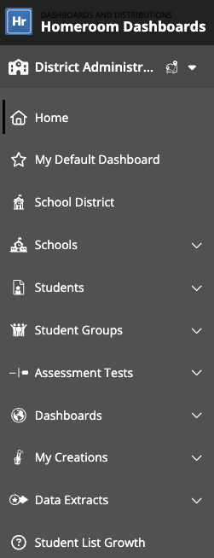
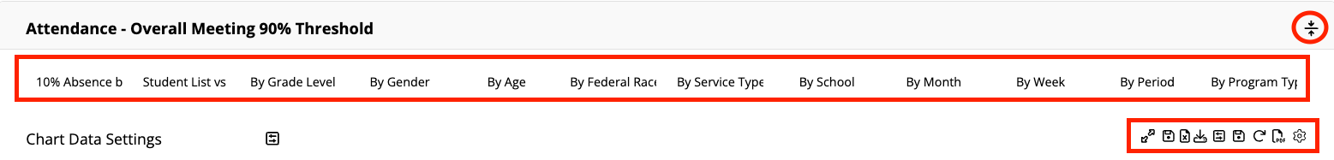
Navigation
Left Navigation Menu
Sub Page Navigation = Tab Menu
Container Tabs, Tools
Notes:
https://support.schooldata.net/hc/en-us/articles/360047081593-Hr-Basic-Dashboard-Navigation-Connect

Slide 19
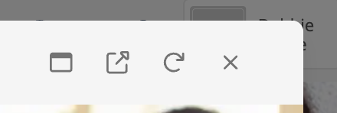
Modal Overlay or Pop-over Functionality
Clicking to see more or searching opens a modal overlay or pop-over window on the screen you are viewing. This window has tools that can be helpful.
 | Opens the pop-over window into the current window you are on.
 | Opens the pop-over window into a new browser tab.
 | Refresh the pop-over window you are on.
 | Close the current pop-over window.

Slide 20
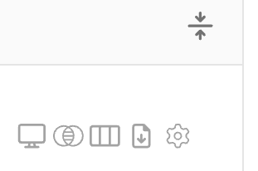




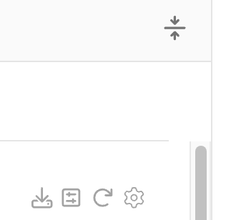

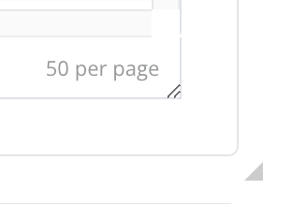


Container & View Functionality
Tools vary depending on the type of container or view.
Table
 | Choose from display options; grid or card view or pop into its own pop-over expanded view
 | Opens up the filter tools, same on the column headers, all into one view, overlay or side by side.
 | Opens up the columns list, allowing the user to hide/show and move columns in the table
 | Download the table into an Excel spreadsheet.
Chart
Shrink or expand the view
Shrink or expand the container
 | Download the chart into a PNG file
 | Options for hiding/showing the Data Settings tool box to make changes to the look of the chart. (horizontal, vertical)
 | Reloads the chart data
Notes:
https://support.schooldata.net/hc/en-us/articles/36557347980819-Hr-Container-Tools-Connect

Slide 21
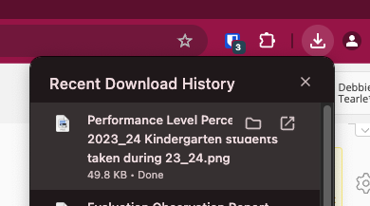
Download Processing
Standard downloading from the dashboard generates instantly into your computer’s download folder.
Notes:
What you did in Homeroom Dashboards (v2), let’s CONNECT the dots to where you can find it in our new CONNECT version.

Slide 22
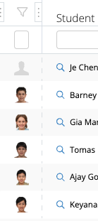
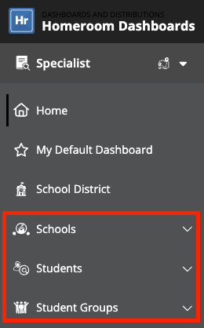
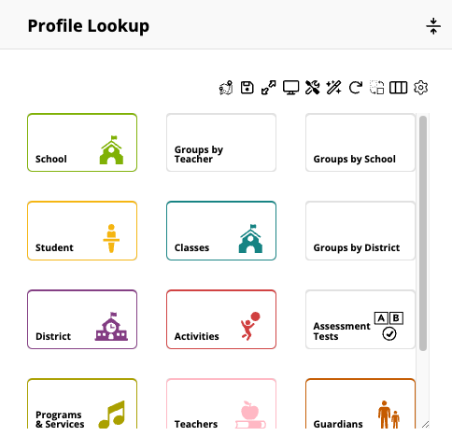
Student Dashboard (Spotlight)
Launch through:
Profile Search
Clicking the bar in a chart
Clicking the magnifying glass icon or name in the data table.
Includes:
Profile / Schedule
Assessments
Demographics
Behaviors / Attendance
Student Plans
Grades and Credits
And More
Notes:
https://support.schooldata.net/hc/en-us/articles/13557621139475-Hr-Student-Spotlight

Slide 23
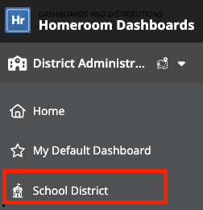
School District Dashboard
Behavior: Attendance, Discipline
Grades and Credits
Risk Summary: Identify student risk levels
Assessments: State and third party assessment scores
Demographics
Student Plans (Optional)

Slide 24
Teachers
Developing Improvement plans, setting challenges yet achievable goals. (Fast start to the school year)
What academic targets (levels) are needed, and what data is connected to those priorities?
Review historical student data, student plans, family contact information.
What might I spotlight for others that will support moving forward?
Track and Monitor Progress for specific groups.
What information could I use to support student conferences, health concerns, additionals services, graduation pathways?
Is a change resulting in improvements? (Student Growth Measures)
Reporting Data
What historical views support reporting? (Student Groups, Grants)

Slide 25
Specialists
Developing Improvement plans, setting challenges yet achievable goals.
What are my district’s priorities, and what data is connected to those priorities?
Where are our highest needs? (Registration, Whole Child Focus (SEL + Academics)
What might I spotlight for others that will support moving forward?
Track and Monitor Progress for specific groups. Monitor for disproportionality.
What are some early indicators we are on the right track?
Is a change resulting in improvements? For whom and under what conditions?
MTSS meetings, Running Start/Work Release
Reporting Data
What historical views support reporting? (Student Groups, Grants)

Slide 26
District/School Administrator
Developing Improvement plans, setting challenges yet achievable goals.
What are my district’s/school’s priorities, and what data is connected to those priorities?
Where are our highest needs? (staff efficiencies with budget reductions)
What might I spotlight for others that will support moving forward?
Track and Monitor Progress for specific groups. Monitor for disproportionality.
What are some early indicators we are on the right track?
Is a change resulting in improvements? For whom and under what conditions?
Student Growth / Assessments (Performance Level Scores)
Reporting Data
What historical views support reporting? (State & District Reports/Requirements, Grants)

Slide 27
Scavenger Hunt
Attendance:
Can you identify which of your students has the highest number of absences? - What was their attendance last year?
What percent of students school-wide/grade-band/class wise are meeting the 90% attendance threshold?
Assessments:
Choose a grade band or class. What percentage of students met the standard?
Find three students who scored below grade level.
Find two students with upward trends in an assessment.
Risk:
Explore two students who are at risk. What are the challenges? What achievable goal could you set to develop improvement? How could you track and monitor progress for a specific group?
Demographic:
Find two students with a Home Language other than English.
Student Spotlight: Select a student:
Are they enrolled in any special programs?
What are their weaknesses/strengths?

Slide 28
Questions?
What was an ah-ha moment?

